Slide 1
Assembly Checklist
Golf
Parent DOI #: 004.301.XXX
Document #: 004.301.XXX.001
Revision: 1.2
Revision Date: 03/14/2018
NPI Engineer: Kang Guoqing
Review the following checklist steps and complete online acknowledgement before the start of each build.
NOTE: P/Ns SHOWN IN THIS DOCUMENT ARE FOR REFERENCE ONLY. FOR PART ORDERING , TRACKING, OR CONFIRMATION OF P/Ns, REFER DIRECTLY TO THE ENGINEERING BOM.

Slide 2
DOCUMENT AMENDMENT HISTORY
文件修改记录
Rev 版本 | Date 修改日期 | Details 修改原因及内容 | Owner 作者（名字 和职位） | Approver 审批（名字 和职位）
1.0 | 01/29/2018 | Initiate version | Kang Guoqing | Jiao Gang
1.1 | 03/05/2018 | Update the fixture code | Kang Guoqing | Jiao Gang
1.2 | 03/14/2018 | Remove PCBA fixture (pg.4); Add the screwing order; | Kang Guoqing | Jiao Gang

Slide 3
 |  | Phone Assy |  |  |  |  |  |  | ‹#›
Phone Assembly
(EMS China, India, Brazil & Argentina)

Slide 4
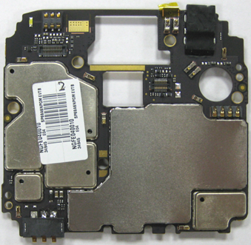
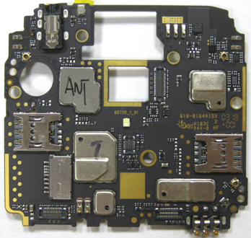
 |  | PCBA entry system |  |  |  |  |  |  | ‹#›
Symbols
Material List
Description / Part # |  | Qty
PCBA
LDS SL19A6N-E7U
Tools/ Equipment
Description | Parameters
ESD wrist strap
PC + scan gun
tweezers
First you need to scan front/rear camera, receiver, vibrator, fingerprint module
Take the PCBA, check the PCBA no damage pieces, missing parts, as well as the housing deformation.Check no off a light sensor chip.Scan the PCBA number plate assembly, print bar code, barcode pasted to the PCBA.Login advance MES system → Selection process route → "station Log" → Selection station bar "WH MN BE Input process" → Select the appropriate time → Start scheduling information → Click to log into the scanning interface. As shown in picture
Pay attention to the PCBA check schedule MES information consistent.
Attention
Operation
Verification

Slide 5
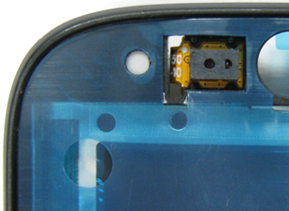
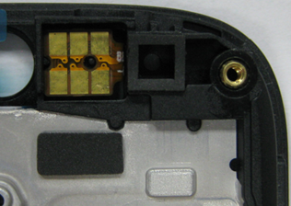
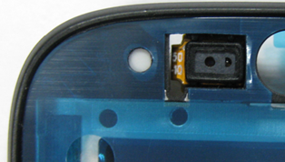
 |  | Assemble L- sensor |  |  |  |  |  |  | ‹#›
Symbols
Material List
Description / Part # |  | Qty
Front housing |  | 1
L-sensor |  | 1
L-sensor rubber |  | 1
Tools/ Equipment
Description | Parameters
ESD wrist strap
Tweezers
Take the front housing and check it no damage.
Take the L-sensor and remove the liner on the sensor. Then assemble the L-sensor through the hole on the front housing. And paste it to the front housing.
Take the L-sensor rubber and check it no damage. Assemble it to the L-sensor.
Self-check the L-sensor and L-sensor rubber assembled in place.
Attention
Operation
Verification
L-sensor
L-sensor
L-sensor rubber
L-sensor rubber

Slide 6
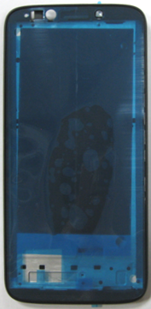
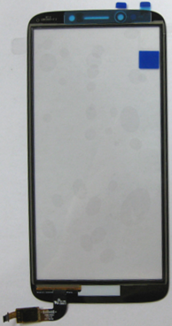
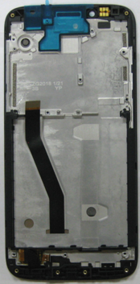
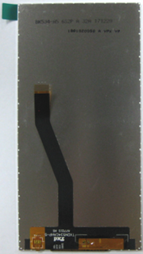
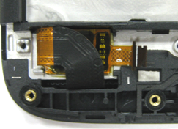
 |  | Assemble TP module |  |  |  |  |  |  | ‹#›
Symbols
Material List
Description / Part # |  | Qty
LCM |  | 1
TP |  | 1
Tools/ Equipment
Description | Parameters
ESD wrist strap
Tweezers
Take the front housing and check the L-sensor and L-sensor rubber assembled in place.
Remove all of the liners on the front housing.
Take the LCM module, check these is no damage on the LCM. Assemble LCM FPC through the hole on the front housing. Then assemble LCM into the front housing. Paste the LCM FPC to the front housing.
Take the TP module, check these is no damage on the TP. Remove all of the liners on the LCD and TP. Assemble TP FPC through the hole on the front housing. Then assemble TP into the front housing. Fold the TP FPC and assemble it to the front housing.
Self-check the LCD and TP assembled in place, FPC doesn't hide under the LCD.
Attention
Operation
Verification
liner
liner
TP FPC
LCM FPC

Slide 7
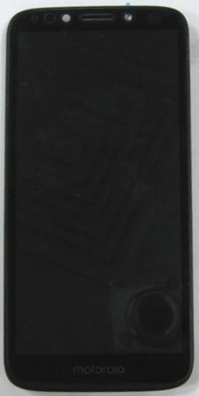
 |  | Press TP module |  |  |  |  |  |  | ‹#›
Symbols
Material List
Description / Part # |  | Qty
Tools/ Equipment
Description | Parameters
ESD wrist strap
Tweezers
Press TP fixture Golf-BE-01-V01 | 800±10N; 10±1s
Take the front housing module which has assembled TP module, check LCD and TP no damage, FPC doesn't hide under the LCD.
Put the front housing module into the press jig, and press the TP.
Take the front housing module out of the press jig. And check the TP.
Self-check LCD and TP no damage.
Attention
Operation
Verification

Slide 8
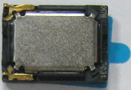
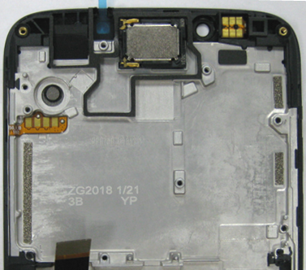
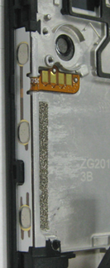
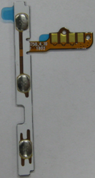
 |  | Assemble receiver and side key FPC |  |  |  |  |  |  | ‹#›
Symbols
Material List
Description / Part # |  | Qty
Receiver |  | 1
Side key FPC |  | 1
Tools/ Equipment
Description | Parameters
ESD wrist strap
Tweezers
Take the front housing module and check LCD and TP no damage..
Remove the liner on the front housing. Take the receive, and remove the liner on the receiver, then assemble it to the front housing.
Note: The direction of the receiver should be correct.
Take the side key FPC, and assemble it to the front housing.
Self-check the receiver, the side key FPC assembled in place.
Attention
Operation
Verification
Receiver
Receiver
Side key FPC
Side key FPC

Slide 9
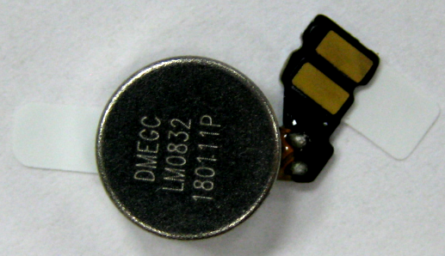
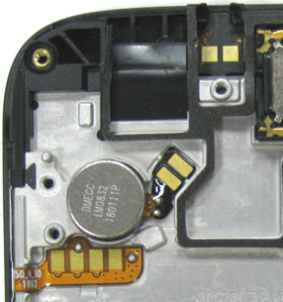
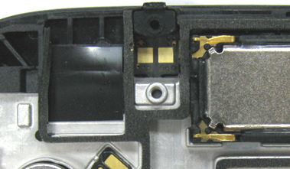
 |  | Assemble motor ,flash board and sub MIC rubber |  |  |  |  |  |  | ‹#›
Symbols
Material List
Description / Part # |  | Qty
Motor |  | 1
Flash board |  | 1
Sub MIC rubber |  | 1
Tools/ Equipment
Description | Parameters
ESD wrist strap
Tweezers
Take the front housing module and check LCD and TP no damage..
Take the motor, and remove the liner on the motor, then paste it to the front housing.
Note: The motor FPC has two positioning holes, must be positioned according to the location of the hole.
Remove the liner on the front housing. Take the flash board, and assemble it to the front housing.
Take the sub MIC rubber, and assemble it to the front housing.
Self-check the motor, the flash board, the sub MIC rubber assembled in place.
Attention
Operation
Verification
Sub MIC rubber
Flash board
Motor
Sub MIC rubber
Motor

Slide 10
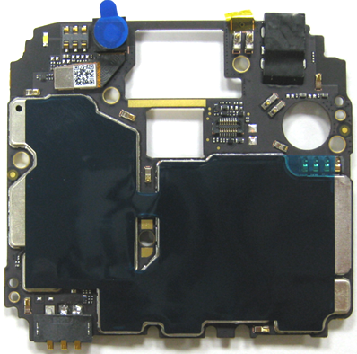
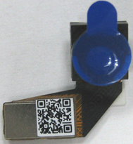
 |  | Paste cooling copper , Assemble Front camera |  |  |  |  |  |  | ‹#›
Symbols
Material List
Description / Part # |  | Qty
PCBA |  | 1
Cooling copper |  | 1
Front camera |  | 1
Tools/ Equipment
Description | Parameters
ESD wrist strap
tweezers
Cooling copper positioning paste fixture Golf-BE-14-V01
Take the PCBA, check the PCBA no damage pieces, missing parts, as well as the housing deformation.
Take the cooling copper, paste it to the main board. As shown in picture.
Assemble the front camera to the camera connector on the main board, as shown in picture.
Self-check the cooling copper pasted in place and the front camera assembled in place.
Attention
Operation
Verification
Front camera
Front camera
Cooling copper

Slide 11
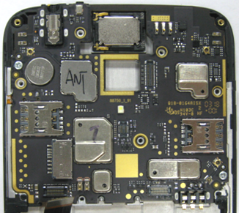
 |  | Assemble main board |  |  |  |  |  |  | ‹#›
Symbols
Material List
Description / Part # |  | Qty
Screws |  | 2
Tools/ Equipment
Description | Parameters
ESD wrist strap
Screwdriver
Screw fixture Golf-BE-16-V01 | Rotational speed : 700 rotate/min; Torque: 0.6±0.05kgf.cm; Screwdriver model: PH0; Screw model: M1.4*2.3
Take the main board and check the cooling copper and the front camera assembled in place.
Take the front housing module and check the motor, the flash board, the sub MIC rubber assembled in place.
Remove the front camera liner and the cooling copper liner. Assemble the main board to the front housing. Combine the main board and front housing, make sure the front camera can be assembled well, and buckle of the front housing can work well.
Pay attention to the LCM FPC doesn't be pressed between the front housing and the main board.
Lock two screws for main board by screwdriver..
Self-check the main board assembled in place.
Attention
Operation
Verification
Screw
2
1

Slide 12
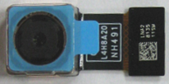
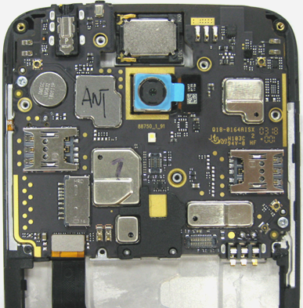
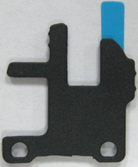
 |  | Assemble LCM FPC, rear camera and fingerprint bracket |  |  |  |  |  |  | ‹#›
Symbols
Material List
Description / Part # |  | Qty
Rear camera |  | 1
Fingerprint bracket |  | 1
Conductive foam |  | 1
Tools/ Equipment
Description | Parameters
ESD wrist strap
Take the front housing module and check the main board assembled in place..
Assemble the LCM FPC to the main board.
Take the rear camera, assemble it to the main board, then install it to the front housing.
Take the fingerprint bracket, and remove the liner on the bracket, then assemble it to the front housing.
Take the conductive foam and paste it on the main board.
Self-check the LCM FPC, the rear camera and the fingerprint bracket assembled in place.
Attention
Operation
Verification
Rear camera
Rear camera
Fingerprint bracket
Conductive foam
LCM FPC
Fingerprint bracket

Slide 13
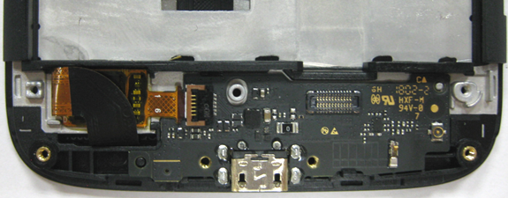
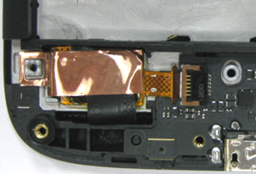
 |  | Assemble sub board, TP FPC, copper foil |  |  |  |  |  |  | ‹#›
Symbols
Material List
Description / Part # |  | Qty
Copper foil |  | 1
Tools/ Equipment
Description | Parameters
ESD wrist strap
Tweezers
Take the front housing module and check the LCM FPC, the rear camera and the fingerprint bracket assembled in place.
Take the sub PCBA, check the PCBA no damage pieces, missing parts, deformation.
Assemble the sub board to the front housing. Combine the sub board and front housing, and buckle of the front housing can work well.
Pay attention to the TP FPC doesn't be pressed between the front housing and the sub board.
Assemble the TP FPC to the sub board.
Take the copper foil, and paste it to the TP FPC.
Self-check the sub board, TP FPC, copper foil assembled in place.
Attention
Operation
Verification
Copper foil
TP FPC
Copper foil

Slide 14
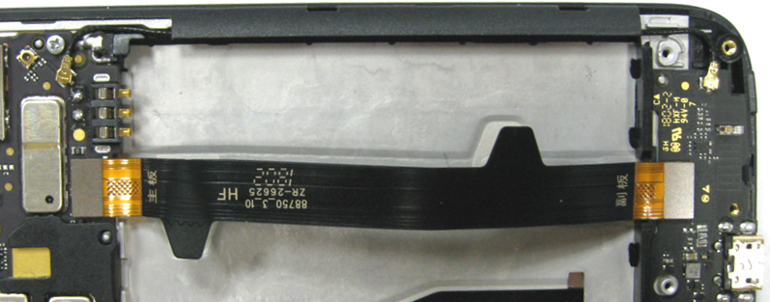
 |  | Assemble main FPC, coaxial cable |  |  |  |  |  |  | ‹#›
Symbols
Material List
Description / Part # |  | Qty
Main FPC |  | 1
Coaxial cable |  | 1
Tools/ Equipment
Description | Parameters
ESD wrist strap
Tweezers
Coaxial cable assembling fixture Golf-BE-15-V01
Take the front housing module and check the sub board, TP FPC, copper foil assembled in place.
Remover the liner from the main FPC, and paste it to the front housing, then assemble it to the main and sub board.
Fix the coaxial cable on the main board connector. Arrange the coaxial cable into the front housing. Then fix the coaxial cable on the sub board connector.
Self-check the main FPC and the coaxial cable assembled in place.
Attention
Operation
Verification
Coaxial cable
Main FPC

Slide 15
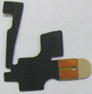
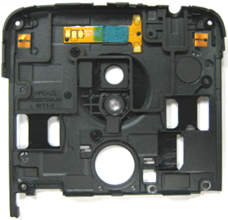
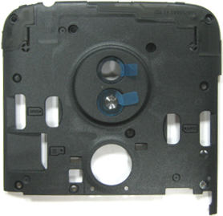
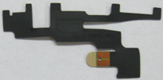
 |  | Assemble speaker FPC, wifi and diversity antenna |  |  |  |  |  |  | ‹#›
Symbols
Material List
Description / Part # |  | Qty
Rear housing |  | 1
Speaker FPC |  | 1
Wifi antenna |  | 1
Diversity antenna |  | 1
Tools/ Equipment
Description | Parameters
ESD wrist strap
Tweezers
Press upper antenna fixture Golf-BE-06-V01 | 100±5N; 9±1s
Take the rear housing and check it no damage.
Take the speaker FPC, remover the liner from the speaker FPC, and paste it to the rear housing. And press it to paste firmly.
Note: The speaker transit FPC has two positioning holes, must be positioned according to the location of the hole.
Take the wifi antenna and paste it on the rear housing.
Take the diversity antenna and paste it on the rear housing.
Put the rear housing in the fixture and press the antenna.
Self-check the speaker FPC, wifi and diversity antenna pasted in place.
Attention
Operation
Verification
Speaker FPC
Wifi antenna
Diversity antenna
Wifi antenna
Diversity antenna
Speaker FPC

Slide 16
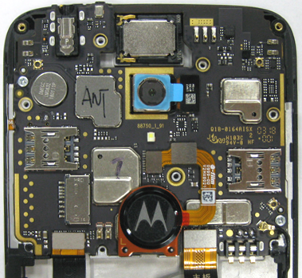
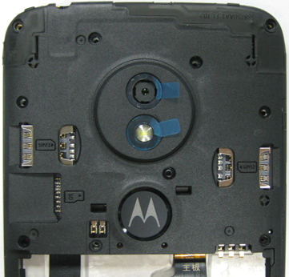
 |  | Assemble fingerprint module, rear housing |  |  |  |  |  |  | ‹#›
Symbols
Material List
Description / Part # |  | Qty
Fingerprint module |  | 1
Tools/ Equipment
Description | Parameters
ESD wrist strap
Take the front housing module and check the main FPC and the coaxial cable assembled in place.
Assemble the fingerprint module to the main board.
Take the rear housing and check the speaker FPC, wifi and diversity antenna pasted in place.
Remove the camera liner and fingerprint module liner, and take the rear housing and assemble it to the front housing. Combine the rear housing and front housing, make sure the buckle of the front housing can work well.
Self-check the fingerprint module, the rear housing assembled in place.
Attention
Operation
Verification
Fingerprint module

Slide 17
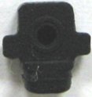
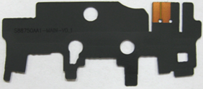
 |  | Assemble main antenna, main MIC rubber |  |  |  |  |  |  | ‹#›
Symbols
Material List
Description / Part # |  | Qty
Main antenna |  | 1
Main MIC rubber |  | 1
Tools/ Equipment
Description | Parameters
ESD wrist strap
Tweezers
Press lower antenna fixture Golf-BE-07-V01 | 100±5N; 9±1s
Take the main antenna bracket and check it no damage.
Take the main antenna and paste it on the main antenna bracket.
Take the main MIC rubber, and assemble it to the main antenna bracket.
Put the main antenna bracket in the fixture and press the antenna.
Self-check the main antenna and the main MIC rubber assembled in place.
Attention
Operation
Verification
Main MIC rubber
Main antenna
Main antenna
Main MIC rubber

Slide 18
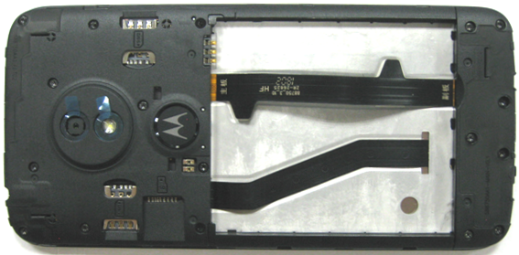
 |  | Assemble lower bracket , Lock screws |  |  |  |  |  |  | ‹#›
Symbols
Material List
Description / Part # |  | Qty
Screws |  | 17
Tools/ Equipment
Description | Parameters
ESD wrist strap
Screwdriver
Screw fixture Golf-BE-02-V01 | Rotational speed : 700 rotate/min; Torque: 0.7±0.05kgf.cm; Screwdriver model: Hexagon T5; Screw model: M1.4*3.0
Take the phone and check the rear housing and lower bracket assembled in place.
Put the phone into the fixture.
Take the main antenna bracket and check the main antenna and the main MIC rubber assembled in place.
Assemble the main antenna bracket to the front housing module.
Lock the screws by screwdriver on the rear housing and main antenna bracket .
Note: The screws in the red box need to be locked by manual operation.
Self-check the screws locked in place, these is no screw missing.
Attention
Operation
Verification
screw
4
7
2
Manual operation 2
11
9
6
13
15
14
5
10
1
8
3
Manual operation 1
12

Slide 19
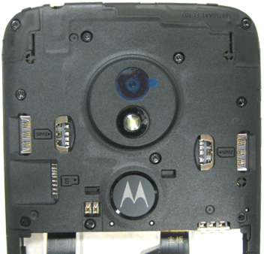
 |  | Assemble camera lens and Press camera lens |  |  |  |  |  |  | ‹#›
Symbols
Material List
Description / Part # |  | Qty
Camera lens |  | 1
Tools/ Equipment
Description | Parameters
ESD wrist strap
Press camera lens fixture Golf-BE-03-V01 | 60±10N; 8±1s
Take the phone and check the screws locked in place, these is no screw missing.
Take the camera lens, and check these is no damage on the lens.
Remove the liner of the camera on the rear housing. Then assemble camera lens into the rear housing.
Put the phone into the press camera lens fixture.
Press the camera lens.
Self-check the camera lens no damage.
Attention
Operation
Verification
Camera lens

Slide 20
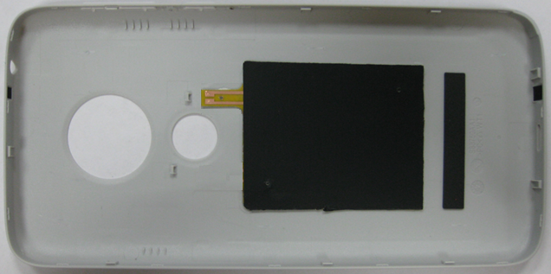
 |  | Paste NFC antenna |  |  |  |  |  |  | ‹#›
Symbols
Material List
Description / Part # |  | Qty
Battery cover |  | 1
NFC antenna |  | 1
Tools/ Equipment
Description | Parameters
ESD wrist strap
NFC antenna positioning paste fixture Golf-BE-09-V01
Press NFC antenna fixture Golf-BE-05-V01 | 50±5N; 6±1s
Take the battery cover and check it no damage.
Take the NFC antenna, and paste it to the battery cover.
Put the battery cover into the press NFC antenna fixture.
Press the NFC antenna.
Self-check the NFC antenna pasted in place.
Attention
Operation
Verification
NFC antenna

Slide 21
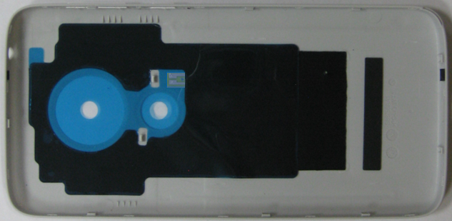
 |  | Paste cooling film |  |  |  |  |  |  | ‹#›
Symbols
Material List
Description / Part # |  | Qty
Cooling film |  | 1
Tools/ Equipment
Description | Parameters
ESD wrist strap
Take the battery cover and check the NFC antenna pasted in place..
Take the cooling film, and paste it to the battery cover.
Self-check the cooling film pasted in place.
Attention
Operation
Verification
Cooling film

Slide 22
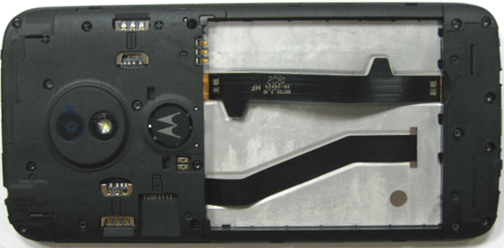
 |  | Paste battery label |  |  |  |  |  |  | ‹#›
Symbols
Material List
Description / Part # |  | Qty
Battery label |  | 1
Tools/ Equipment
Description | Parameters
ESD wrist strap
Take the phone and check the camera lens pasted in place.
Take the battery label, and paste it to the battery compartment. Sticking labels must not have bubbles, skew, etc.
Self-check the battery label pasted in place.
Attention
Operation
Verification
Position of battery label

Slide 23
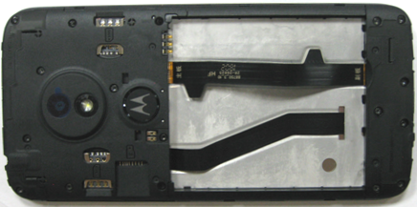
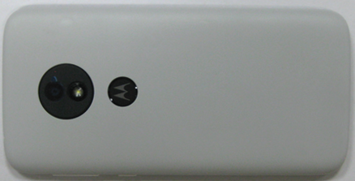
 |  | Paste fragile label, Pack battery cover |  |  |  |  |  |  | ‹#›
Symbols
Material List
Description / Part # |  | Qty
Tools/ Equipment
Description | Parameters
ESD wrist strap
Take the phone and check the battery label pasted in place.
Take the fragile label, and paste two fragile labels to the screw holes, as show in picture.
Take the battery cover, remove the liner on the battery cover. Pack the battery cover.
Self-check the battery cover packed in place.
Attention
Operation
Verification
Fragile label

Slide 24
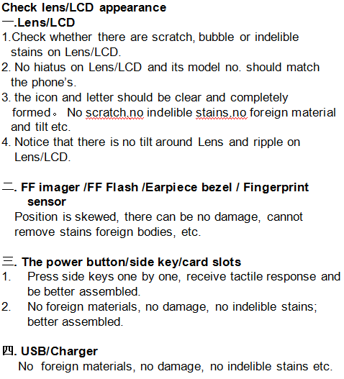
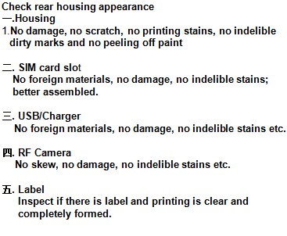
 |  | Check |  |  |  |  |  |  | ‹#›
Bar code without loss of loss, print code, writing clear, check the front of the host and the surrounding border area, then press the power button to turn off the phone;
According to 061 appearance standard check the appearance of the phone no bad product,
as shown in pic1/2.
Symbols
Material List
Description / Part # | Qty
Tools/ Equipment
Description | Parameters
Gloves
dust-free cloth
Film / plug / anhydrous ethanol
Attention
Operation
Verification
Pic 1
Pic 2

Slide 25
 |  | MMI test |  |  |  |  |  |  | ‹#›
Symbols
Material List
Description / Part # |  | Qty
 |  | 1
Tools/ Equipment
Description | Parameters
ESD wrist strap
SIM cards
T flash card
Take the phone.
Insert battery, two SIM cards ,T flash card. Start the phone into the engineering mode.
MMI test.
Self-check.
Attention
Operation
Verification

Slide 26
 |  | Coupling test |  |  |  |  |  |  | ‹#›
Symbols
Material List
Description / Part # |  | Qty
Tools/ Equipment
Description | Parameters
ESD wrist strap
Shielding box
PC
CMU
Take the phone.
Coupling test: Insert USB cable, hold down the power button and volume button into the engineering mode, the phone is placed in the position have been adjusted properly shielded box . Press "enter", the test program will automatically be tested. Test results are shown on the screen.
Open the shielding box after test over. And take out the phone.
Self-check.
Attention
Operation
Verification

