Slide 1
Disassembly Checklist
Golf
Parent DOI #:
Document #:
Revision: 1.0
Revision Date: 04/12/2018
NPI Engineer: NA

Slide 2
DOCUMENT AMENDMENT HISTORY
文件修改记录
Rev 版本 | Date 修改日期 | Details 修改原因及内容 | Owner 作者（名字 和职位） | Approver 审批（名字 和职位）
1.0 | 03/12/2018 | Initiate version | NA | NA

Slide 3
 |  | Phone Disassembly |  |  |  |  |  |  | ‹#›
Phone Disassembly

Slide 4
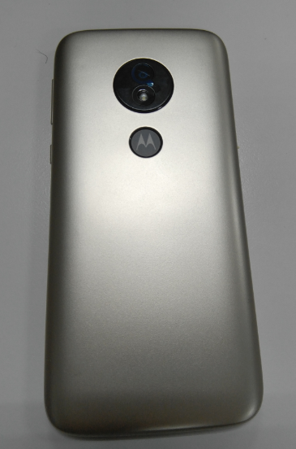
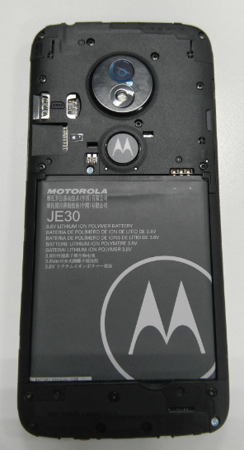
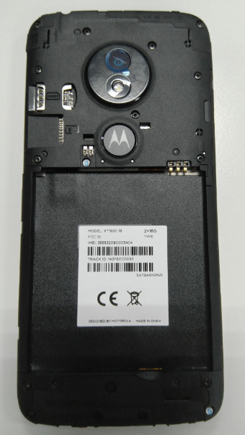
 |  | Disassembly battery cover &battery |  |  |  |  |  |  | ‹#›
Symbols
Material List
Description / Part # |  | Qty
Tools/ Equipment
Description | Parameters
ESD wrist strap
tweezers
Screwdriver
Open the battery cover from the left bottom to take out the SIM card and T flash card
2. Remove the battery from the right bottom
Attention
Operation
Verification

Slide 5
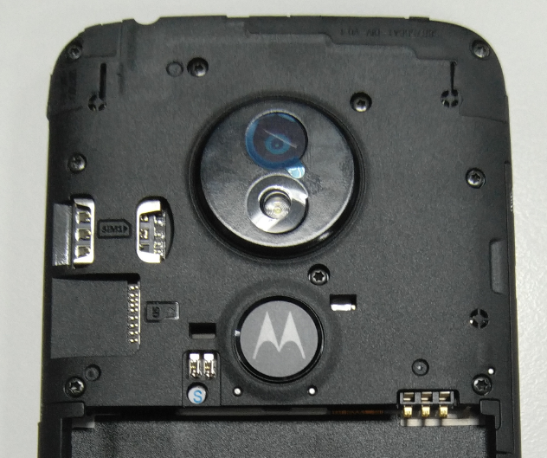
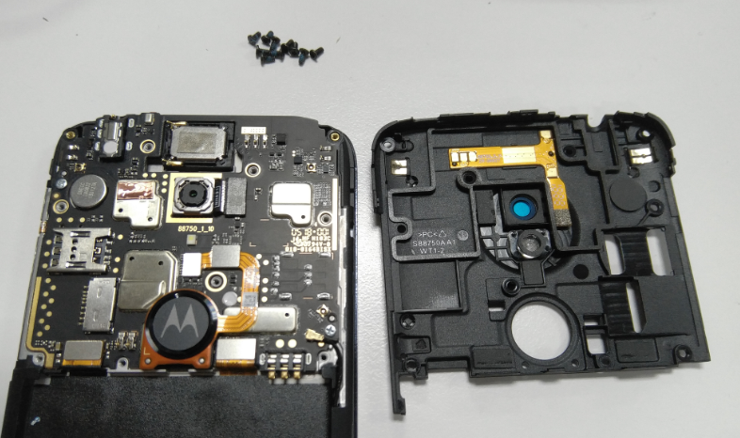
Symbols
Material List
Description / Part # |  | Qty
Tools/ Equipment
Description | Parameters
ESD wrist strap
Screwdriver
Release 10pcs screw (M1.4*3.0) from rear housing by screwdriver
2. Open the rear housing left side to remove rear housing from front housing

Slide 6
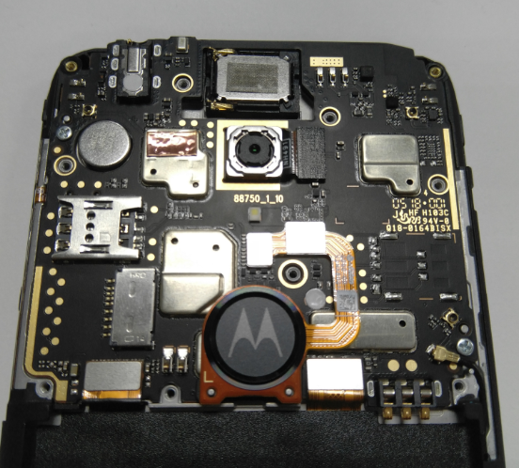
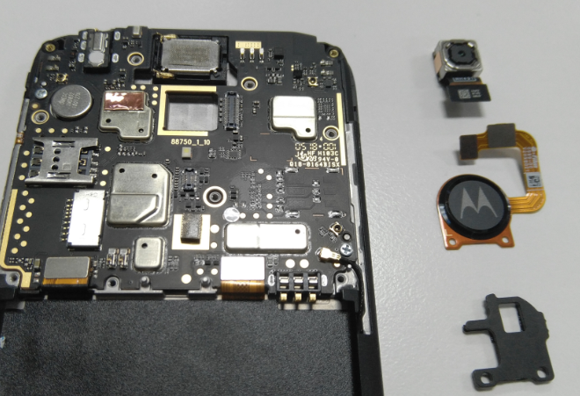
Symbols
Material List
Description / Part # |  | Qty
Tools/ Equipment
Description | Parameters
ESD wrist strap
Release main camera BTB connecter and fingerprint BTB connecter
Attention
Operation
Verification
2. Remove the fingerprint holder
3. Checking BTB connecter of camera and fingerprint and make sure it no damage before reuse

Slide 7
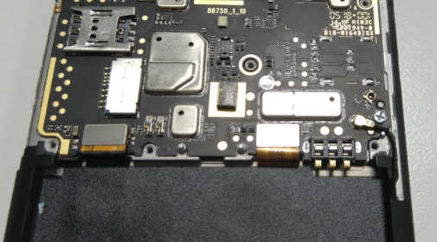
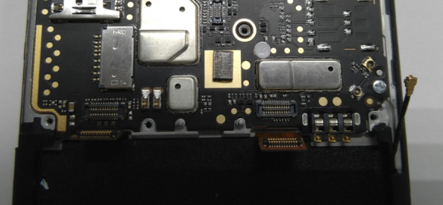
Symbols
Material List
Description / Part # |  | Qty
Tools/ Equipment
Description | Parameters
ESD wrist strap
tweezers
Release LCM FPC BTB connecter 、main FPC BTB connecter and RF cable connecter
Attention
Operation
Verification

Slide 8
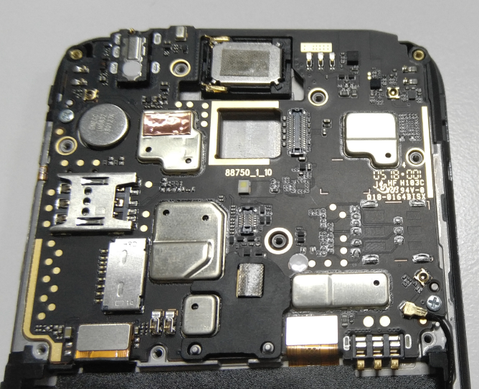
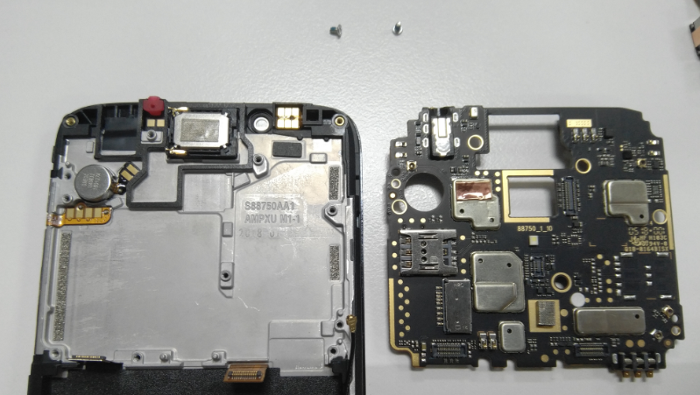
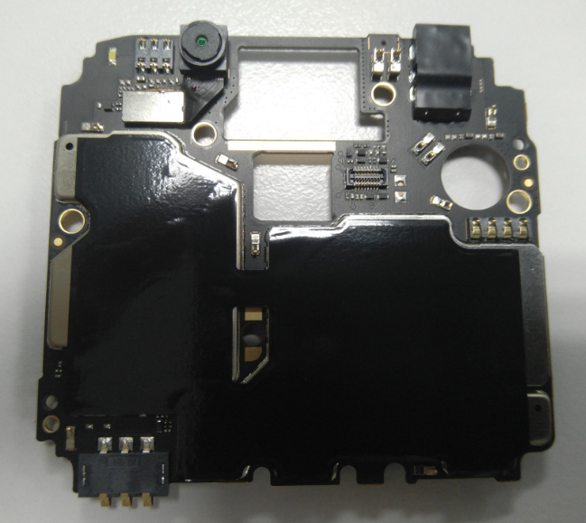
Symbols
Material List
Description / Part # |  | Qty
Tools/ Equipment
Description | Parameters
ESD wrist strap
Screwdriver
Release 2pcs screw (M1.4*2.3) from PCBA with screwdriver
Attention
Operation
Verification
2. Remove the PCBA from front housing
3. Release front camera BTB connecter and remove it from PCBA

Slide 9
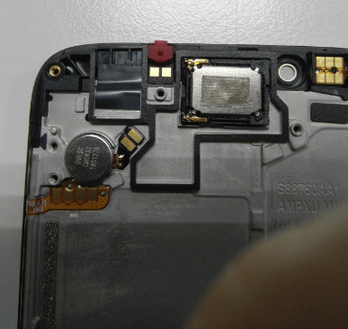
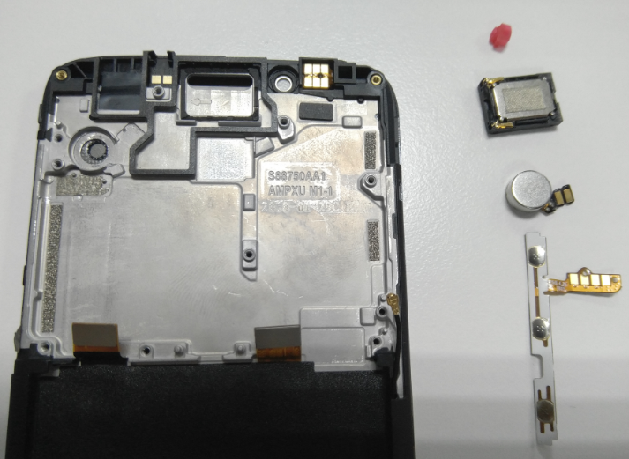
1. Remove motor、speaker 、side key FPC and sub-Mic rubber from front housing with tweezers
Symbols
Material List
Description / Part # |  | Qty
Tools/ Equipment
Description | Parameters
ESD wrist strap
tweezers
2. Checking the speaker and make sure vibrating diaphragm no damage
Attention
Operation
Verification

Slide 10
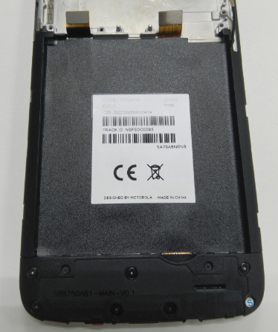
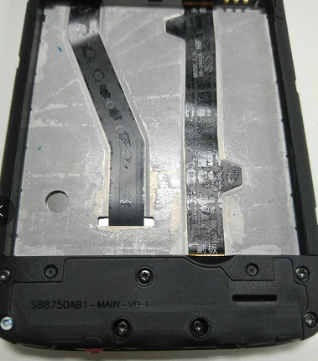
1. Lift up main FPC to Separate battery label slowly
Symbols
Material List
Description / Part # |  | Qty
Tools/ Equipment
Description | Parameters
ESD wrist strap
2. Clean front housing surface adhesive residue before reuse
Operation
Attention
Verification

Slide 11
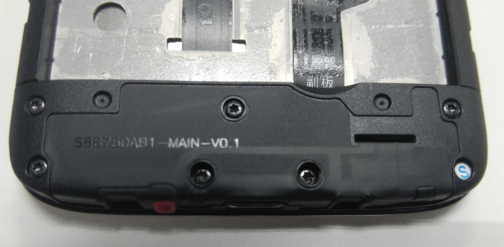
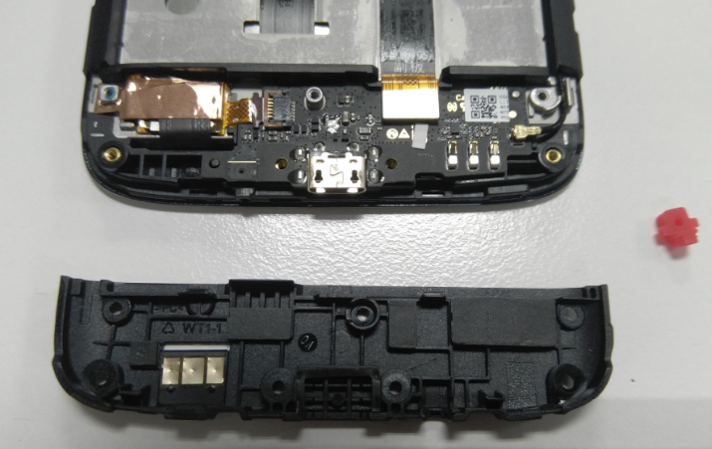
1. Release 5pcs screw (M1.4*2.5) from main antenna holder with screwdriver
Symbols
Material List
Description / Part # |  | Qty
Tools/ Equipment
Description | Parameters
ESD wrist strap
tweezers
Screwdriver
2. Remove the holder from front housing
Attention
Operation
Verification

Slide 12
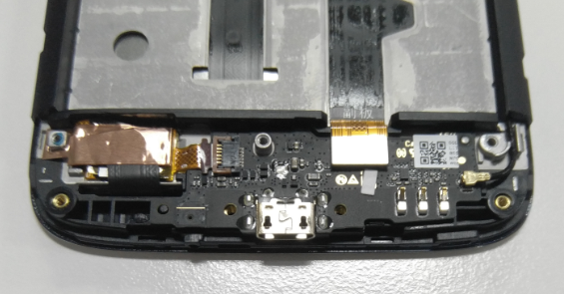
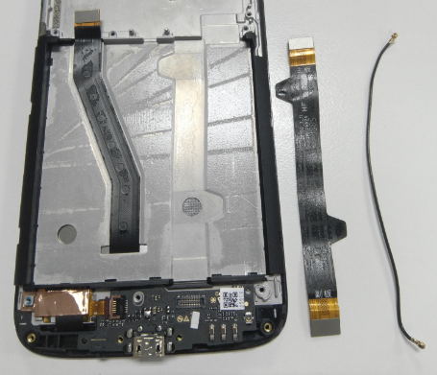
1. Release main FPC BTB connecter and RF cable connecter to remove it from Front housing
Symbols
Material List
Description / Part # |  | Qty
Tools/ Equipment
Description | Parameters
ESD wrist strap
tweezers
2. Cosmetic inspect of FPC and RF cable before reuse
Attention
Operation
Verification

Slide 13
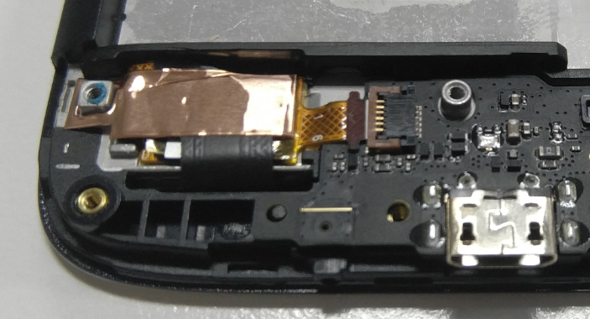
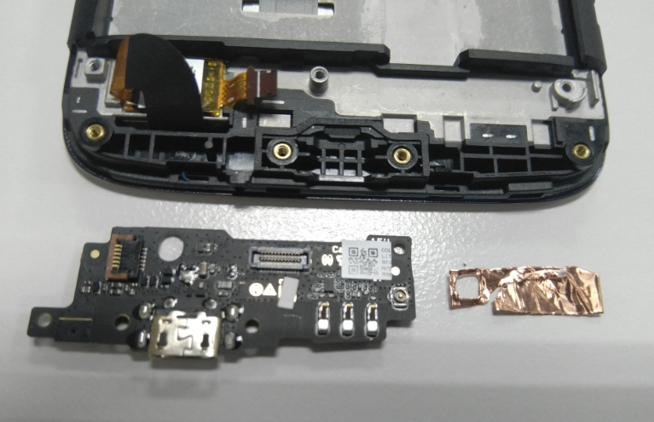
1. Remove Copper foil with tweezers
Symbols
Material List
Description / Part # |  | Qty
Tools/ Equipment
Description | Parameters
ESD wrist strap
tweezers
2. Release TP FPC ZIF FPC and remove Sub-board from front housing
Attention
Operation
Verification

Slide 14
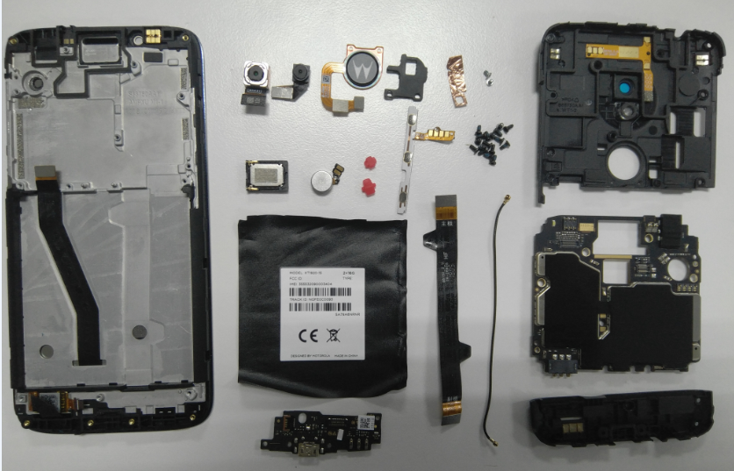
1. Don’t separate speaker FPC 、PCBA cooling copper and battery cover cooling film if material not damage
Symbols
Material List
Description / Part # |  | Qty
Tools/ Equipment
Description | Parameters
ESD wrist strap
tweezers
Screwdriver
Attention
Operation
Verification

Slide 15
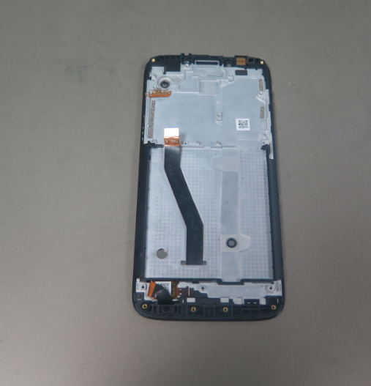
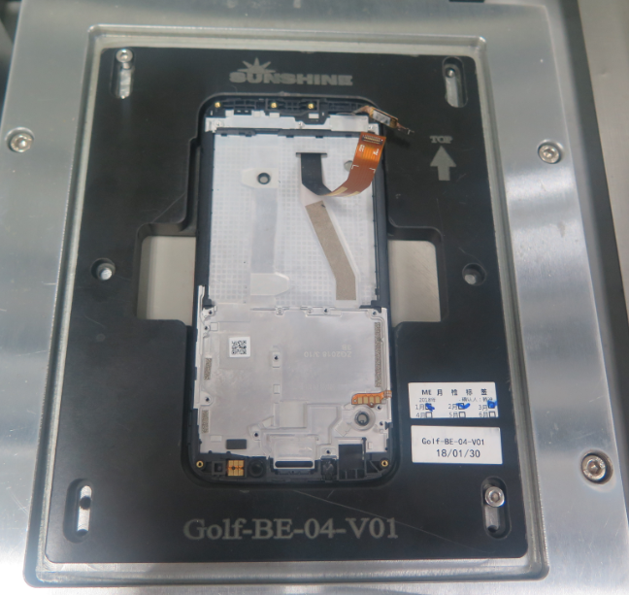
1. Warm Time： 3/minutes Warm Temperature:75±5 °
Symbols
Material List
Description / Part # |  | Qty
Tools/ Equipment
Description | Parameters
ESD wrist strap
Hot plat
Disassembly equipment
2. Put the Front housing module on the hot plat surface ( TP surface adown)
Attention
Operation
Verification
3. Put the Front housing module into the disassembly equipment ( TP surface adown)

Slide 16
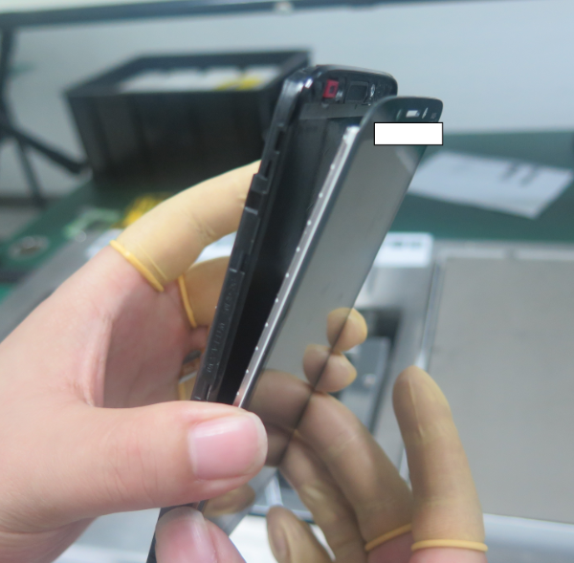
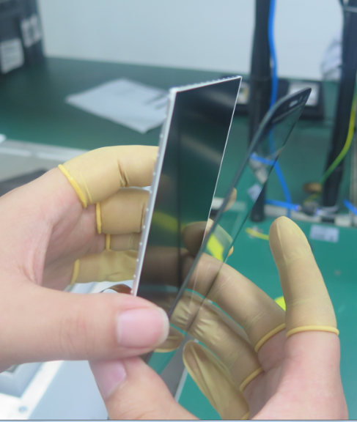
1. Take out the Front housing module from disassembly equipment
Symbols
Material List
Description / Part # |  | Qty
Tools/ Equipment
Description | Parameters
ESD wrist strap
2. Separate TP module and front housing slowly
Attention
Operation
Verification
3. Separate TP and LCM slowly
4. Cover TP and LCM surface with protection film
1. Check TP and LCM module not damage
1. Do not touch TP inside surface and LCM upper surface with finger

