Slide 1
Bounce Shatterproof Liner Replacement in Service Version: 2.0

Slide 2
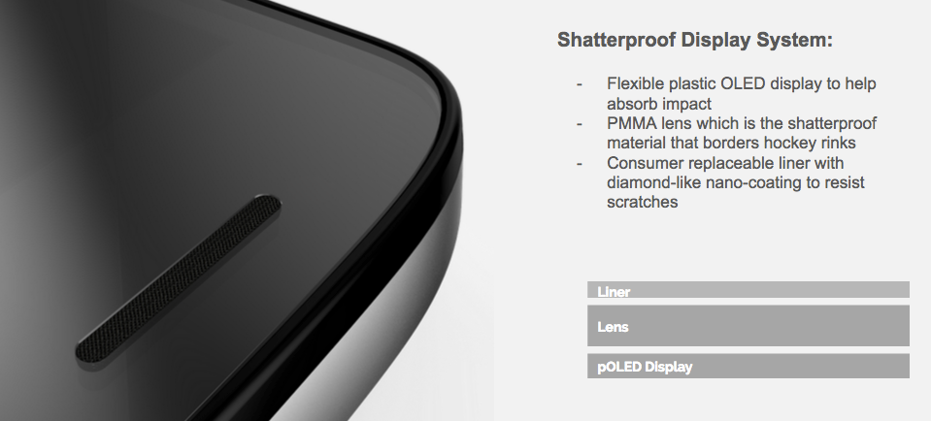
ShattershieldTM
“World’s first shatterproof display, guaranteed not to crack or shatter”
Duration … 4 years on display and lens, original owner with proof of purchase

Slide 3
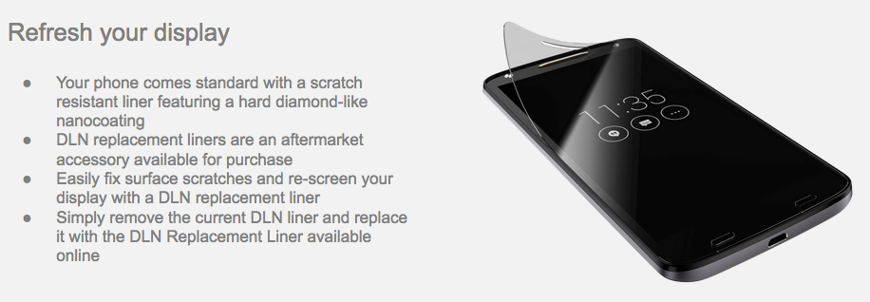
DLN Replacement Liner

Slide 4
Replacement Options
Consumer
motorola.com
Motorola
Call Center
Motorola
Walk-in Service Center
Options?
Options?
Options?
Options?
Options?
Options?
Option #1:
Self Serve
Option #2:
Retail
Option #3:
MASC
Option #1:
Self Serve
Option #2:
Retail
Option #3:
MASC
Option #1:
Self Serve
Option #2:
MASC
Direct to URL to order self serve kit (Need process flow)
Provide list of retails supporting this service
Refer to Replacement at MASC (Mail-in) Flow
Order self serve kit for consumer
Provide list of retails supporting this service
Refer to Replacement at MASC (Mail-in) Flow
Direct consumer to order self serve kit online
Refer to Replacement at MASC (Walk-in) Flow

Slide 5
Option #3 Service Center (Mail-in)
Replacement at Motorola Service Center (Mail-in)
Consumer
Customer Interface (motorola.com or Motorola Call Center)
MASC
Mail Device to Service Center
Repair?
Receive Device
No
Send Pre-paid Label to Consumer
Contact Consumer
Yes
No
In Warranty?
Yes
Repair
Replace DLN Lens
Mail Device back to Consumer

Slide 6
Option #3 Service Center (Mail-in)
Replacement at Motorola Service Center (Walk-in)
Consumer
MASC
Give Device to Service Center
Contact Consumer
Repair?
Receive Device
No
Yes
No
In Warranty?
Yes
Repair
Replace DLN Lens
Give Device back to Consumer

