Slide 1
RioH
Troubleshooting Guides
Rio H EE Team
Date Dec. 11 2018

Slide 2
TABLE OF CONTENTS
1. Snapshots of Antennas …………………………..…………………………………..
2. Snapshots of Main Board .……………………….………………………………….
3. LTE/WCDMA/CDMA/GSM Troubleshooting ………………………………………
4. GPS Troubleshooting ………………………………………………………………
5. WLAN / BT / FM / DTV Troubleshooting …………………………………………
6. Charging Troubleshooting …………………………………………………………
7. LED/Prox & IR Sensor/uSIM Troubleshooting ……..…………………………..
8. Vibrator and Sensors Troubleshooting ………………………………………….
9. Touch Troubleshooting …………………………………………………………....
10. Display Troubleshooting …………………………………………………….…..
11. Camera Troubleshooting …………………………………………………………
12. Audio Troubleshooting …………………………………………………………..

Slide 3
SNAPSHOTS OF ANTENNAS

Slide 4
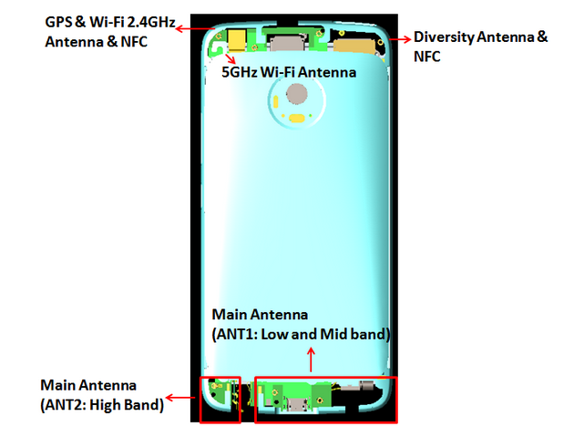

Slide 5
SNAPSHOTS OF MAIN BOARD

Slide 6


Slide 7
LTE/WCDMA/CDMA/GSM
TROUBLESHOOTING

Slide 8
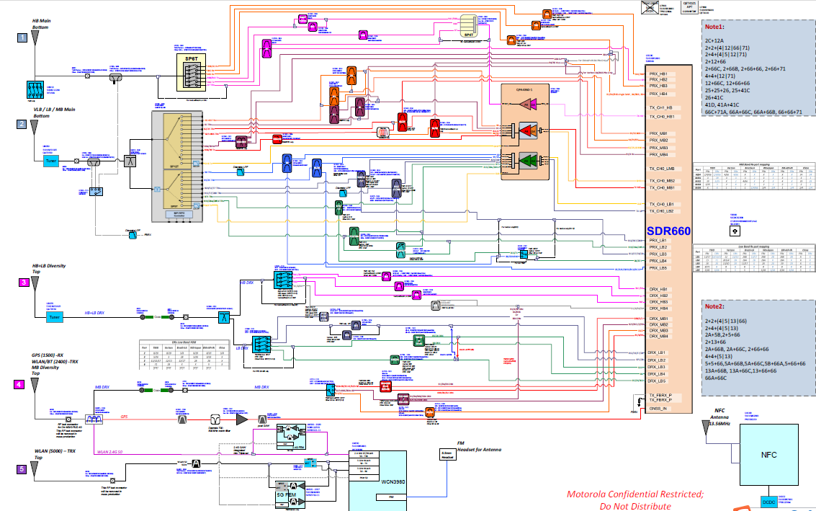
RF BLOCK

Slide 9
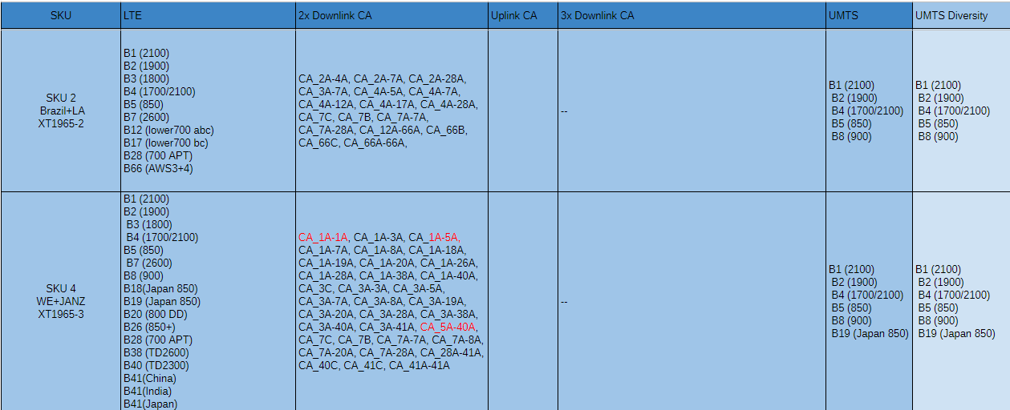
Frequency Band information

Slide 10
FDD Band
Several FDD Band（WCDMA LTE and CDMA）have the shared path below：
WCDMA band1 and LTE band1；
WCDMA band2,LTE band2,band25
WCDMA band5,B18,B19,LTE band5,band26 and CDMA BC0；
WCDMA band8 and LTE band8.
Mainly devices on FDD path about :
PA:U7150（QPA4360）band support B1,B2,B3,B4,B5（B19，B26）,B7,B8，B12，B13,B17，B20，B28；B66,B38，B40，B41,GSM Q_band；Antenna Switch:.U7000
Now taking an example of Middle Band LTE band1（WCDMA band1）：

Slide 11
LTE/WCDMA B1 Tx and Rx

Slide 12
LTE/WCDMA B1 Tx Check Chart(LATAM) – No Tx
START
SDR660Voltage CHECK ?
FAIL
CHECK & REPLACE
R3001,R3002,R3004,R3005,R3006
OK
TX SIGNAL CHECK?
FAIL
CHECK & REPLACE
C7067,C7182
OK
PA MODE & MATCH
CHECK?
FAIL
CHECK & REPLACE
C7316,C7313,L7311,,
OK
DUPLEXER & TXM
CHECK ?
FAIL
CHECK & REPLACE
C7314
OK
COUPLE R & RF CONNECTOR CHECK ?
FAIL
CHECK & REPLACE
C7004,C8011,C7028,
OK
TX LEVEL
CHECK ?
FAIL
2
Go to TX CHECK CHART- Low TX
OK
END

Slide 13
LTE/WCDMA B1 Tx Check Chart(LATAM) – Low Tx
2
OK
SDR660
TX Level
CHECK ?
FAIL
CHECK & REPLACE
C7067,C7182,L7181
OK
PAM GAIN & DPX LOSS
CHECK ?
FAIL
CHECK & REPLACE
C7316,C73123,L7311,C7360,C7314,L7312
OK
TXM LOSS
CHECK ?
FAIL
CHECK & REPLACE
C7004,L7002
OK
COUPLER & RF CONNECTOR
CHECK
FAIL
CHECK & REPLACE
C8011,C7028
OK
END

Slide 14
LTE/WCDMA B1 PRx Check Chart(LATAM)
START
XO Frequency
CHECK ?
FAIL
CHECK & REPLACE
Y2000
OK
SDR660 Voltage CHECK ?
FAIL
CHECK & REPLACE
3001,R3002,R3004,R3005,R3006
OK
DPX & MATCHING CHECK ?
FAIL
CHECK & REPLACE
C7314,L7312,C7315,C7304,C7357,L7363,
OK
SDR660, COUPLER,
RF CON. CHECK ?
CHECK & REPLACE
C8011,C7028
FAIL
OK
OK
END

Slide 15
LTE/WCDMA B1 Tx Check Chart(WE&JP) – No Tx
START
SDR660Voltage CHECK ?
FAIL
CHECK & REPLACE
R3001,R3002,R3004,R3005,R3006
OK
TX SIGNAL CHECK?
FAIL
CHECK & REPLACE
C7067,C7182
OK
PA MODE & MATCH
CHECK?
FAIL
CHECK & REPLACE
C7316,C7301,
OK
QUPLEXER & TXM
CHECK ?
FAIL
CHECK & REPLACE
C7358
OK
COUPLE R & RF CONNECTOR CHECK ?
FAIL
CHECK & REPLACE
C7004,C8011,C7028,
OK
TX LEVEL
CHECK ?
FAIL
2
Go to TX CHECK CHART- Low TX
OK
END

Slide 16
LTE/WCDMA B1 Tx Check Chart(WE&JP) – Low Tx
2
OK
SDR660
TX Level
CHECK ?
FAIL
CHECK & REPLACE
C7067,C7182,L7181
OK
PAM GAIN & DPX LOSS
CHECK ?
FAIL
CHECK & REPLACE
C7316,L7357,C7301,L7356,C7358
OK
TXM LOSS
CHECK ?
FAIL
CHECK & REPLACE
C7004,L7002
OK
COUPLER & RF CONNECTOR
CHECK
FAIL
CHECK & REPLACE
C8011,C7028
OK
END

Slide 17
LTE/WCDMA B1 PRx Check Chart(WE&JP)
START
XO Frequency
CHECK ?
FAIL
CHECK & REPLACE
Y2000
OK
SDR660 Voltage CHECK ?
FAIL
CHECK & REPLACE
R3001,R3002,R3004,R3005,R3006
OK
,QPX & MATCHING CHECK ?
FAIL
CHECK & REPLACE
L7359,C7302,C7304,C7357,L7363
OK
SDR660, COUPLER,
RF CON. CHECK ?
CHECK & REPLACE
C8011,C7028
FAIL
OK
OK
END

Slide 18
LTE/WCDMA B1 DRx Check Chart(ALL SKU)
START
XO Frequency
CHECK ?
FAIL
CHECK & REPLACE
Y2000
OK
SDR660 Voltage CHECK ?
FAIL
CHECK & REPLACE
R3001,R3002,R3004,R3005,R3006
OK
Filter & MATCHING CHECK ?
FAIL
CHECK & REPLACE
C7700,L7701,C7747,L7747,C7746
OK
SP3T CHECK ?
CHECK & REPLACE
C7740
FAIL
OK
OK
END

Slide 19
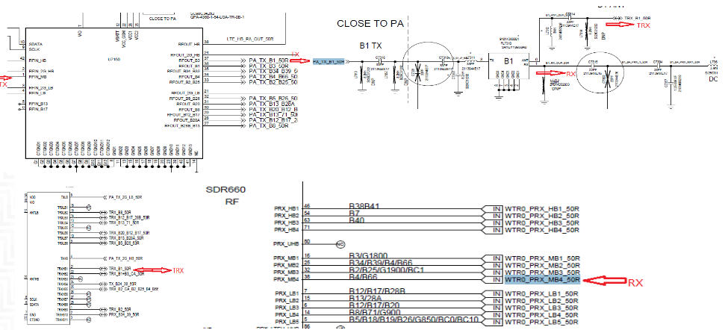
B1 TRx Circuits(LATAM)

Slide 20
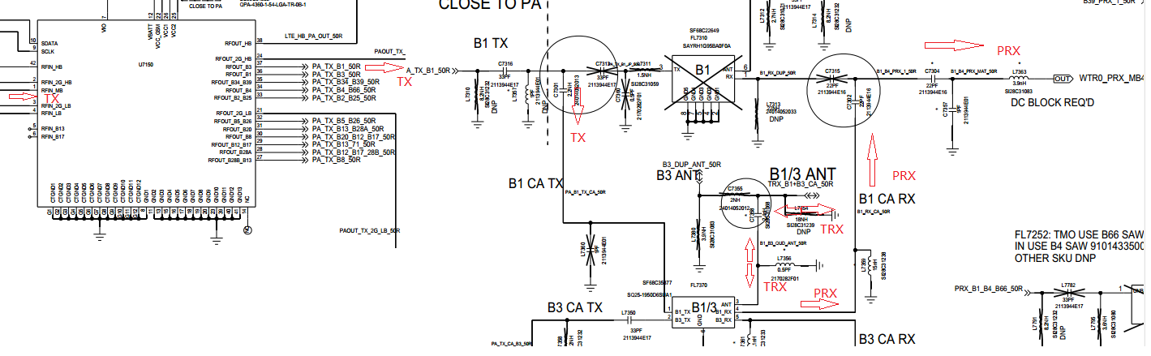
B1 TRx Circuits(WE&JP)

Slide 21
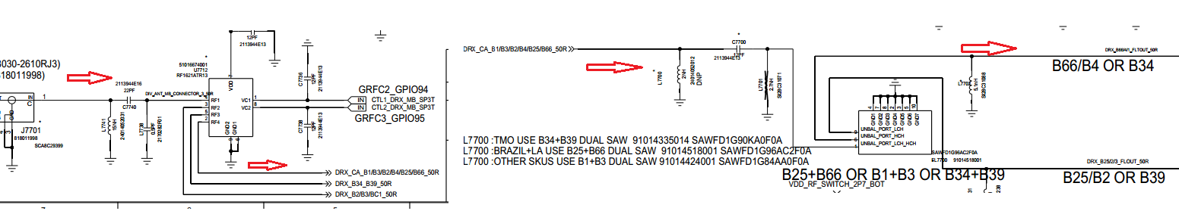
B1 DRx Circuits

Slide 22
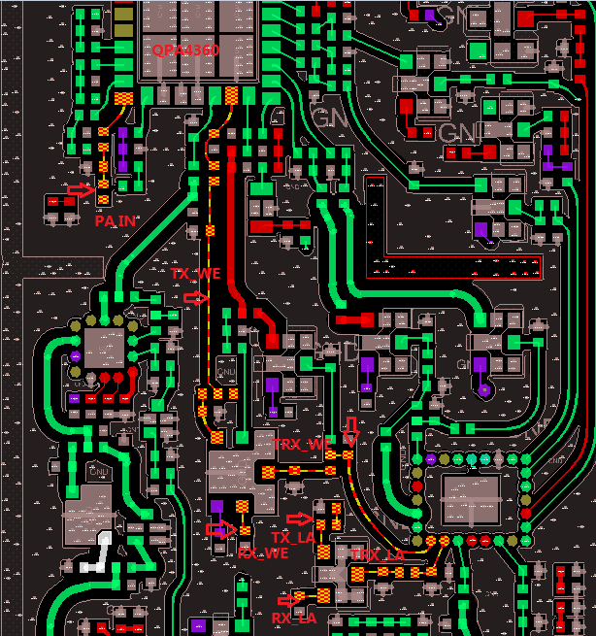
B1 (LATAM&WE) TX+PRX Layout

Slide 23
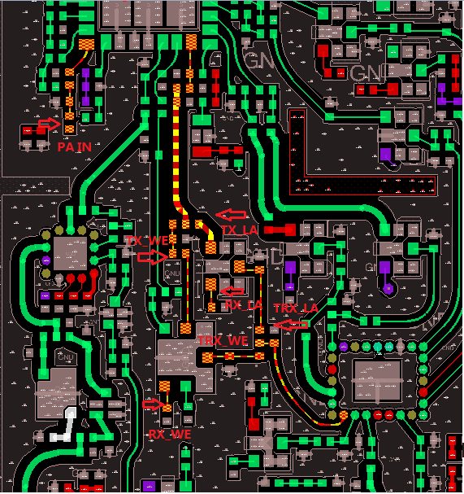
B3 (LATAM&WE) TX+PRX Layout

Slide 24
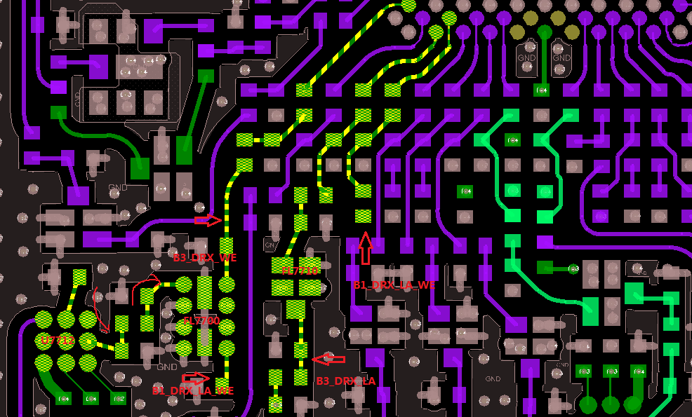
B1/B3 DRX Layout

Slide 25
LTE/WCDMA B2 Tx and Rx

Slide 26
LTE/WCDMA B2 Tx Check Chart(LATAM&WE) – No Tx
START
LATAM
WE
CHECK & REPLACE
R3001,R3002,R3004,R3005,R3006
CHECK & REPLACE
R3001,R3002,R3004,R3005,R3006
SDR660Voltage CHECK ?
FAIL
CHECK & REPLACE
R3001,R3002,R3004,R3005,R3006
OK
TX SIGNAL CHECK?
FAIL
CHECK & REPLACE
C7067,C7182
CHECK & REPLACE
C7067,C7182
OK
PA MODE & MATCH
CHECK?
FAIL
CHECK & REPLACE
C7341，C7343
CHECK & REPLACE
C7341，C7343
OK
DUPLEXER & TXM
CHECK ?
FAIL
CHECK & REPLACE
C7339,C7342,C7311
CHECK & REPLACE
C7339,C7307
OK
COUPLE R & RF CONNECTOR CHECK ?
FAIL
CHECK & REPLACE
C7004,C8011,C7028,
CHECK & REPLACE
C7004,C8011,C7028,
OK
TX LEVEL
CHECK ?
FAIL
2
Go to TX CHECK CHART- Low TX
OK
END

Slide 27
LTE/WCDMA B2 Tx Check Chart(LATAM&WE) – Low Tx
2
LATAM
WE
OK
SDR660
TX Level
CHECK ?
FAIL
CHECK & REPLACE
C7067,C7182,L7181
CHECK & REPLACE
C7067,C7182,L7181
OK
PAM GAIN & DPX LOSS
CHECK ?
FAIL
CHECK & REPLACE
C7341,C7343,L7342,L7347,C7339,L7337,C7342,L7356,C7311
CHECK & REPLACE
C7341,C7343,L7342,L7347,C7339,L7337,C7307
OK
TXM LOSS
CHECK ?
FAIL
CHECK & REPLACE
C7004,L7002
CHECK & REPLACE
C7004,L7002
OK
COUPLER & RF CONNECTOR
CHECK
FAIL
CHECK & REPLACE
C7004,C8011,C7028,
CHECK & REPLACE
C7004,C8011,C7028,
OK
END

Slide 28
LTE/WCDMA B2 PRx Check Chart(LATAM&WE)
START
LATAM
WE
XO Frequency
CHECK ?
FAIL
CHECK & REPLACE
Y2000
CHECK & REPLACE
Y2000
OK
SDR660 Voltage CHECK ?
FAIL
CHECK & REPLACE
R3001,R3002,R3004,R3005,R3006
CHECK & REPLACE
R3001,R3002,R3004,R3005,R3006
OK
DPX & MATCHING CHECK ?
FAIL
CHECK & REPLACE
C7311，L7336，C7342，L7337，C7339，L7339，L7347，L7191,L7346,C7345
CHECK & REPLACE
C7307,L7337，C7339，L7339，L7347，L7191,L7346,C7345
OK
, COUPLER,
RF CON. CHECK ?
CHECK & REPLACE
C7004,C8011,C7028,
CHECK & REPLACE
C7004,C8011,C7028
FAIL
OK
OK
END

Slide 29
LTE/WCDMA B2 DRx Check Chart(LATAM)
START
XO Frequency
CHECK ?
FAIL
CHECK & REPLACE
Y2000
OK
SDR660 Voltage CHECK ?
FAIL
CHECK & REPLACE
R3001,R3002,R3004,R3005,R3006
OK
Filter & MATCHING CHECK ?
FAIL
CHECK & REPLACE
L7731，C7731，L7737，C7732，,L7701,C7700,L7700,
OK
SP3T CHECK ?
CHECK & REPLACE
C7740,L7741,L7738
FAIL
OK
OK
END
Notes:
，TRX_

Slide 30
LTE/WCDMA B2 DRx Check Chart(WE)
START
XO Frequency
CHECK ?
FAIL
CHECK & REPLACE
Y2000
OK
SDR660 Voltage CHECK ?
FAIL
CHECK & REPLACE
R3001,R3002,R3004,R3005,R3006
OK
Filter & MATCHING CHECK ?
FAIL
CHECK & REPLACE
L7742，L7744，L7743，L7722，C7721，L7705，C7704，
OK
SP4T CHECK ?
CHECK & REPLACE
C7740,L7741,L7738
FAIL
OK
OK
END
Notes:
，TRX_

Slide 31
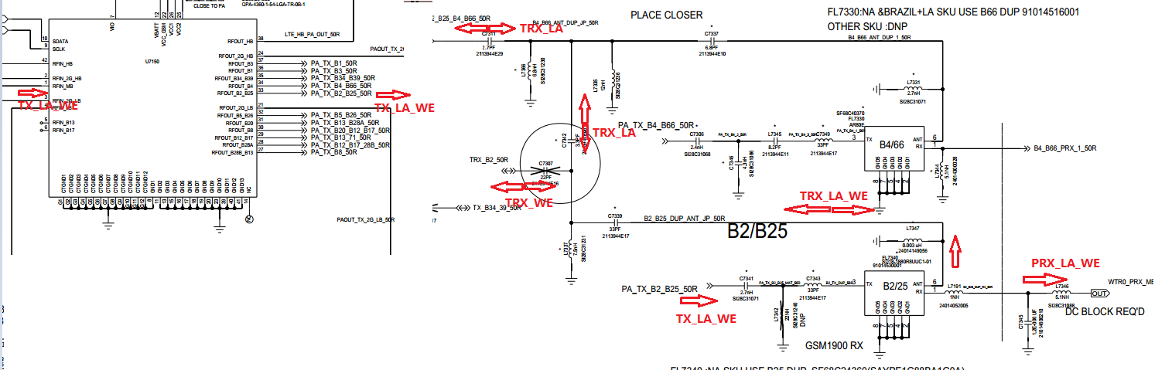
B2 TRx Circuits(NA&WE)

Slide 32
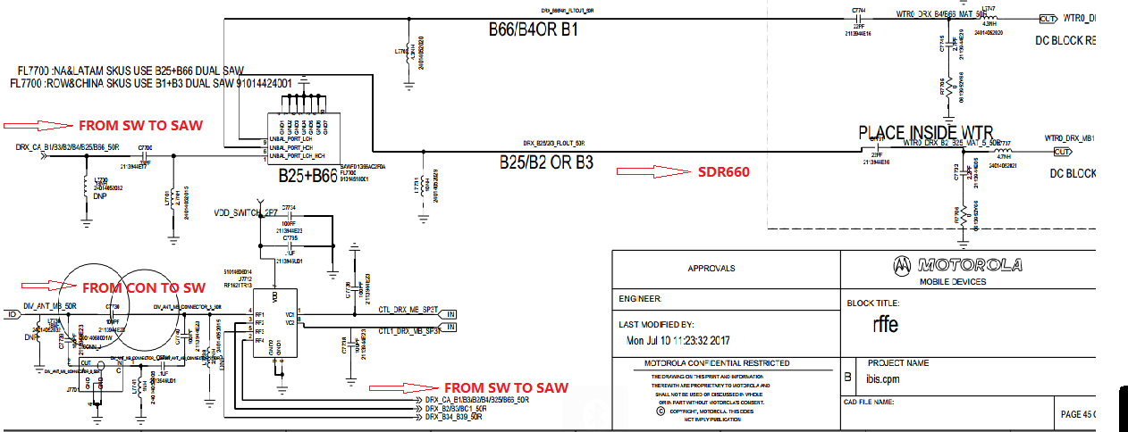
B2 DRx Circuits(NA&LATAM)

Slide 33
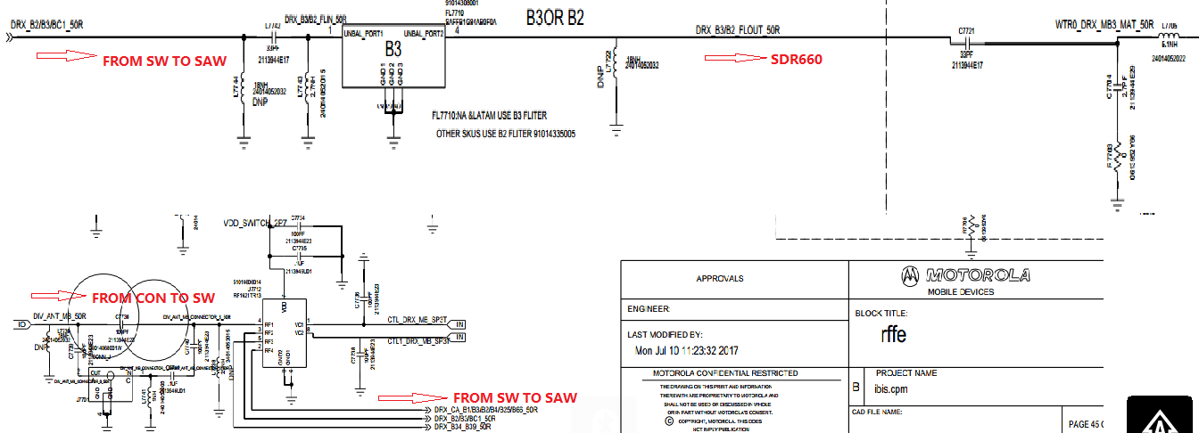
B2 DRx Circuits(APAC)

Slide 34
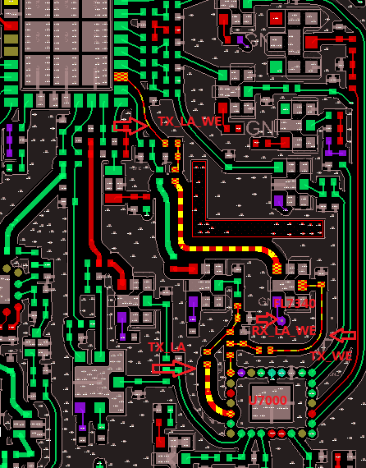
B2 TX+PRX Layout

Slide 35
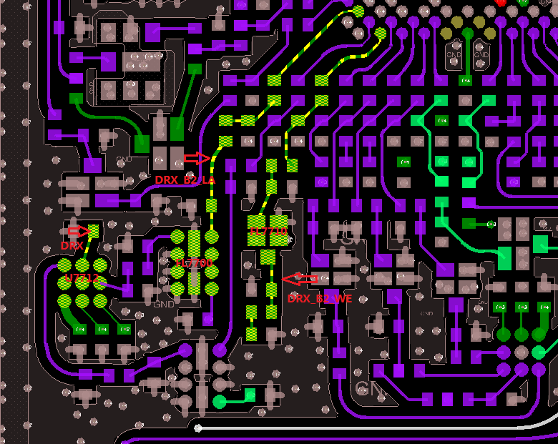
B2 DRX Layout

Slide 36
LTE B3 Tx and Rx

Slide 37
LTE B3 Tx Check Chart(LATAM) – No Tx
START
SDR660Voltage CHECK ?
FAIL
CHECK & REPLACE
R3001,R3002,R3004,R3005,R3006
OK
TX SIGNAL CHECK?
FAIL
CHECK & REPLACE
C7067,C7182
OK
PA MODE & MATCH
CHECK?
FAIL
CHECK & REPLACE
C7356,L7351,
OK
DUPLEXER & TXM
CHECK ?
FAIL
CHECK & REPLACE
C7355
OK
COUPLE R & RF CONNECTOR CHECK ?
FAIL
CHECK & REPLACE
C7004,C8011,C7028,
OK
TX LEVEL
CHECK ?
FAIL
2
Go to TX CHECK CHART- Low TX
OK
END

Slide 38
LTE B3 Tx Check Chart(LATAM) – Low Tx
2
OK
SDR660
TX Level
CHECK ?
FAIL
CHECK & REPLACE
C7067,C7182,L7181
OK
PAM GAIN & DPX LOSS
CHECK ?
FAIL
CHECK & REPLACE
C7356,L7351,C7355,L7380
OK
TXM LOSS
CHECK ?
FAIL
CHECK & REPLACE
C7004,L7002
OK
COUPLER & RF CONNECTOR
CHECK
FAIL
CHECK & REPLACE
C8011,C7028,C8000
OK
END

Slide 39
LTE B3 PRx Check Chart(LATAM)
START
XO Frequency
CHECK ?
FAIL
CHECK & REPLACE
Y2000
OK
SDR660 Voltage CHECK ?
FAIL
CHECK & REPLACE
R3001,R3002,R3004,R3005,R3006
OK
DPX & MATCHING CHECK ?
FAIL
CHECK & REPLACE
C7355,L7380,C7352,C7338,L7336
OK
SDR660, COUPLER,
RF CON. CHECK ?
CHECK & REPLACE
C8011,C7028,C8000
FAIL
OK
OK
END

Slide 40
LTE B3 Tx Check Chart(WE) – No Tx
START
SDR660Voltage CHECK ?
FAIL
CHECK & REPLACE
R3001,R3002,R3004,R3005,R3006
OK
TX SIGNAL CHECK?
FAIL
CHECK & REPLACE
C7067,C7182
OK
PA MODE & MATCH
CHECK?
FAIL
CHECK & REPLACE
C7356,C7351,L7350
OK
QUPLEXER & TXM
CHECK ?
FAIL
CHECK & REPLACE
L7356,C7358,L7002,C7004
OK
COUPLE R & RF CONNECTOR CHECK ?
FAIL
CHECK & REPLACE
C8000,C7038,L7043,R7046,L7045
OK
TX LEVEL
CHECK ?
FAIL
2
Go to TX CHECK CHART- Low TX
OK
END

Slide 41
LTE B3 Tx Check Chart(WE) – Low Tx
2
OK
SDR660
TX Level
CHECK ?
FAIL
CHECK & REPLACE
C7067,C7182,L7181
OK
PAM GAIN & QPX LOSS
CHECK ?
FAIL
CHECK & REPLACE
L7355,C7356,C7351,L7350,L7356,C7358
OK
TXM LOSS
CHECK ?
FAIL
CHECK & REPLACE
C7004,L7002
OK
COUPLER & RF CONNECTOR
CHECK
FAIL
CHECK & REPLACE
C8011,C7028,C8000
OK
END

Slide 42
LTE B3 PRx Check Chart(WE)
START
XO Frequency
CHECK ?
FAIL
CHECK & REPLACE
Y2000
OK
SDR660 Voltage CHECK ?
FAIL
CHECK & REPLACE
R3001,R3002,R3004,R3005,R3006
OK
,QPX & MATCHING CHECK ?
FAIL
CHECK & REPLACE
C7358,L7356,C7333,L7336,C7338
OK
SDR660, COUPLER,
RF CON. CHECK ?
CHECK & REPLACE
C8011,C7028,C8000
FAIL
OK
OK
END

Slide 43
LTE B3 DRx Check Chart(WE)
START
XO Frequency
CHECK ?
FAIL
CHECK & REPLACE
Y2000
OK
SDR660 Voltage CHECK ?
FAIL
CHECK & REPLACE
R3001,R3002,R3004,R3005,R3006
OK
Filter & MATCHING CHECK ?
FAIL
CHECK & REPLACE
C7700,L7701,C7731,C7732,L7737
OK
SP3T CHECK ?
CHECK & REPLACE
C7440,L7741,L7738,
FAIL
OK
OK
END

Slide 44
LTE B3 DRx Check Chart(LATAM)
START
XO Frequency
CHECK ?
FAIL
CHECK & REPLACE
Y2000
OK
SDR660 Voltage CHECK ?
FAIL
CHECK & REPLACE
R3001,R3002,R3004,R3005,R3006
OK
Filter & MATCHING CHECK ?
FAIL
CHECK & REPLACE
L7742,C7721,L7705,C7704
OK
SP3T CHECK ?
CHECK & REPLACE
C7440,L7741,L7738,
FAIL
OK
OK
END

Slide 45
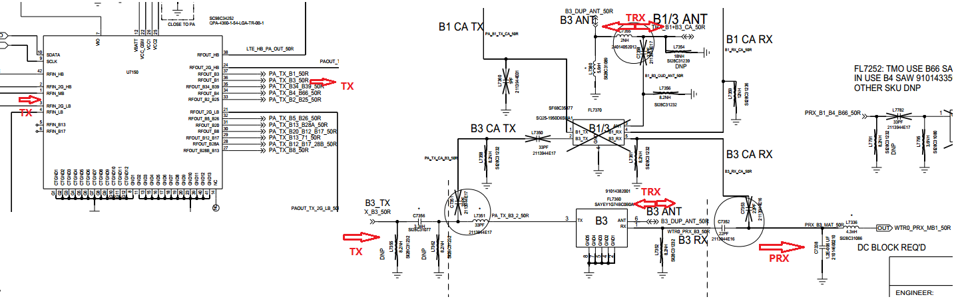
B3 TRx Circuits(LATAM)

Slide 46
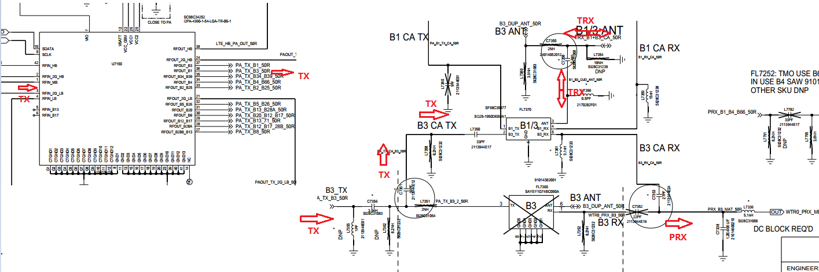
B3 TRx Circuits(WE)

Slide 47
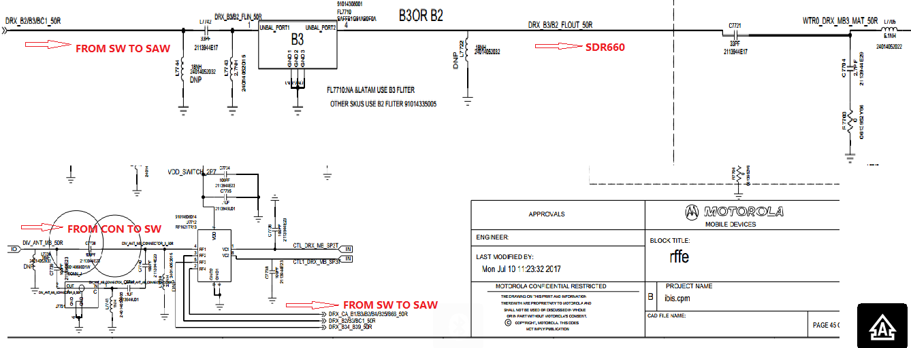
B3 DRx Circuits(LATAM)

Slide 48
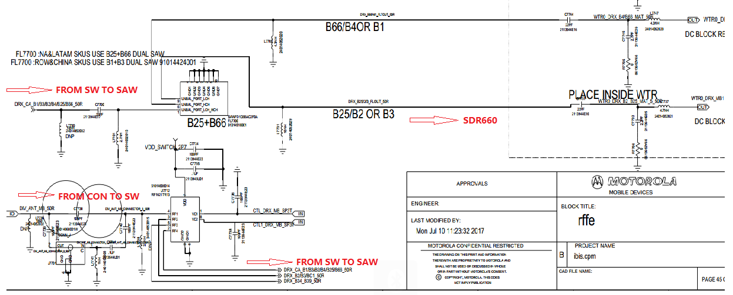
B3 DRx Circuits(WE)

Slide 49
LTE/WCDMA B4\66 Tx and Rx

Slide 50
LTE/WCDMA B4\66 Tx Check Chart(LATAM) – No Tx
START
SDR660Voltage CHECK ?
FAIL
CHECK & REPLACE
R3001,R3002,R3004,R3005,R3006
OK
TX SIGNAL CHECK?
FAIL
CHECK & REPLACE
C7067,C7182, L7181
OK
PA MODE & MATCH
CHECK?
FAIL
CHECK & REPLACE
C7306,C7346,L7345,C7349,U7150
OK
DUPLEXER & TXM
CHECK ?
FAIL
CHECK & REPLACE
L7331,C7337,L7335,L7366,C7311,FL7330,U7000
OK
COUPLE R & RF CONNECTOR CHECK ?
FAIL
CHECK & REPLACE
L7002,C7004,C8011,C7028,C8000,L8000,J8000,FL8010,U7003
OK
TX LEVEL
CHECK ?
FAIL
2
Go to TX CHECK CHART- Low TX
OK
END

Slide 51
LTE/WCDMA B4\66 Tx Check Chart(LATAM) – Low Tx
2
OK
SDR660
TX Level
CHECK ?
FAIL
CHECK & REPLACE
C7067,C7182, L7181
OK
PAM GAIN & DPX LOSS
CHECK ?
FAIL
CHECK & REPLACE
C7306,C7346,L7345,C7349,U7150,L7331,C7337,L7335,L7366,C7311,FL7330
OK
TXM LOSS
CHECK ?
FAIL
CHECK & REPLACE
U7000
OK
COUPLER & RF CONNECTOR
CHECK
FAIL
CHECK & REPLACE
L7002,C7004,C8011,C7028,C8000,L8000,J8000,FL8010,U7003
OK
END

Slide 52
LTE/WCDMA B4\66 PRx Check Chart(LATAM)
START
XO Frequency
CHECK ?
FAIL
CHECK & REPLACE
Y2000
OK
SDR660 Voltage CHECK ?
FAIL
CHECK & REPLACE
R3001,R3002,R3004,R3005,R3006
OK
DPX & MATCHING CHECK ?
FAIL
CHECK & REPLACE
L7344,C7422,L7353
OK
SDR660, COUPLER,
RF CON. CHECK ?
CHECK & REPLACE
L7002,C7004,C8011,C7028,C8000,L8000,J8000,FL8010,U7003
FAIL
OK
OK
END

Slide 53
LTE/WCDMA B4 Tx Check Chart(WE&PRC) – No Tx
START
SDR660Voltage CHECK ?
FAIL
CHECK & REPLACE
R3001,R3002,R3004,R3005,R3006
OK
TX SIGNAL CHECK?
FAIL
CHECK & REPLACE
C7067,C7182, L7181
OK
PA MODE & MATCH
CHECK?
FAIL
CHECK & REPLACE
U7150,C7356,C7351,L7350,L7355
OK
QUPLEXER & TXM
CHECK ?
FAIL
CHECK & REPLACE
FL7370,L7356,C7358,U7000
OK
COUPLE R & RF CONNECTOR CHECK ?
FAIL
CHECK & REPLACE
L7002,C7004,C8011,C7028,C8000,L8000,J8000,FL8010,U7003
OK
TX LEVEL
CHECK ?
FAIL
2
Go to TX CHECK CHART- Low TX
OK
END

Slide 54
LTE/WCDMA B4 Tx Check Chart(WE&PRC) – Low Tx
2
OK
SDR660
TX Level
CHECK ?
FAIL
CHECK & REPLACE
C7067,C7182, L7181
OK
PAM GAIN & QPX LOSS
CHECK ?
FAIL
CHECK & REPLACE
U7150,C7356,C7351,L7350,L7355,FL7370,L7356,C7358
OK
TXM LOSS
CHECK ?
FAIL
CHECK & REPLACE
U7000
OK
COUPLER & RF CONNECTOR
CHECK
FAIL
CHECK & REPLACE
L7002,C7004,C8011,C7028,C8000,L8000,J8000,FL8010,U7003
OK
END

Slide 55
LTE/WCDMA B4 PRx Check Chart(WE&PRC)
START
XO Frequency
CHECK ?
FAIL
CHECK & REPLACE
Y2000
OK
SDR660 Voltage CHECK ?
FAIL
CHECK & REPLACE
R3001,R3002,R3004,R3005,R3006
OK
,QPX & MATCHING CHECK ?
FAIL
CHECK & REPLACE
L7356,C7358,FL7370,L7361
,C7353
OK
SDR660, COUPLER,
RF CON. CHECK ?
CHECK & REPLACE
L7002,C7004,C8011,C7028,C8000,L8000,J8000,FL8010,U7003
FAIL
OK
OK
END

Slide 56
LTE/WCDMA B4/66 DRx Check Chart(ALL SKU)
START
XO Frequency
CHECK ?
FAIL
CHECK & REPLACE
Y2000
OK
SDR660 Voltage CHECK ?
FAIL
CHECK & REPLACE
R3001,R3002,R3004,R3005,R3006
OK
Filter & MATCHING CHECK ?
FAIL
CHECK & REPLACE
FL7700,C7747,C7746,L7747,L7701,C7700
OK
SP4T CHECK ?
CHECK & REPLACE
U7712,C7740,L7741,L7738
FAIL
OK
OK
END

Slide 57
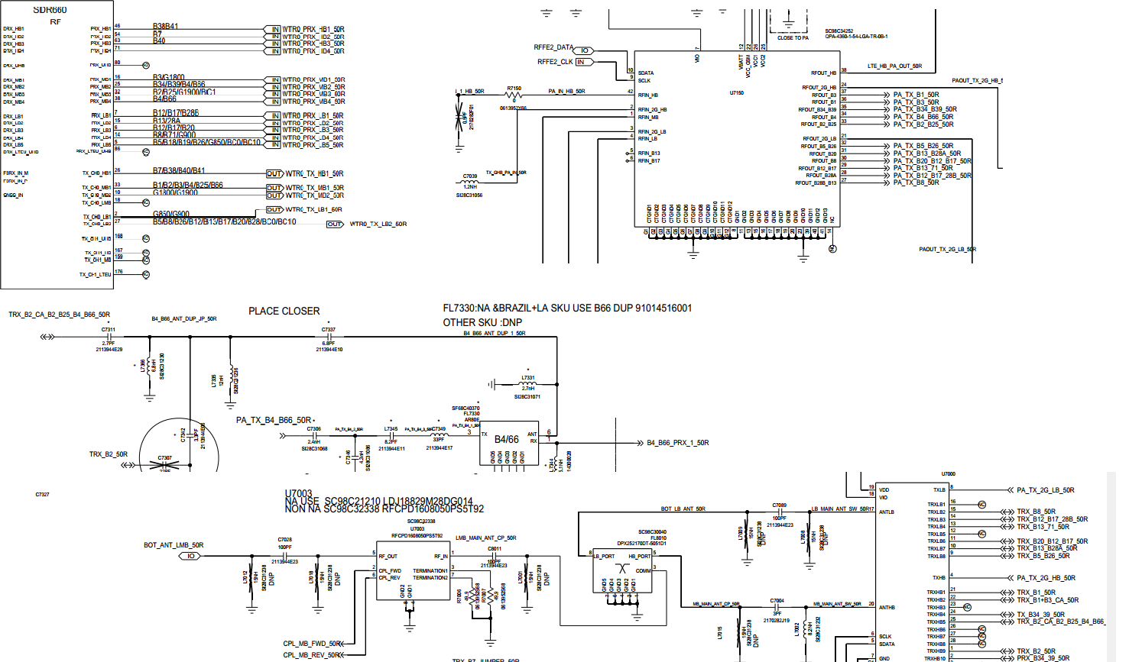
B4 TRx Circuits(LATAM)

Slide 58
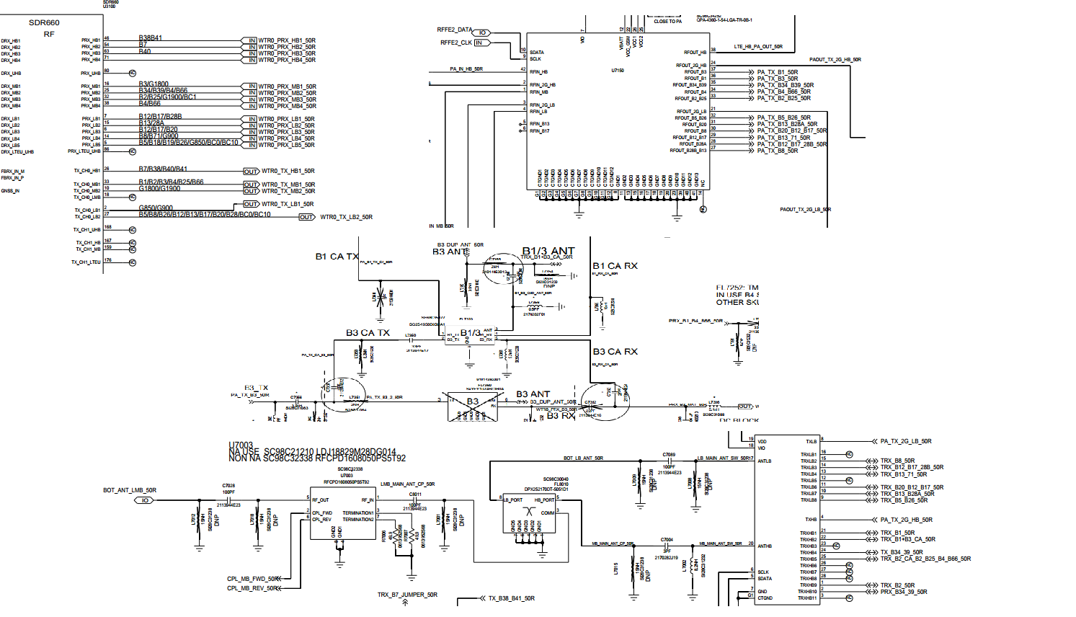
B4 TRx Circuits(WE&PRC)

Slide 59
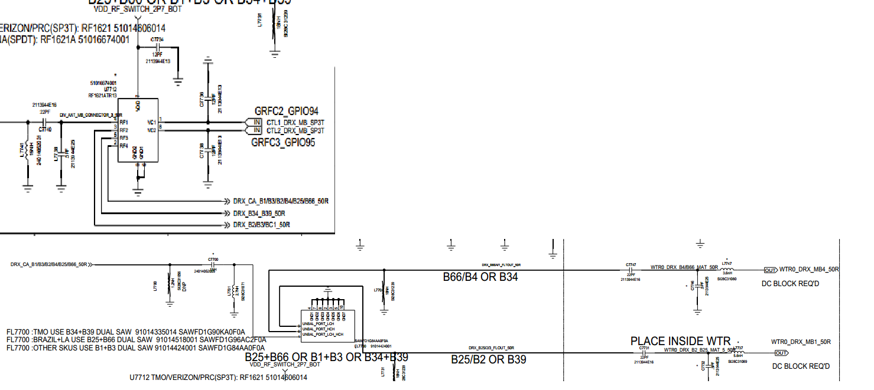
B4 DRx Circuits(ALL)

Slide 60
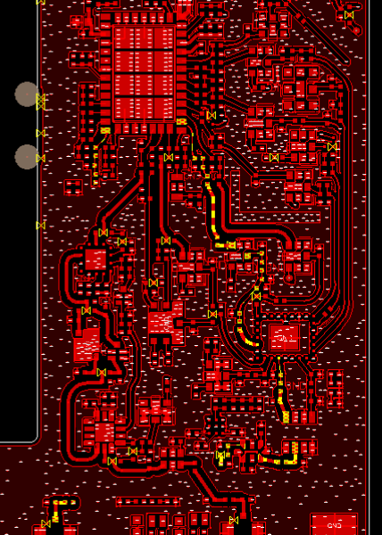
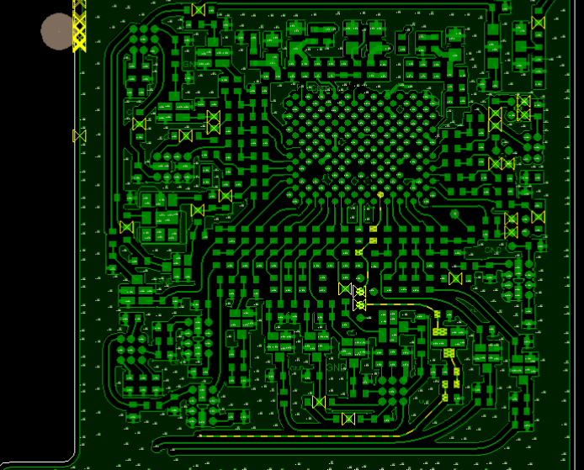
B4/66 TX+PRX

Slide 61
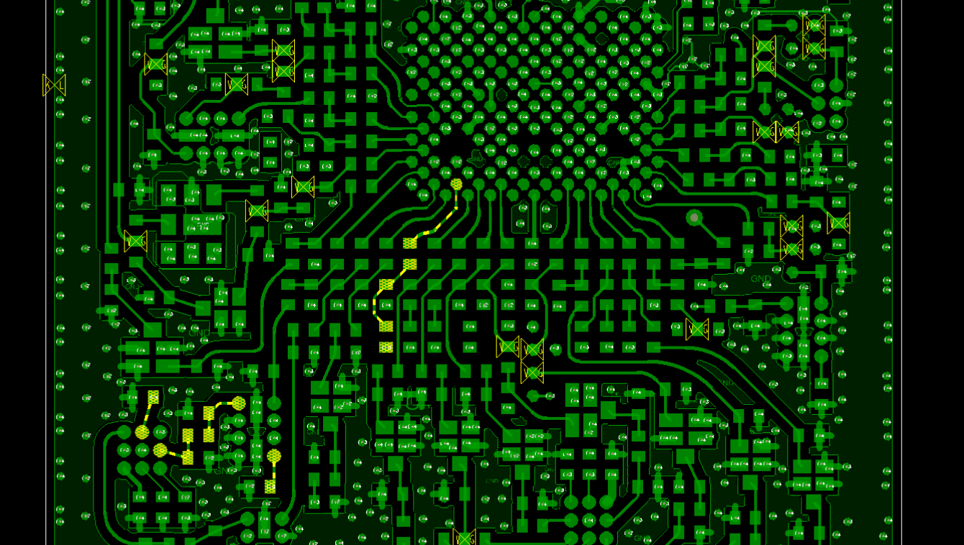
B4/66 DRX Layout

Slide 62
LTE/WCDMA/CDMA B5\26\18\19\BC0 Tx and Rx

Slide 63
LTE/WCDMA/CDMA B5\26\18\19\BC0 Tx Check Chart(ALL SKU) – No Tx
START
SDR660Voltage CHECK ?
FAIL
CHECK & REPLACE
R3001,R3002,R3004,R3005,R3006
OK
TX SIGNAL CHECK?
FAIL
CHECK & REPLACE
C7195,C7125
OK
PA MODE & MATCH
CHECK?
FAIL
CHECK & REPLACE
U7150,C7412,L7510,L7511
OK
DUPLEXER & TXM
CHECK ?
FAIL
CHECK & REPLACE
FL7510,L7516,C7515,U7000,C7089,FL8010,C8011
OK
COUPLE R & RF CONNECTOR CHECK ?
FAIL
CHECK & REPLACE
U7003,C7028,C8000,L8000,J8000
OK
TX LEVEL
CHECK ?
FAIL
2
Go to TX CHECK CHART- Low TX
OK
END

Slide 64
LTE/WCDMA/CDMA B5\26\18\19\BC0 Tx Check Chart(ALL SKU) – Low Tx
2
OK
SDR660
TX Level
CHECK ?
FAIL
CHECK & REPLACE
C7195,C7125
OK
PAM GAIN & DPX LOSS
CHECK ?
FAIL
CHECK & REPLACE
U7150,C7412,L7510,L7511,FL7510,L7516,C7515
OK
TXM LOSS
CHECK ?
FAIL
CHECK & REPLACE
U7000,C7089,FL8010,C8011
OK
COUPLER & RF CONNECTOR
CHECK
FAIL
CHECK & REPLACE
U7003,C7028,C8000,L8000,J8000
OK
END

Slide 65
LTE/WCDMA/CDMA B5\26\18\19\BC0 PRx Check Chart(ALL SKU)
START
XO Frequency
CHECK ?
FAIL
CHECK & REPLACE
Y2000
OK
SDR660 Voltage CHECK ?
FAIL
CHECK & REPLACE
R3001,R3002,R3004,R3005,R3006
OK
DPX & MATCHING CHECK ?
FAIL
CHECK & REPLACE
FL7510,C7515,L7516,C7512,C7513,L7515
OK
SDR660, COUPLER,
RF CON. CHECK ?
CHECK & REPLACE
U7003,C7028,C8000,L8000,J8000
FAIL
OK
OK
END

Slide 66
LTE/WCDMA/CDMA B5\26\18\19 DRx Check Chart(ALL SKU)
START
XO Frequency
CHECK ?
FAIL
CHECK & REPLACE
Y2000
OK
SDR660 Voltage CHECK ?
FAIL
CHECK & REPLACE
R3001,R3002,R3004,R3005,R3006
OK
Filter & MATCHING CHECK ?
FAIL
CHECK & REPLACE
FL7785,C7785,C7789,C7783,C7753,L7759
OK
SP6T,CON CHECK ?
CHECK & REPLACE
U7660,C7695,FL7600,C7696
FAIL
OK
OK
END

Slide 67
LTE/WCDMA/CDMA B5\BC0 DRx Check Chart(LA/PRC)
START
XO Frequency
CHECK ?
FAIL
CHECK & REPLACE
Y2000
OK
SDR660 Voltage CHECK ?
FAIL
CHECK & REPLACE
R3001,R3002,R3004,R3005,R3006
OK
Filter & MATCHING CHECK ?
FAIL
CHECK & REPLACE
FL7760,L7760,C7797,L7793
OK
SP6T,CON CHECK ?
CHECK & REPLACE
U7660,C7695,FL7600,C7696
FAIL
OK
OK
END

Slide 68
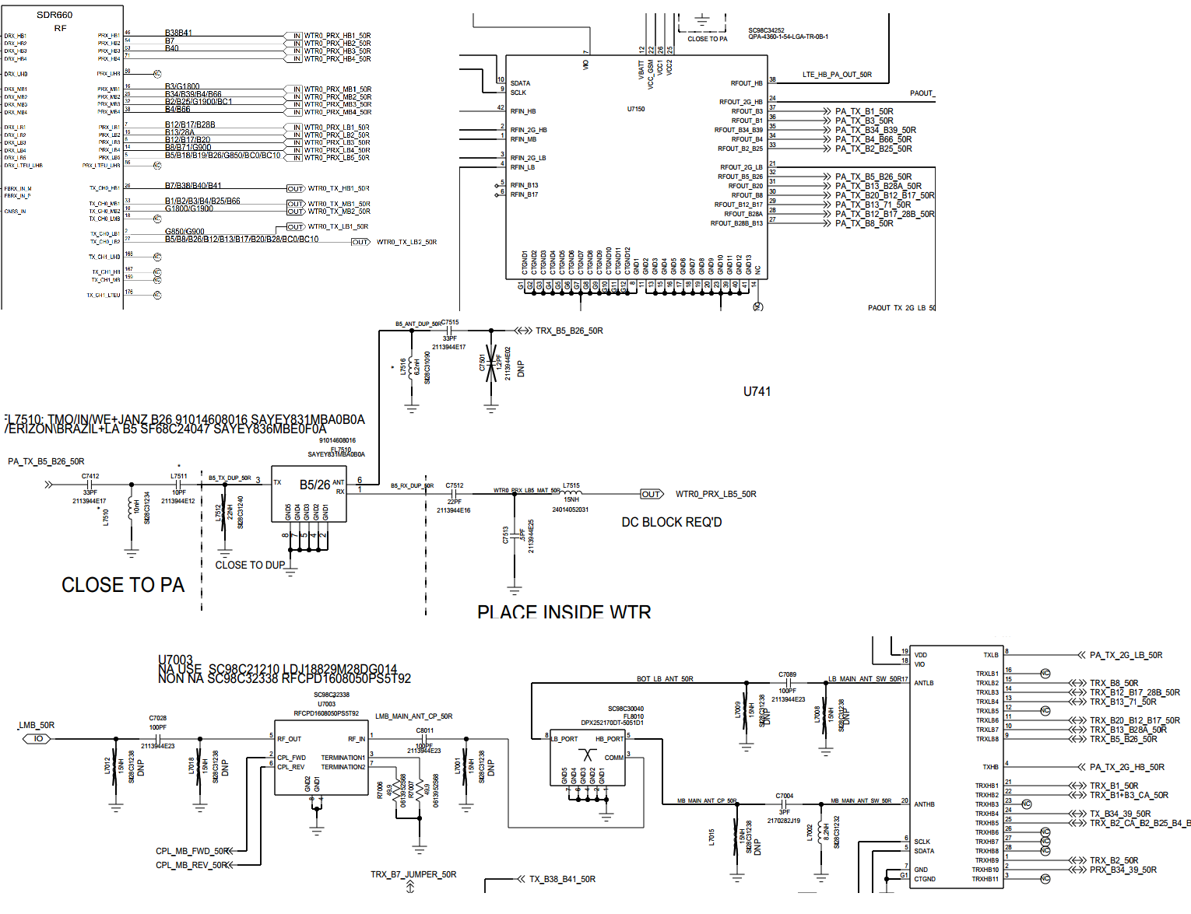
B5 TRx Circuit(ALL SKU)

Slide 69
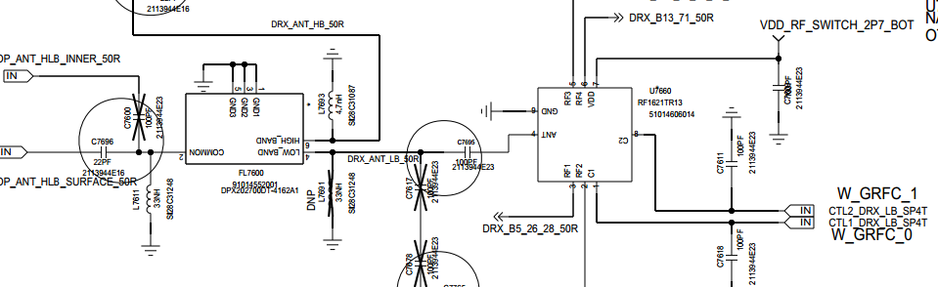
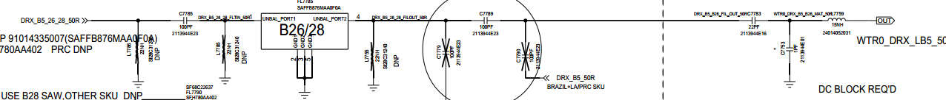
B5 DRx Circuits(WE)

Slide 70
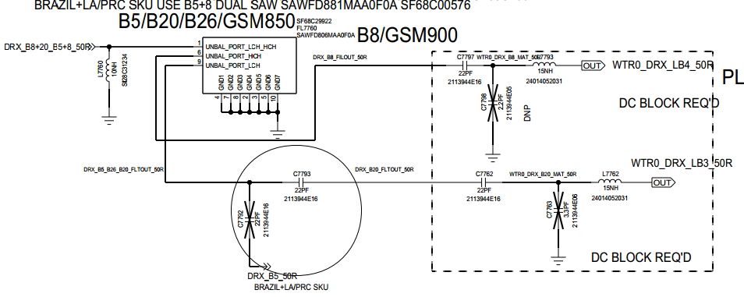
B5 DRx Circuits(LA/PRC)

Slide 71
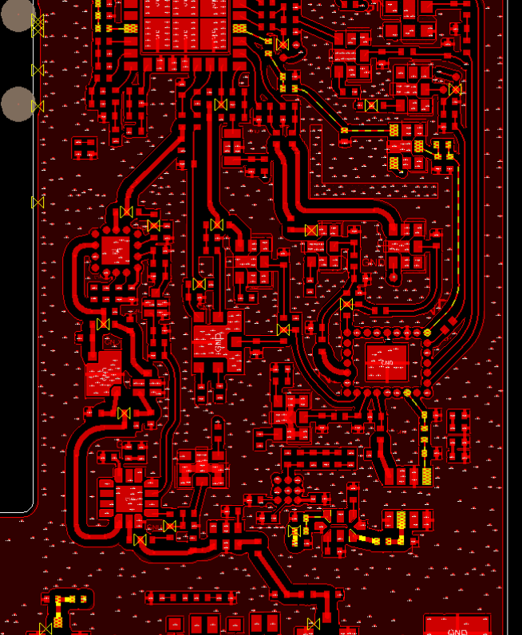
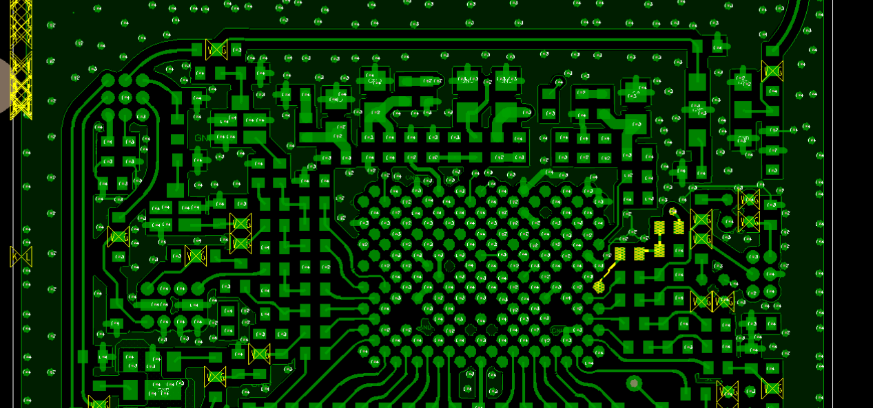
B5/26 TX+PRX Layout

Slide 72
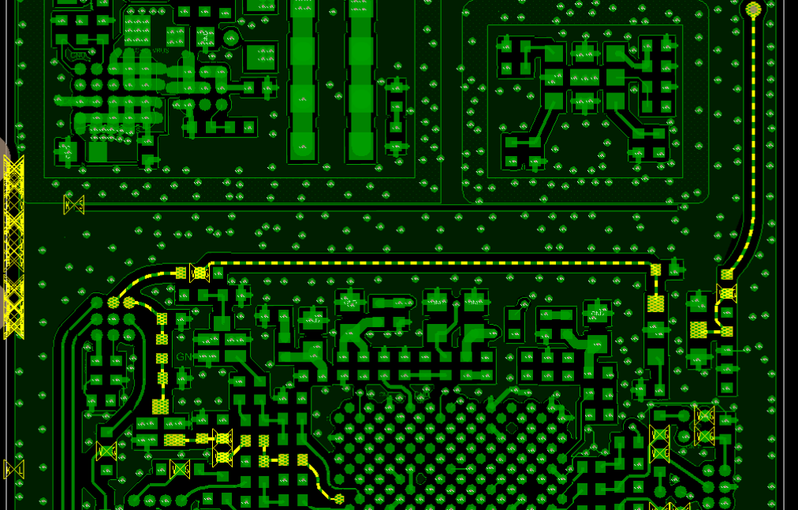
B5\26 DRX Layout(WE)

Slide 73
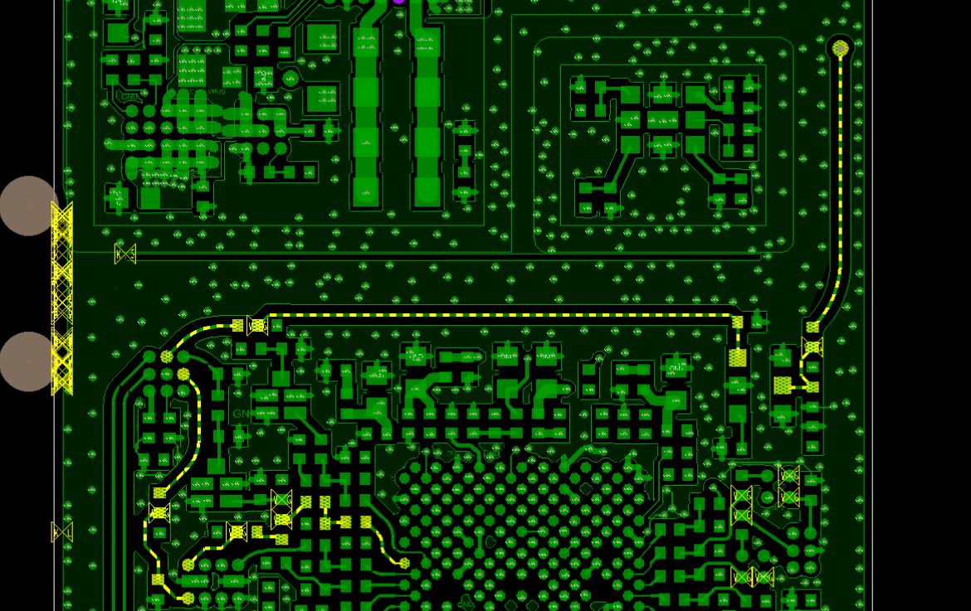
B5\26 DRX Layout(LA/PRC)

Slide 74
LTE/WCDMA B8 Tx and Rx

Slide 75
LTE/WCDMA B8 Tx Check Chart(ALL SKU) – No Tx
START
SDR660Voltage CHECK ?
FAIL
CHECK & REPLACE
R3001,R3002,R3004,R3005,R3006
OK
TX SIGNAL CHECK?
FAIL
CHECK & REPLACE
C7195,C7125
OK
PA MODE & MATCH
CHECK?
FAIL
CHECK & REPLACE
U7150,L7500,C7500
OK
DUPLEXER & TXM
CHECK ?
FAIL
CHECK & REPLACE
FL7500,C7504,L7504,L7502,U7000,C7089,FL8010,C8011
OK
COUPLE R & RF CONNECTOR CHECK ?
FAIL
CHECK & REPLACE
U7003,C7028,C8000,L8000,J8000
OK
TX LEVEL
CHECK ?
FAIL
2
Go to TX CHECK CHART- Low TX
OK
END

Slide 76
LTE/WCDMA B8 Tx Check Chart(ALL SKU) – Low Tx
2
OK
SDR660
TX Level
CHECK ?
FAIL
CHECK & REPLACE
C7195,C7125
OK
PAM GAIN & DPX LOSS
CHECK ?
FAIL
CHECK & REPLACE
U7150,L7500,C7500,FL7500,C7504,L7504,L7502
OK
TXM LOSS
CHECK ?
FAIL
CHECK & REPLACE
U7000,C7089,FL8010,C8011
OK
COUPLER & RF CONNECTOR
CHECK
FAIL
CHECK & REPLACE
U7003,C7028,C8000,L8000,J8000
OK
END

Slide 77
LTE/WCDMA B8 PRx Check Chart(ALL SKU)
START
XO Frequency
CHECK ?
FAIL
CHECK & REPLACE
Y2000
OK
SDR660 Voltage CHECK ?
FAIL
CHECK & REPLACE
R3001,R3002,R3004,R3005,R3006
OK
DPX & MATCHING CHECK ?
FAIL
CHECK & REPLACE
FL7500,C7504,L7504,L7502,C7539,C7540,C7527,L7522
OK
SDR660, COUPLER,
RF CON. CHECK ?
CHECK & REPLACE
U7003,C7028,C8000,L8000,J8000
FAIL
OK
OK
END

Slide 78
LTE/WCDMA B8 DRx Check Chart(ALL SKU)
START
XO Frequency
CHECK ?
FAIL
CHECK & REPLACE
Y2000
OK
SDR660 Voltage CHECK ?
FAIL
CHECK & REPLACE
R3001,R3002,R3004,R3005,R3006
OK
Filter & MATCHING CHECK ?
FAIL
CHECK & REPLACE
FL7760,L7760,C7797,L7793
OK
SP6T,CON CHECK ?
CHECK & REPLACE
C7696，FL7600，U7660，C7695,C7765
FAIL
OK
OK
END

Slide 79
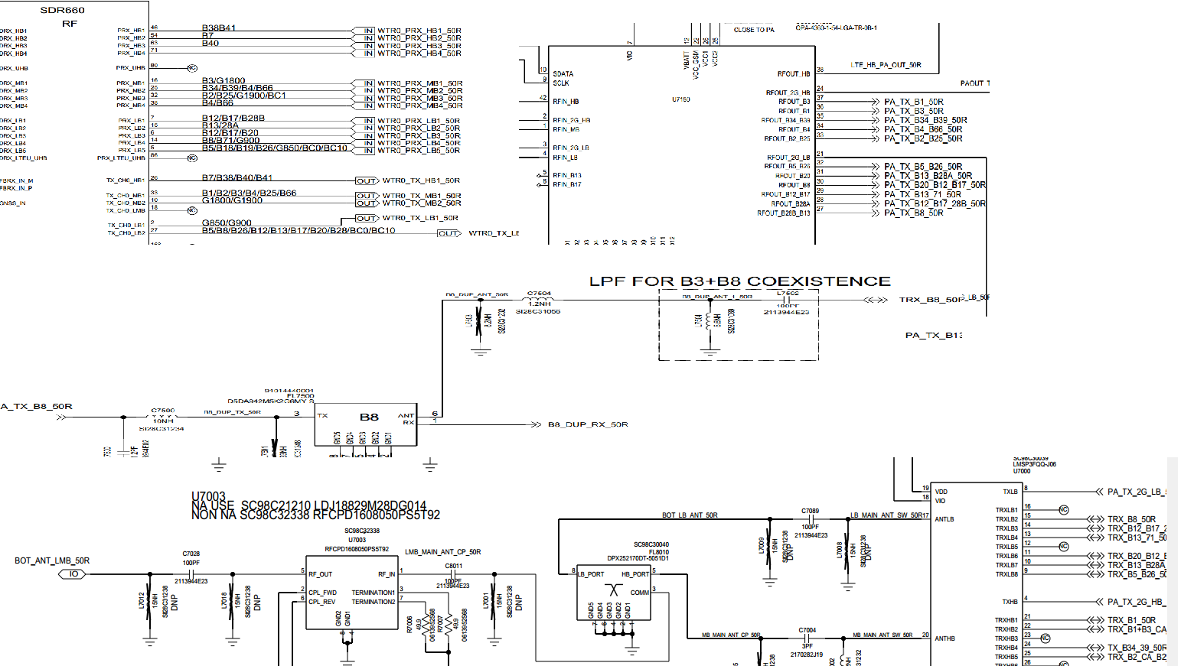
B8 TRx Circuit(ALL SKU)

Slide 80
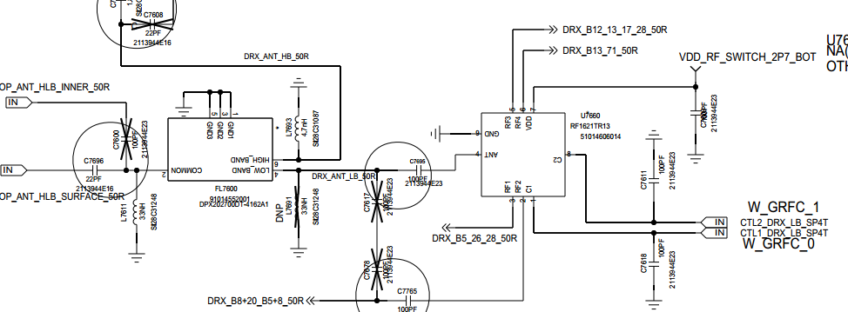
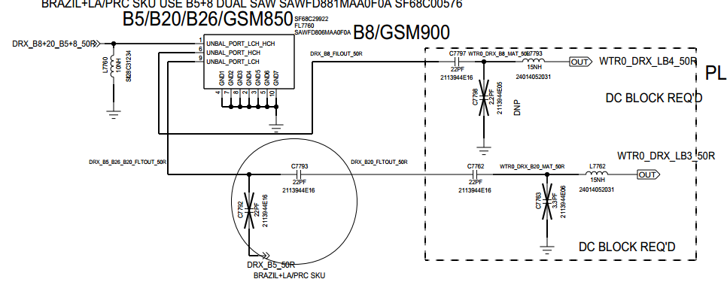
B8 DRx Circuits(ALL SKU)

Slide 81
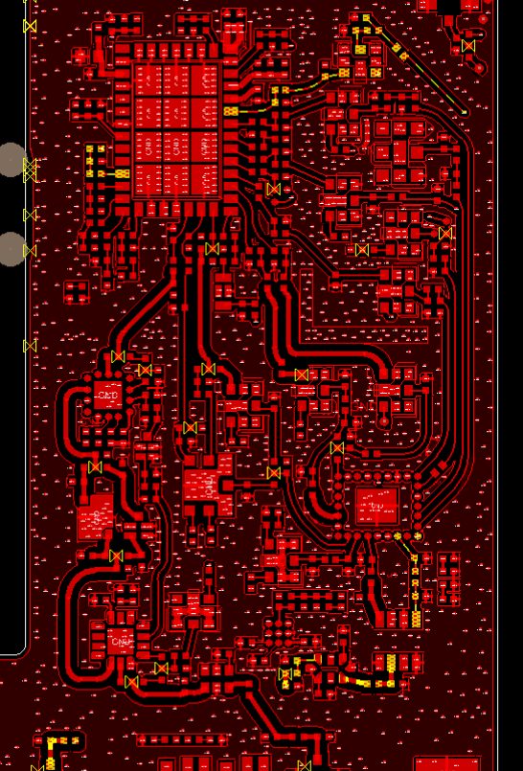
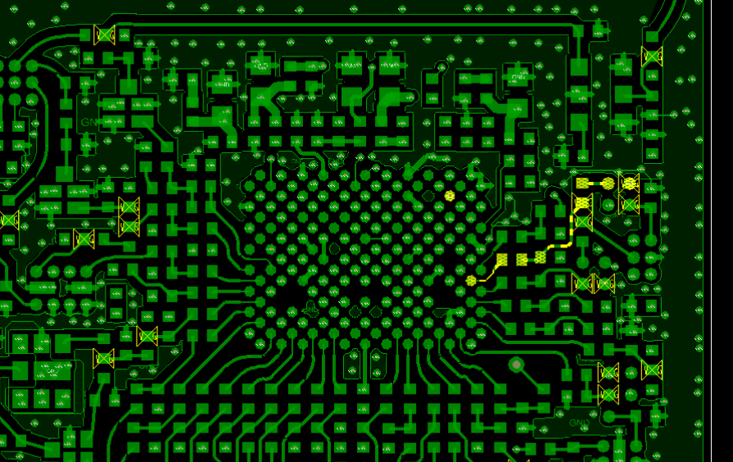
B8 Primary layout

Slide 82
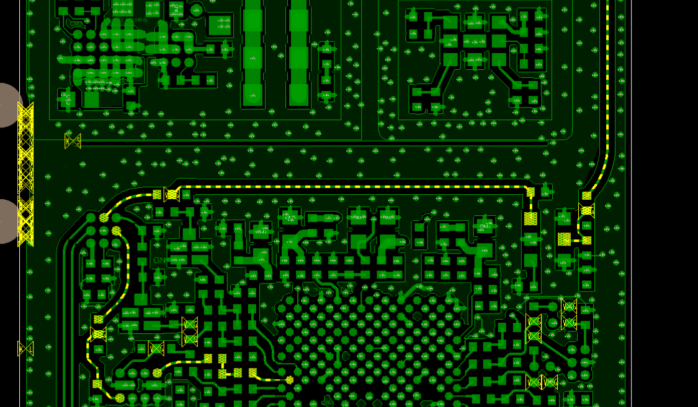
B8 Div

Slide 83
LTE 12/17 Tx and Rx

Slide 84
LTE 12/17 Tx Check Chart(LATAM) – No Tx
START
SDR660Voltage CHECK ?
FAIL
CHECK & REPLACE
R3001,R3002,R3004,R3005,R3006
OK
TX SIGNAL CHECK?
FAIL
CHECK & REPLACE
C7195,C7125
OK
PA MODE & MATCH
CHECK?
FAIL
CHECK & REPLACE
U7150,L7471,C7470
OK
DUPLEXER & TXM
CHECK ?
FAIL
CHECK & REPLACE
FL7470,L7473,L7474,C7472,L7475,U7000,C7089,FL8010,C8011
OK
COUPLE R & RF CONNECTOR CHECK ?
FAIL
CHECK & REPLACE
U7003,C7028,C8000,L8000,J8000
OK
TX LEVEL
CHECK ?
FAIL
2
Go to TX CHECK CHART- Low TX
OK
END

Slide 85
LTE 12/17 Tx Check Chart(LATAM) – Low Tx
2
OK
SDR660
TX Level
CHECK ?
FAIL
CHECK & REPLACE
C7115，C7125，L7120
OK
PAM GAIN & DPX LOSS
CHECK ?
FAIL
CHECK & REPLACE
U7150,L7471,C7470,FL7470,L7473,L7474,C7472,L7475,
OK
TXM LOSS
CHECK ?
FAIL
CHECK & REPLACE
U7000,C7089,FL8010,C8011
OK
COUPLER & RF CONNECTOR
CHECK
FAIL
CHECK & REPLACE
U7003,C7028,C8000,L8000,J8000
OK
END

Slide 86
LTE 12/17 PRx Check Chart(LATAM)
START
XO Frequency
CHECK ?
FAIL
CHECK & REPLACE
Y2000
OK
SDR660 Voltage CHECK ?
FAIL
CHECK & REPLACE
R3001,R3002,R3004,R3005,R3006
OK
DPX & MATCHING CHECK ?
FAIL
CHECK & REPLACE
FL7470,L7475,C7472,L7474,L7473
OK
SDR660, COUPLER,
RF CON. CHECK ?
CHECK & REPLACE
U7003,C7028,C8000,L8000,J8000
FAIL
OK
OK
END

Slide 87
LTE 12/17 DRx Check Chart(LATAM)
START
XO Frequency
CHECK ?
FAIL
CHECK & REPLACE
Y2000
OK
SDR660 Voltage CHECK ?
FAIL
CHECK & REPLACE
R3001,R3002,R3004,R3005,R3006
OK
Filter & MATCHING CHECK ?
FAIL
CHECK & REPLACE
FL7750,C7750,L7751,L7757,C777,C7784,L7784
OK
SP6T,CON CHECK ?
CHECK & REPLACE
C7696，FL7600，U7660，C7695,C7765
FAIL
OK
OK
END

Slide 88
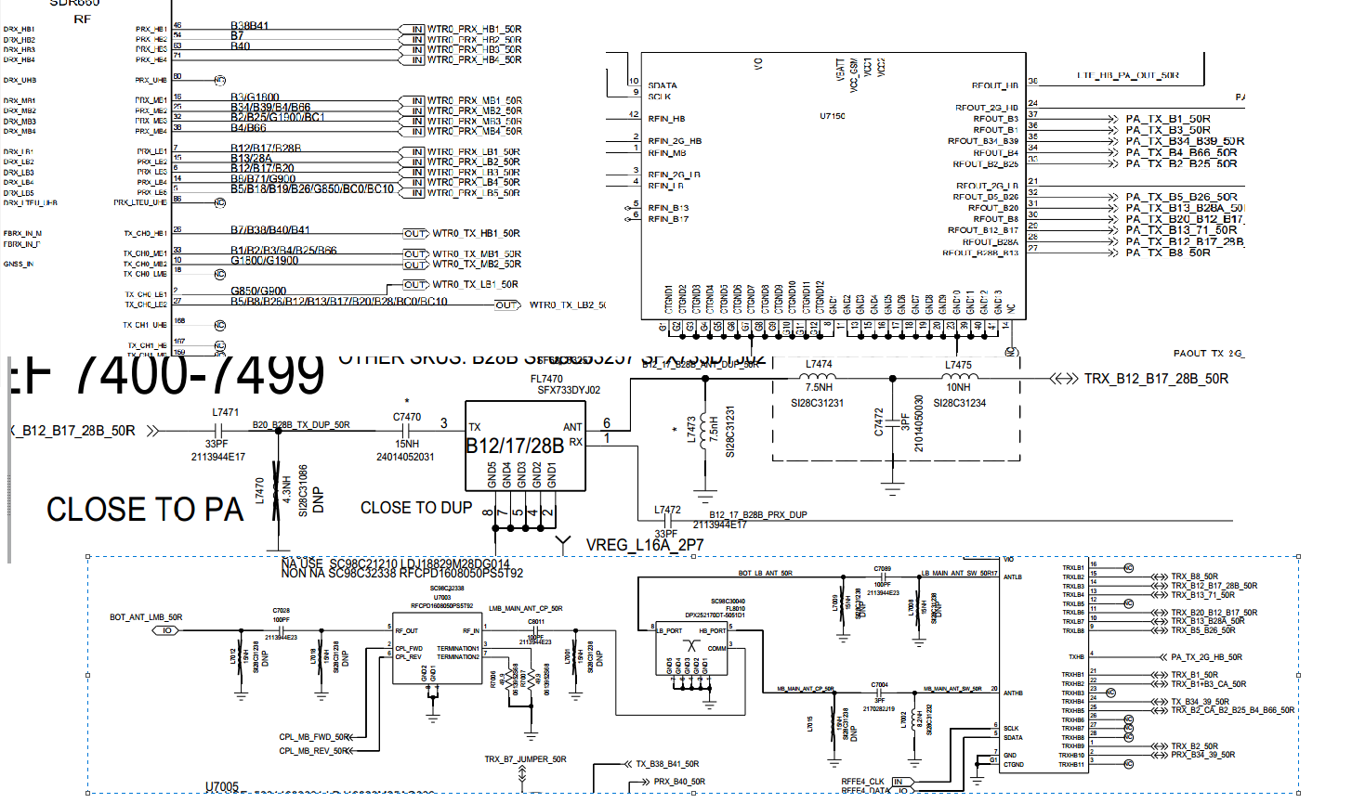
B12/17 TRx Circuit(LATAM)

Slide 89
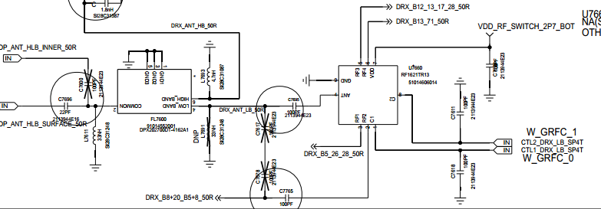
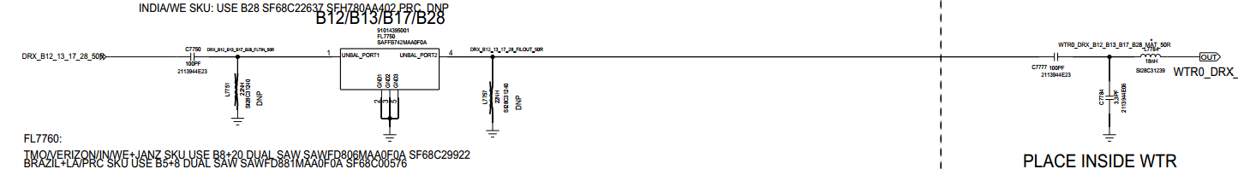
B12/17 DRx Circuits(LATAM)

Slide 90
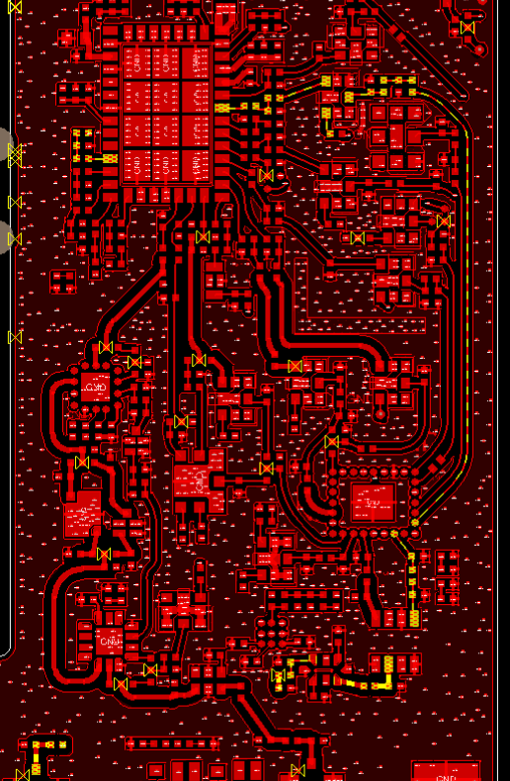
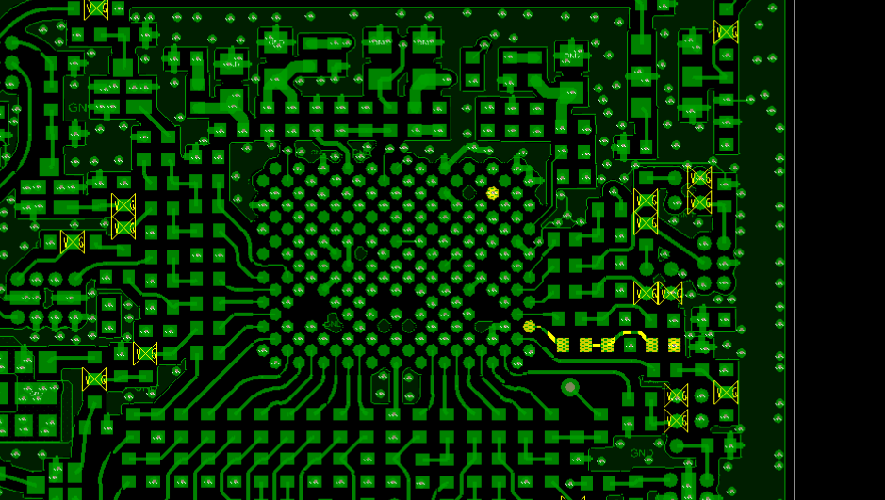
B12/17 TX+PRX Layout

Slide 91
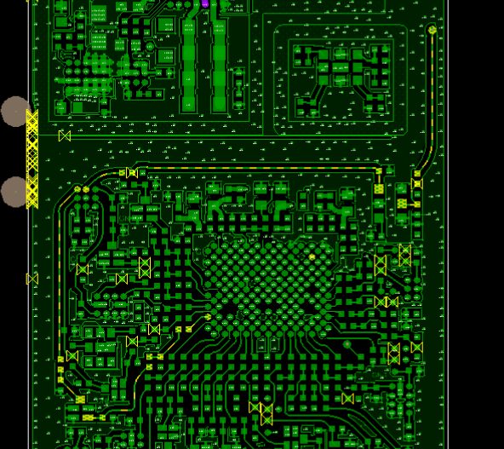
B12 DRX(LATAM)

Slide 92
LTE 20 Tx and Rx

Slide 93
LTE 20 Tx Check Chart(WE) – No Tx
START
SDR660Voltage CHECK ?
FAIL
CHECK & REPLACE
R3001,R3002,R3004,R3005,R3006
OK
TX SIGNAL CHECK?
FAIL
CHECK & REPLACE
C7195,C7125
OK
PA MODE & MATCH
CHECK?
FAIL
CHECK & REPLACE
U7150,C7411,L7430,C7430
OK
DUPLEXER & TXM
CHECK ?
FAIL
CHECK & REPLACE
FL7430,L7434,C7433,U7000,C7089,FL8010,C8011
OK
COUPLE R & RF CONNECTOR CHECK ?
FAIL
CHECK & REPLACE
U7003,C7028,C8000,L8000,J8000
OK
TX LEVEL
CHECK ?
FAIL
2
Go to TX CHECK CHART- Low TX
OK
END

Slide 94
LTE 20 Tx Check Chart(WE) – Low Tx
2
OK
SDR660
TX Level
CHECK ?
FAIL
CHECK & REPLACE
C7115，C7125，L7120
OK
PAM GAIN & DPX LOSS
CHECK ?
FAIL
CHECK & REPLACE
U7150,C7411,L7430,C7430,FL7430,L7434,C7433
OK
TXM LOSS
CHECK ?
FAIL
CHECK & REPLACE
U7000,C7089,FL8010,C8011
OK
COUPLER & RF CONNECTOR
CHECK
FAIL
CHECK & REPLACE
U7003,C7028,C8000,L8000,J8000
OK
END

Slide 95
LTE 20 PRx Check Chart(WE)
START
XO Frequency
CHECK ?
FAIL
CHECK & REPLACE
Y2000
OK
SDR660 Voltage CHECK ?
FAIL
CHECK & REPLACE
R3001,R3002,R3004,R3005,R3006
OK
，PX & MATCHING SP3T CHECK ?
FAIL
CHECK & REPLACE
FL7430,L7434,C7433,L7432,C7451,L7453
OK
SDR660, COUPLER,
RF CON. CHECK ?
CHECK & REPLACE
U7003,C7028,C8000,L8000,J8000
FAIL
OK
OK
END

Slide 96
LTE 20 DRx Check Chart(WE)
START
XO Frequency
CHECK ?
FAIL
CHECK & REPLACE
Y2000
OK
SDR660 Voltage CHECK ?
FAIL
CHECK & REPLACE
R3001,R3002,R3004,R3005,R3006
OK
Filter & MATCHING CHECK ?
FAIL
CHECK & REPLACE
FL7760,L7760,C7793,C7762,L7762
OK
SP6T,CON CHECK ?
CHECK & REPLACE
C7696,FL7600,C7695,U7660,C7765
FAIL
OK
OK
END

Slide 97
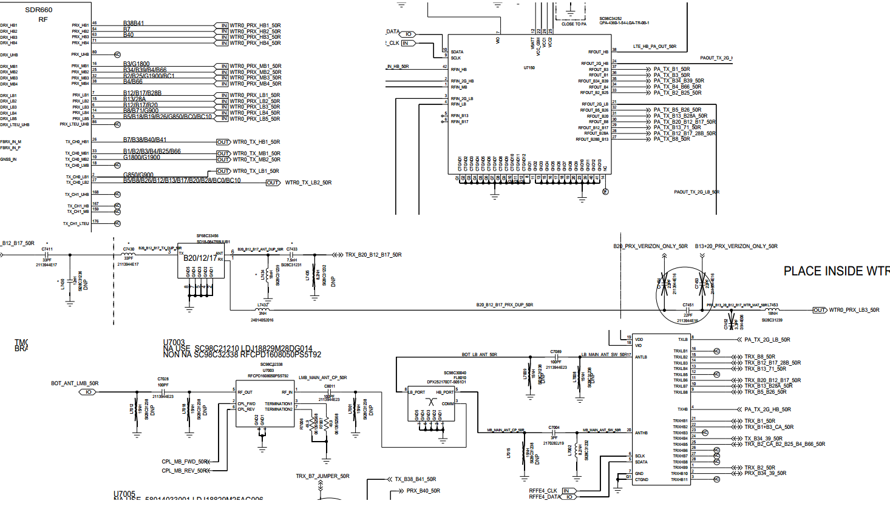
B20 TRx Circuit(WE)

Slide 98
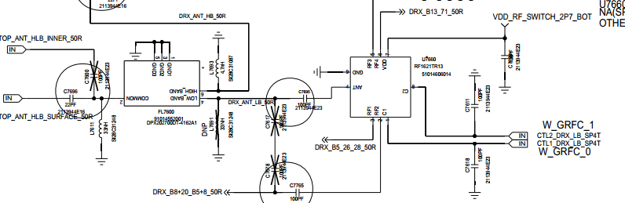
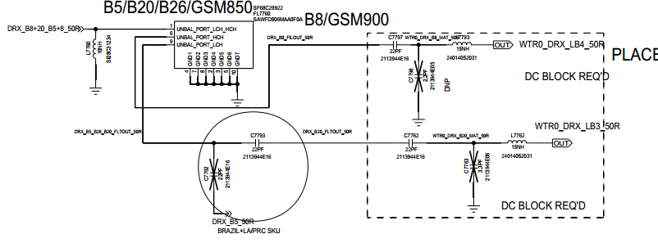
B20 DRx Circuits(WE)

Slide 99
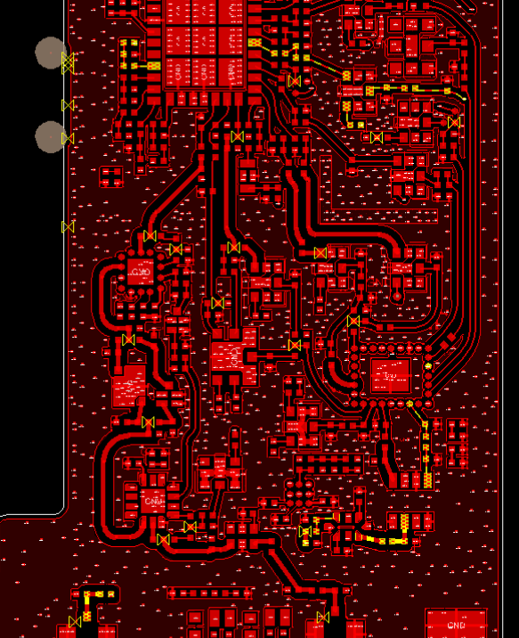
B20 TX+PRX Layout

Slide 100
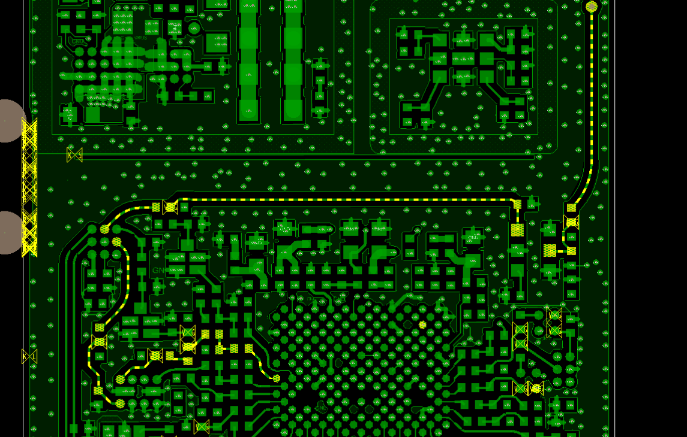
B20 Div

Slide 101
LTE 28A Tx and Rx

Slide 102
LTE 28A Tx Check Chart(ALL SKU) – No Tx
START
SDR660Voltage CHECK ?
FAIL
CHECK & REPLACE
R3001,R3002,R3004,R3005,R3006
OK
TX SIGNAL CHECK?
FAIL
CHECK & REPLACE
C7195,L7120,C7125
OK
PA & PA MATCH CHECK?
FAIL
CHECK & REPLACE
U7150,L7450,C7450
OK
DUPLEXER & TXM
CHECK ?
FAIL
CHECK & REPLACE
FL7450,C7400,C7440, L7403,U7000
OK
Diplexer&COUPLE R & RF CONNECTOR CHECK ?
FAIL
CHECK & REPLACE
C7089,FL8010,U7003,C7089,C8011,C7028,C8000,J8000
OK
TX LEVEL
CHECK ?
FAIL
2
Go to TX CHECK CHART- Low TX
OK
END

Slide 103
LTE 28A Tx Check Chart(ALL SKU) – Low Tx
2
OK
SDR660
TX Level
CHECK ?
FAIL
CHECK & REPLACE
C7195，C7125，L7120
OK
PAM GAIN & DPX LOSS
CHECK ?
FAIL
CHECK & REPLACE
U7150,L7450，L7451，C7450，FL7450,C7400，L7406，C7440，L7442，L7403
OK
TXM LOSS
CHECK ?
FAIL
U7000
OK
DIPLEXER&COUPLER & RF CONNECTOR
CHECK
FAIL
CHECK & REPLACE
C7089,FL8010,C8011,U7003,C7028,C8000,L8000,J8000
OK
END

Slide 104
LTE 28A PRx Check Chart(ALL SKU)
START
XO Frequency
CHECK ?
FAIL
CHECK & REPLACE
Y2000
OK
SDR660 Voltage CHECK ?
FAIL
CHECK & REPLACE
R3001,R3002,R3004,R3005,R3006
OK
，DPX & MATCHING SWITCH CHECK ?
FAIL
CHECK & REPLACE
L7402,C7407,C7402,L7452,FL7450,
C7400,L7406,C7440,L7442,L7403,U7000
OK
DIPLEXER&SDR660, COUPLER,
RF CON. CHECK ?
CHECK & REPLACE
C7089,FL8010,C8011,U7003,C7028,C8000,L8000,J8000
FAIL
OK
OK
END

Slide 105
LTE 28A DRx Check Chart(LATAM SKU)
START
XO Frequency
CHECK ?
FAIL
CHECK & REPLACE
Y2000
OK
SDR660 Voltage CHECK ?
FAIL
CHECK & REPLACE
R3001,R3002,R3004,R3005,R3006
OK
Filter & MATCHING CHECK ?
FAIL
CHECK & REPLACE
C7785,L7785,FL7785,L7755,C7779,C7778,C7773,L7773
OK
SP3T,CON CHECK ?
CHECK & REPLACE
U7660,C7695,FL7600,L7611,C7696,C8021,L8010,J8010
FAIL
OK
OK
END

Slide 106
LTE 28A DRx Check Chart(WE SKU)
START
XO Frequency
CHECK ?
FAIL
CHECK & REPLACE
Y2000
OK
SDR660 Voltage CHECK ?
FAIL
CHECK & REPLACE
R3001,R3002,R3004,R3005,R3006
OK
Filter & MATCHING CHECK ?
FAIL
CHECK & REPLACE
C7750,L7751,FL7750,L7757,C7777,C7784,L7784
OK
SP3T,CON CHECK ?
CHECK & REPLACE
U7660,C7695,FL7600,L7611,C7696,C8021,L8010,J8010
FAIL
OK
OK
END

Slide 107
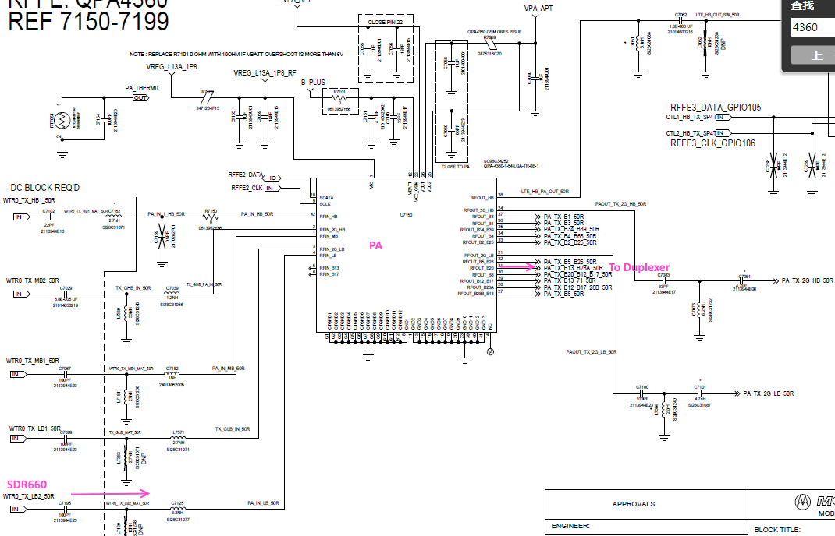




B28A TRx Circuit(ALL SKU)

Slide 108



B28A DRx Circuits(LATAM SKU)

Slide 109


B28A DRx Circuits(WE SKU)

Slide 110


B28A TX/PRX and DRX Layout LATAM SKU

Slide 111

B28A TX/PRX and DRX Layout WE SKU

Slide 112
LTE 28B Tx and Rx

Slide 113
LTE 28B Tx Check Chart(ALL SKU) – No Tx
START
SDR660Voltage CHECK ?
FAIL
CHECK & REPLACE
R3001,R3002,R3004,R3005,R3006
OK
TX SIGNAL CHECK?
FAIL
CHECK & REPLACE
C7195,L7120,C7125
OK
PA & PA MATCH CHECK?
FAIL
CHECK & REPLACE
U7150,L7471,C7470
OK
DUPLEXER & TXM
CHECK ?
FAIL
CHECK & REPLACE
FL7470,L7473,L7474, C7472,L7475,U7000
OK
Diplexer&COUPLE R & RF CONNECTOR CHECK ?
FAIL
CHECK & REPLACE
C7089,FL8010,U7003,C7089,C8011,C7028,C8000,J8000
OK
TX LEVEL
CHECK ?
FAIL
2
Go to TX CHECK CHART- Low TX
OK
END

Slide 114
LTE 28B Tx Check Chart(ALL SKU) – Low Tx
2
OK
SDR660
TX Level
CHECK ?
FAIL
CHECK & REPLACE
C7195，C7125，L7120
OK
PAM GAIN & DPX LOSS
CHECK ?
FAIL
CHECK & REPLACE
U7150,L7471,C7470,FL7470,L7473,L7474,C7472,L7475
OK
TXM LOSS
CHECK ?
FAIL
U7000
OK
DIPLEXER&COUPLER & RF CONNECTOR
CHECK
FAIL
CHECK & REPLACE
C7089,FL8010,C8011,U7003,C7028,C8000,L8000,J8000
OK
END

Slide 115
LTE 28B PRx Check Chart(ALL SKU)
START
XO Frequency
CHECK ?
FAIL
CHECK & REPLACE
Y2000
OK
SDR660 Voltage CHECK ?
FAIL
CHECK & REPLACE
R3001,R3002,R3004,R3005,R3006
OK
，DPX & MATCHING SWITCH CHECK ?
FAIL
CHECK & REPLACE
L7437,C7502,L7472,FL7470,L7473,
L7474,C7472,L7475,U7000
OK
DIPLEXER&SDR660, COUPLER,
RF CON. CHECK ?
CHECK & REPLACE
C7089,FL8010,C8011,U7003,C7028,C8000,L8000,J8000
FAIL
OK
OK
END

Slide 116
LTE 28B DRx Check Chart(LATAM SKU)
START
XO Frequency
CHECK ?
FAIL
CHECK & REPLACE
Y2000
OK
SDR660 Voltage CHECK ?
FAIL
CHECK & REPLACE
R3001,R3002,R3004,R3005,R3006
OK
Filter & MATCHING CHECK ?
FAIL
CHECK & REPLACE
C7750,L7751,FL7750,L7757,C7777,C7784,L7784
OK
SP3T,CON CHECK ?
CHECK & REPLACE
U7660,C7695,FL7600,L7611,C7696,C8021,L8010,J8010
FAIL
OK
OK
END

Slide 117
LTE 28B DRx Check Chart(WE SKU)
START
XO Frequency
CHECK ?
FAIL
CHECK & REPLACE
Y2000
OK
SDR660 Voltage CHECK ?
FAIL
CHECK & REPLACE
R3001,R3002,R3004,R3005,R3006
OK
Filter & MATCHING CHECK ?
FAIL
CHECK & REPLACE
C7750,L7751,FL7750,L7757,C7777,C7784,L7784
OK
SP3T,CON CHECK ?
CHECK & REPLACE
U7660,C7695,FL7600,L7611,C7696,C8021,L8010,J8010
FAIL
OK
OK
END

Slide 118



B28B TRx Circuit(ALL SKU)

Slide 119
B28B DRx Circuits(LATAM SKU)

Slide 120
B28B DRx Circuits(WE SKU)

Slide 121


B28B TX/PRX and DRX Layout LATAM SKU
duplexer
PA
Switch

Slide 122
B28B TX/PRX and DRX Layout WE SKU
duplexer
PA
Switch

Slide 123
LTE B7 Tx and Rx LATAM SKU

Slide 124
LTE B7 TX Check Chart – No TX(LATAM SKU)
START
SDR660 Voltage CHECK ?
FAIL
CHECK & REPLACE
R3001, R3002, R3004, R3005, R3006
OK
TX VOLTAGE CHECK?
FAIL
CHECK & REPLACE
R7901,R7101,R7102,C7055,C7080,R7059,C7001,C7019
OK
PA & PA MATCH CHECK?
FAIL
CHECK & REPLACE
C7102, C7162, R7150, U7150, C7062,C7156,C7157,C7202
OK
DUPLEXER & SW CHECK ?
FAIL
CHECK & REPLACE
FL7200,C7204
OK
COUPLE R & RF CON. CHECK ?
FAIL
CHECK & REPLACE
C7013, C7015, U7005, C7043,C8003, J8001
OK
TX LEVEL
CHECK ?
FAIL
2
Go to TX CHECK CHART- Low TX
OK
END

Slide 125
LTE B7 TX Check Chart – Low TX(LATAM SKU)
2
OK
SDR660
TX Level
CHECK ?
FAIL
CHECK & REPLACE
C7102,C7162,R7150
OK
PAM GAIN & DPX LOSS CHECK ?
FAIL
CHECK & REPLACE
U7150, L7051,C7062,C7156,C7157,C7202,FL7200,C7204,L7204
OK
SW LOSS
CHECK ?
FAIL
CHECK & REPLACE
U7001
OK
COUPLER & RF CONNECTOR
CHECK ?
FAIL
CHECK & REPLACE
C7013,C7015,L7005,U7005,C7043,C7071,C8003,L8001,J8001
OK
END

Slide 126
LTE B7 PRX Check Chart – (LATAM SKU)
START
XO Frequency
CHECK ?
FAIL
CHECK & REPLACE
R2009, C2006,Y2000
OK
SDR660 Voltage CHECK ?
FAIL
CHECK & REPLACE
R3001, R3002, R3004, R3005, R3006
OK
DPX & MATCHING CHECK ?
FAIL
CHECK & REPLACE
L7204,C7204,FL7200,C7208,C7207,R7201,L7205
OK
SW, COUPLER
RF CON. CHECK ?
CHECK & REPLACE
C7013,C7015,L7005,U7005,C7043,C7071,C8003,L8001,J8001
FAIL
OK
OK
END

Slide 127
LTE B7 DRX Check Chart – (LATAM SKU)
START
XO Frequency
CHECK ?
FAIL
CHECK & REPLACE
R2009, C2006,Y2000
OK
SDR660 Voltage CHECK ?
FAIL
CHECK & REPLACE
R3001, R3002, R3004, R3005, R3006
OK
FILTER & MATCHING CHECK ?
FAIL
CHECK & REPLACE
C7612,L7661,FL7660,C7663,C7662,R7681,L7663
OK
SW
RF CON. CHECK ?
CHECK & REPLACE
J8010,L8010,C8021,C7696,L7611,FL7600,L7693,C7608
FAIL
OK
OK
END

Slide 128




LTE B7 TRX Path for LATAM SKU

Slide 129


LTE B7 DRX Path for LATAM SKU

Slide 130


LTE B7 TRX Path for LATAM SKU

Slide 131
LTE B7 Tx and Rx WE/PRC SKU

Slide 132
LTE B7 TX Check Chart – No TX(WE/PRC SKU)
START
SDR660 Voltage CHECK ?
FAIL
CHECK & REPLACE
R3001, R3002, R3004, R3005, R3006
OK
TX VOLTAGE CHECK?
FAIL
CHECK & REPLACE
R7901,R7101,R7102,C7055,C7080,R7059,C7001,C7019
OK
PA & PA MATCH CHECK?
FAIL
CHECK & REPLACE
C7102, C7162,R7150,U7150,C7062,C7153,U7100,C71578,C7202
OK
DUPLEXER & SW CHECK ?
FAIL
CHECK & REPLACE
FL7200,C7204,L7204,C7011,U7001
OK
COUPLE R & RF CON. CHECK ?
FAIL
CHECK & REPLACE
C7057,L7006,U7005, C7043,C8003, J8001
OK
TX LEVEL
CHECK ?
FAIL
2
Go to TX CHECK CHART- Low TX
OK
END

Slide 133
LTE B7 TX Check Chart – Low TX(WE/PRC SKU)
2
OK
SDR660
TX Level
CHECK ?
FAIL
CHECK & REPLACE
C7102,C7162,R7150
OK
PAM GAIN & DPX LOSS CHECK ?
FAIL
CHECK & REPLACE
U7150, L7051,C7062,C7153,C7158,C7202,FL7200,C7204,L7204,C7011
OK
SW LOSS
CHECK ?
FAIL
CHECK & REPLACE
U7001
OK
COUPLER & RF CONNECTOR
CHECK ?
FAIL
CHECK & REPLACE
C7057,L7005,U7005,C7043,C7071,C8003,L8001,J8001
OK
END

Slide 134
LTE B7 PRX Check Chart – (WE/PRC SKU)
START
XO Frequency
CHECK ?
FAIL
CHECK & REPLACE
R2009, C2006,Y2000
OK
SDR660 Voltage CHECK ?
FAIL
CHECK & REPLACE
R3001, R3002, R3004, R3005, R3006
OK
DPX & MATCHING CHECK ?
FAIL
CHECK & REPLACE
L7204,C7204,FL7200,C7208,C7207,R7201,L7205
OK
SW, COUPLER
RF CON. CHECK ?
CHECK & REPLACE
C7011,U7001,C7057,L7005,U7005,C7043,C7071,C8003,L8001,J8001
FAIL
OK
OK
END

Slide 135
LTE B7 DRX Check Chart – (WE/PRC SKU)
START
XO Frequency
CHECK ?
FAIL
CHECK & REPLACE
R2009, C2006,Y2000
OK
SDR660 Voltage CHECK ?
FAIL
CHECK & REPLACE
R3001, R3002, R3004, R3005, R3006
OK
FILTER & MATCHING CHECK ?
FAIL
CHECK & REPLACE
C7606,L7661,FL7660,C7663,C7662,R7681,L7663
OK
SW
RF CON. CHECK ?
CHECK & REPLACE
J8010,L8010,C8021,C7696,L7611,FL7600,L7693,C7610,U7610
FAIL
OK
OK
END

Slide 136


LTE B7 TRX Path for WE/PRC SKU

Slide 137

LTE B7 DRX Path for WE/PRC SKU

Slide 138


LTE B7 TRX Path for WE/PRC SKU

Slide 139
TDD Band
TDD-LTE support Band38,Band40 and Band41.Band38 and Band41 have the shared path；

Slide 140
LTE B40 Tx and Rx

Slide 141
LTE B40 TX Check Chart – No TX(WE&PRC)
START
SDR660 Voltage CHECK ?
FAIL
CHECK & REPLACE
R3001, R3002, R3004, R3005, R3006
OK
TX VOLTAGE CHECK?
FAIL
CHECK & REPLACE
R7901,R7101,R7102,C7055,C7080,R7059,C7001,C7019
OK
PA & PA MATCH CHECK?
FAIL
CHECK & REPLACE
C7102, C7162,R7150,U7150,C7062,C7153,U7100,C7243,L7242
OK
SAW & SW CHECK?
FAIL
CHECK & REPLACE
FL7240,C7244,U7001
OK
COUPLE R & RF CON. CHECK ?
FAIL
CHECK & REPLACE
C7057,L7006,U7005, C7043,C8003, J8001
OK
TX LEVEL
CHECK ?
FAIL
2
Go to TX CHECK CHART- Low TX
OK
END

Slide 142
LTE B40 TX Check Chart – Low TX(WE/PRC SKU)
2
OK
SDR660
TX Level
CHECK ?
FAIL
CHECK & REPLACE
C7102,C7162,R7150
OK
PAM GAIN & DPX LOSS CHECK ?
FAIL
CHECK & REPLACE
U7150, L7051,C7062,C7153,
OK
SW LOSS
CHECK ?
FAIL
CHECK & REPLACE
U7100
,C7243,L7242,FL7240,C7244,U7001
OK
COUPLER & RF CONNECTOR
CHECK ?
FAIL
CHECK & REPLACE
C7057,L7006,U7005, C7043,C8003, J8001
OK
END

Slide 143
LTE B40 PRX Check Chart – (WE&PRC)
START
XO Frequency
CHECK ?
FAIL
CHECK & REPLACE
R2009, C2006,Y2000
OK
SDR660 Voltage CHECK ?
FAIL
CHECK & REPLACE
R3001, R3002, R3004, R3005, R3006
OK
SAW & MATCHING CHECK ?
FAIL
CHECK & REPLACE
C7211,L7210,FL7210,L7214,L7192,L7195,
OK
SW, COUPLER
RF CON. CHECK ?
CHECK & REPLACE
U7001,C7057,L7005,U7005,C7043,C7071,C8003,L8001,J8001
FAIL
OK
OK
END

Slide 144
LTE B40 DRX Check Chart – (WE&PRC)
START
XO Frequency
CHECK ?
FAIL
CHECK & REPLACE
R2009, C2006,Y2000
OK
SDR660 Voltage CHECK ?
FAIL
CHECK & REPLACE
R3001, R3002, R3004, R3005, R3006
OK
FILTER & MATCHING CHECK ?
FAIL
CHECK & REPLACE
C7620,L7621,FL7620,L7622,C7622,C7685,L7684
OK
SW
RF CON. CHECK ?
CHECK & REPLACE
J8010,L8010,C8021,C7696,L7611,FL7600,L7693,C7610,U7610
FAIL
OK
OK
END

Slide 145




B40 TX/PRX Circuit(WE&PRC)

Slide 146

B40 DRx Circuits(WE&PRC)

Slide 147


LTE B40 TRX Path for WE&PRC SKU

Slide 148
LTE B38/41 Tx and Rx

Slide 149
LTE B38/41 TX Check Chart – No TX(WE&PRC)
START
SDR660 Voltage CHECK ?
FAIL
CHECK & REPLACE
R3001, R3002, R3004, R3005, R3006
OK
TX VOLTAGE CHECK?
FAIL
CHECK & REPLACE
R7901,R7101,R7102,C7055,C7080,R7059,C7001,C7019
OK
PA & PA MATCH CHECK?
FAIL
CHECK & REPLACE
C7102, C7162,R7150,U7150,C7062,C7153,U7100,C7230,C7232,
OK
SAW & SW CHECK?
FAIL
CHECK & REPLACE
FL7230,L7251,C7231,U7001
OK
COUPLE R & RF CON. CHECK ?
FAIL
CHECK & REPLACE
C7057,L7006,U7005, C7043,C8003, J8001
OK
TX LEVEL
CHECK ?
FAIL
2
Go to TX CHECK CHART- Low TX
OK
END

Slide 150
LTE B38/41 TX Check Chart – Low TX(WE&PRC)
2
OK
SDR660
TX Level
CHECK ?
FAIL
CHECK & REPLACE
C7102,C7162,R7150
OK
PAM GAIN & DPX LOSS CHECK ?
FAIL
CHECK & REPLACE
U7150, L7051,C7062,C7153,
OK
SW LOSS
CHECK ?
FAIL
CHECK & REPLACE
U7100
,C7230,C7232,FL7230,L7251,C7231,U7001
OK
COUPLER & RF CONNECTOR
CHECK ?
FAIL
CHECK & REPLACE
C7057,L7006,U7005, C7043,C8003, J8001
OK
END

Slide 151
LTE B38/41 PRX Check Chart – (WE&PRC)
START
XO Frequency
CHECK ?
FAIL
CHECK & REPLACE
R2009, C2006,Y2000
OK
SDR660 Voltage CHECK ?
FAIL
CHECK & REPLACE
R3001, R3002, R3004, R3005, R3006
OK
SAW & MATCHING CHECK ?
FAIL
CHECK & REPLACE
C7330,C7332,FL7221,L7581,C7172,L7173,C7174,L7175
OK
SW, COUPLER
RF CON. CHECK ?
CHECK & REPLACE
U7001,C7057,L7005,U7005,C7043,C7071,C8003,L8001,J8001
FAIL
OK
OK
END

Slide 152
LTE B38/41 DRX Check Chart – (WE&PRC)
START
XO Frequency
CHECK ?
FAIL
CHECK & REPLACE
R2009, C2006,Y2000
OK
SDR660 Voltage CHECK ?
FAIL
CHECK & REPLACE
R3001, R3002, R3004, R3005, R3006
OK
FILTER & MATCHING CHECK ?
FAIL
CHECK & REPLACE
C7640,L7630,FL7630,L7631,C7632,L7632
OK
SW
RF CON. CHECK ?
CHECK & REPLACE
J8010,L8010,C8021,C7696,L7611,FL7600,L7693,C7610,U7610
FAIL
OK
OK
END

Slide 153





B38/41 TX/PRx Circuit

Slide 154



B38/41 DRx Circuits

Slide 155


LTE B38/41 TRx Path

Slide 156
GSM Section
Transmitter Path
GSM850/GSM900/DCS1800/PCS1900 PA are integrated into QPA4360 for Rio_H
Receiver Path
GSM850 Rx share the same path with WCDMA and LTE band5；GSM900 Rx share the same Rx path with WCDMA and LTE band8；
For LATAM&PRC SKU，G850&G900 use B5+B8 dual SAW while WE SKU use single B26 DRx to cover G850 and B8+B20 to cover G900；
PCS1900 share Rx path with WCDMA and LTE B2 which use B2 duplxer for LATAM SKU,
As PCS1900,DCS1800 share Rx path with LTE B3 which use B3 duplexer for LATAM SKU.
For other SKUs（WE and PRC）,DCS1800 share Rx path with B1+B3 quadplexer , PCS1900 share Rx path with B2 duplexer.

Slide 157
GSM PRX

Slide 158
GSM PRX Check Chart -(LATAM)
START
XO Frequency
CHECK ?
FAIL
CHECK & REPLACE
R2009, C2006
OK
SDR660 Voltage CHECK ?
FAIL
CHECK & REPLACE
R3001, R3002, R3004, R3005, R3006
OK
CHECK & REPLACE
G850:C7515,L7516,FL7510,C7512,C7513,L7515
G900:L7502,L7504,C7504,FL7500,C7539,C7540,C7527,L7522
DCS:C7355,L7380,FL7360,C7352,C7338,L7336
PCS:C7311,L7336,C7342,L7337,C7339,L7347,FL7340,L7191,C7345,L7346
DPX & MATCHING CHECK ?
FAIL
OK
TXM, COUPLER
RF CON. CHECK ?
CHECK & REPLACE
U7000,C7089,FL8010,C8011,U7003,C7028,C8000,L8000,J8000
FAIL
OK
OK
END

Slide 159
GSM PRX Check Chart -(WE&PRC)
START
XO Frequency
CHECK ?
FAIL
CHECK & REPLACE
R2009, C2006
OK
SDR660 Voltage CHECK ?
FAIL
CHECK & REPLACE
R3001, R3002, R3004, R3005, R3006
OK
CHECK & REPLACE
G850:C7515,L7516,FL7510,C7512,C7513,L7515
G900:L7502,L7504,C7504,FL7500,C7539,C7540,C7527,L7522
DCS:C7358,L7356,FL7370,L7361,C7353,C7338,L7336
PCS:C7307,L7337,C7339,L7347,FL7340,L7191,C7345,L7346
DPX & MATCHING CHECK ?
FAIL
OK
TXM, COUPLER
RF CON. CHECK ?
CHECK & REPLACE
U7000,C7089,FL8010,C8011,U7003,C7028,C8000,L8000,J8000
FAIL
OK
OK
END

Slide 160





GSM G850 / G900 PRX(ALL SKU)

Slide 161



GSM DCS PRX(LATAM)

Slide 162

GSM DCS PRX(WE/PRC)

Slide 163



GSM PCS PRX(LATAM)

Slide 164


GSM PCS PRX(WE/PRC)

Slide 165


G850/G900 PRX(ALL SKU)

Slide 166


DCS/PCS (LATAM)

Slide 167


DCS/PCS (WE&PRC)

Slide 168
GSM DRX

Slide 169
GSM LB DRX Check Chart
START
XO Frequency
CHECK ?
FAIL
CHECK & REPLACE
R2009, C2006
OK
SDR660 Voltage CHECK ?
FAIL
CHECK & REPLACE
R3001, R3002, R3004, R3005, R3006
OK
CHECK & REPLACE
LATAM: GSM850:C7765,L7760,FL7760,C7792,C7790,C7783,C7753,L7759
PRC:GSM850:L7760,FL7760,C7792,C7790,C7783,C7753,L7759
WE GSM850:C7785,FL7785,C7789,C7783,C7753,L7759
ALL SKU GSM900:C7765,L7760,FL7760,C7797,C7798,L7793
SAW & MATCHING CHECK ?
FAIL
OK
SW, COUPLER
RF CON. CHECK ?
CHECK & REPLACE
LATAM&WE:G850/G900:J8010,L8010,C8021,C7696,L7611,FL7600,C7695,U7660
PRC:G850/G900:J8010,L8010,C8021,C7696,L7611,FL7600,C7617,C7678
FAIL
OK
OK
END

Slide 170
GSM HB DRX Check Chart
START
XO Frequency
CHECK ?
FAIL
CHECK & REPLACE
R2009, C2006
OK
SDR660 Voltage CHECK ?
FAIL
CHECK & REPLACE
R3001, R3002, R3004, R3005, R3006
OK
CHECK & REPLACE
LATAM DCS:L7742,FL7710,C7721,C7704,L7705
LATAM PCS:L7700,C7700,FL7700,L7731,C7731,L7737
WE&PRC DCS:C7700,L7701,FL7700,C7731,C7732,L7737
WE&PRC PCS:L7742,L7743,FL7710,C7721,C7704,L7705
SAW & MATCHING CHECK ?
FAIL
OK
SW,
RF CON. CHECK ?
CHECK & REPLACE
ALL SKU
DCS/PCS:J7701,L7741,C7740,L7738,U7712
FAIL
OK
OK
END

Slide 171




GSM G850 / G900 DRX(LATAM&PRC)
LATAM
PRC

Slide 172



GSM G850 / G900 DRX(WE)
WE

Slide 173



GSM HB DRX LATAM

Slide 174


GSM HB DRX WE&PRC

Slide 175
GSM LB DRX

Slide 176


GSM DRX (LATAM SKU)

Slide 177

GSM DRX (WE SKU)

Slide 178


GSM DRX (PRC SKU)

Slide 179
GSM Low Band Tx Check Chart ALL SKU
START
SDR660 Voltage CHECK ?
FAIL
CHECK & REPLACE
R3001, R3002, R3004, R3005, R3006
OK
TX VOLTAGE CHECK?
FAIL
CHECK & REPLACE
R7901,R7101,R7102,C7055,C7080,R7059,C7001,C7019
OK
CHECK & REPLACE
C7099,L7571,U7150，C7100,L7384,C7101,U7000
PA&MATCH&SW CHECK ?
FAIL
OK
DIPLEXER&COUPLE R & RF CON. CHECK ?
FAIL
CHECK & REPLACE
C7089,FL8010,C8011,U7003,C7028,C8000,L8000,J8000
OK
TX LEVEL
CHECK ?
OK
END

Slide 180
GSM High Band Tx Check Chart ALL SKU
START
SDR660 Voltage CHECK ?
FAIL
CHECK & REPLACE
R3001, R3002, R3004, R3005, R3006
OK
TX VOLTAGE CHECK?
FAIL
CHECK & REPLACE
R7901,R7101,R7102,C7055,C7080,R7059,C7001,C7019
OK
CHECK & REPLACE
C7029,L7339,C7039,U7150，C7083,C7076,C7081,U7000
PA&MATCH&SW CHECK ?
FAIL
OK
DIPLEXER&COUPLE R & RF CON. CHECK ?
FAIL
CHECK & REPLACE
L7002,C7004,FL8010,C8011,U7003,C7028,C8000,L8000,J8000
OK
TX LEVEL
CHECK ?
OK
END

Slide 181



GSM Quad Band Tx Schematics ALL SKU

Slide 182


GSM Quad Band Tx

Slide 183
TDS Tx

Slide 184
TDS B34/B39 Tx check chart
2
OK
SDR660
TX Level
CHECK ?
FAIL
CHECK & REPLACE
C7067,C7182, L7181
OK
PAM GAIN & QPX LOSS
CHECK ?
FAIL
CHECK & REPLACE
U7150,C7320,C7321,FL7320,C7327
OK
TXM LOSS
CHECK ?
FAIL
CHECK & REPLACE
U7000
OK
COUPLER & RF CONNECTOR
CHECK
FAIL
CHECK & REPLACE
L7002,C7004,FL8010,C8011,U7003,C7028,C8000,L8000,J8000
OK
END

Slide 185
TDS B34/B39 PRx check chart
START
XO Frequency
CHECK ?
FAIL
CHECK & REPLACE
R2009, C2006
OK
SDR660 Voltage CHECK ?
FAIL
CHECK & REPLACE
R3001, R3002, R3004, R3005, R3006
OK
CHECK & REPLACE
B34:C7324,L7322,FL7350,C7359,C7376,L7373
B39:C7324,L7322,FL7350,C7421,C7354,L7353
SAW & MATCHING CHECK ?
FAIL
OK
TXM, COUPLER
RF CON. CHECK ?
CHECK & REPLACE
U7000,C7089,FL8010,C8011,U7003,C7028,C8000,L8000,J8000
FAIL
OK
OK
END

Slide 186
TDS B34/B39 DRX check chart
START
XO Frequency
CHECK ?
FAIL
CHECK & REPLACE
R2009, C2006
OK
SDR660 Voltage CHECK ?
FAIL
CHECK & REPLACE
R3001, R3002, R3004, R3005, R3006
OK
CHECK & REPLACE
B34:L7714,C7711,L7715,FL7715,C7705,C7702,L7707
B39:L7714,C7711,L7715,FL7715,C7713,C7715,L7712
SAW & MATCHING CHECK ?
FAIL
OK
SW,
RF CON. CHECK ?
CHECK & REPLACE
J7701,L7741,C7740,L7738,U7712
FAIL
OK
OK
END

Slide 187


TDS B34/B39 path layout

Slide 188




TDS B34/B39 Tx

Slide 189




TDS B34/B39 PRx

Slide 190


TDS B34/B39 DRx

Slide 191
GPS/WLAN/BT/FM/DTV
TROUBLESHOOTING

Slide 192
GPS TROUBLESHOOTING

Slide 193
GPS Troubleshoot Flow Chart
Start
GPS Voltage Check
Check VREG_L12A_1P8 and replace U2000 (PM660)
Ok
check the GPS eLNA enable
Ok
GPS Front/Inter-stage filter check
Check and replace FL7821/FL7822
Ok
External LNA gain check
Check and replace U7800
Ok
End

Slide 194




GPS Front End Block

Slide 195
WLAN / BT TROUBLESHOOTING

Slide 196
Bluetooth/WiFi power-on failure
  WLAN/BT power-on failure Symptoms:
      WLAN DL test firmware test commands fail
      Bluetooth power-on test commands fail

Slide 197
Step 1 for BT/Wi-Fi 2.4GHz power-on failure
  Check if the other functionality fails as well, e.g. check WLAN “power on” if Bluetooth can not be powered on. Check Bluetooth “power on” if WLAN can not be powered on.
  WLAN 2.4G and Bluetooth share the same IC and RF circuit, so if one of the BT/Wi-Fi fails, the other should fail as well. If only one of them fails, it is highly likely that it is not a hardware problem and it could just that the BT/Wi-Fi is turned on through the UI already and the test commands can not turn it on again.

Slide 198
Step 2 for BT/Wi-Fi power-on failure
  If both BT and WLAN fails, it is highly indicative of a hardware failure.
  Location of the Bluetooth and WLAN circuit (Shown on the next few pages)
  Check for any visible damage around the BT/WLAN antenna/IC area.

Slide 199


BT/2.4GWi-Fi & GPS Antenna Schematic

Slide 200

5GHz Wi-Fi Antenna Schematic

Slide 201


WCN3980 control and IO Schematic

Slide 202

Power supply Schematic

Slide 203


Power supply Schematic

Slide 204

BT/2.4GHz & 5GHz WiFi RF/Antenna Part placement

Slide 205
Step 3 for BT/Wi-Fi power-on failure
  If no visible damage can be seen, open up the shield and check for any visible damage on the IC and components. Look for misplaced or damaged components.

Slide 206

Debugging BT / WLAN Power-up Failure

Slide 207

Debugging BT / WLAN Power-up Failure

Slide 208

Debugging BT/WLAN low TX power

Slide 209
Bluetooth/WiFi TX/RX RF failure
  BT/Wi-Fi TX/RX RF failure
    Symptoms:
      Wi-Fi Radiated TX test value out of limits
      Bluetooth radiated TX test value out of limits
      Wi-Fi scan test fails
      Bluetooth ping test fails

Slide 210
Step 1 for BT/Wi-Fi TX/RX RF failure
  Look for visible damage of the BT/WiFi Antenna, Antenna Contacts and BT/WiFi circuits

Slide 211
Step 2 for BT/Wi-Fi TX/RX RF failure
  If there is no visible sign of antenna damage and antenna contacts damage, it's most likely something wrong in the BT/Wi-Fi chips or circuits.
  Open up the shield and look for misplaced or damaged RF front-end components. Please refer to the previous slide describing the layout of the WLAN circuit.
  It is recommended to probe the amplitude of the TX signal along the RF path to look for the failure component.

Slide 212
FM TROUBLESHOOTING

Slide 213

Debugging FM RSSI failure

Slide 214

Debugging FM RSSI failure

Slide 215


Slide 216



Slide 217


FM part placement/routing

Slide 218
CHARGING
TROUBLESHOOTING

Slide 219


Charging Path – Block Diagram
There are 2 charging path in RIO H.
Path_1 for normal charging with no-standard USB PD3.0 PPS AC adapter as blue line.
Path_2 for fast charging with inbox 27W standard PPS AC adapter as green line.
Path_1:
24 pin type C (J5001) ⇾ Ferrite (E5001)⇾ OVP IC U803 (AW33909) ⇾ Ferrite (E5010)⇾Charger IC (PM660, U2000⇾ Switch Regulator Circuit including L2400⇾ Battery FET (PM660, U2000) ⇾Sense RES(R2419)⇾ Battery connector (P510)
Path_2:
24 pin Type C (J5001) ⇾ Ferrite (E5001)⇾ OVP IC U803 (AW33909) ⇾ Ferrite (E5300)⇾Charger IC (BQ25970, U5300)⇾Sense RES(R2419)⇾ Battery connector (P510)
NOTE：
J5001/E5001/U803/R2419/P510 are shared by Path_1 & Path_2.

Slide 220


Charging Path – Schematics(Type C & OVP)
Input path shared by Path_1 & Path_2:
24 pin Type C (J5001) ⇾ Ferrite (E5001)⇾ OVP IC U803 (AW33909) ⇾

Slide 221

Charging Path – Schematics(main Path_1)
Path1
24 pin Type C (J5001) ⇾ Ferrite (E5001)⇾ OVP IC U803 (AW33909) ⇾
Ferrite (E5010)⇾Charger IC (PM660, U2000⇾ Switch Regulator Circuit including L2400⇾ Battery FET (PM660, U2000) ⇾Sense RES(R2419)⇾

Slide 222


Charging Path – Schematics(main Path_2)
Path2:
24 pin Type C (J5001) ⇾ Ferrite (E5001)⇾ OVP IC U803 (AW33909) ⇾
Ferrite (E5300)⇾Charger IC (BQ25970, U5300)⇾Sense RES(R2419)⇾
Section of PM660

Slide 223

Charging Path – Schematics(Battery Connector)
Battery connector shared by Path_1 & Path_2:
⇾ Battery connector (P510)

Slide 224



Charging Path – PCB Layout(Type C & OVP IC)
Input path shared by Path_1 & Path_2:
24 pin Type C (J5001) ⇾ Ferrite (E5001)⇾ OVP IC U803 (AW33909) ⇾
(Top View : E5001)
(Bottom View: Type C J5001)
(Bottom View:
OVP IC U803)

Slide 225

Charging Path_1 – PCB Layout(PM660)
Path1
24 pin Type C (J5001) ⇾ Ferrite (E5001)⇾ OVP IC U803 (AW33909) ⇾
Ferrite (E5010)⇾Charger IC (PM660, U2000⇾ Switch Regulator Circuit including LP2400⇾ Battery FET (PM660, U2000) ⇾
Top View:
Charger IC (PM660, U2000)
Top View:
Inductor LP2400
Top View:
Ferrite (E5010)

Slide 226
Charging Path_2 – PCB Layout(BQ25970 )
Path2:
24 pin Type C (J5001) ⇾ Ferrite (E5001)⇾ OVP IC U803 (AW33909) ⇾
Ferrite (E5300)⇾Charger IC (BQ25970, U5300)⇾Sense RES(R2419)⇾
(Bottom View:
BQ25970 U5300)
(Bottom View:E5300)

Slide 227

Charging Path – PCB Layout(Battery Connector.&R2419 )
Battery connector & R 2419 shared by Path_1 & Path_2:
Sense RES R2419⇾ Battery connector (P510)
(Bottom View:
Sense Res
R2419
(Bottom View:
Battery Connector P510

Slide 228

Charging Path_1 – Troubleshooting
In the event of charging issues :
1.Do visual inspection on type C USB connector, 24 pin connector, battery connector and battery pack.
2.Check charging voltages along the charging path.
Measure ‘USB_VBUS’ and ‘CHG_VBUS’ charger input voltage at E5001and E5010.
The voltage should be around 5V while charging.
Check ‘B_plus’ voltage at C2404 or LP2400. It should be higher than 2.1V and lower than 4.40V.
Check the battery voltage at R2419. It should be higher than 2.1V and lower than 4.45V. If the battery is below 2.1V, there maybe a short in the circuit somewhere and the battery protection circuit has been triggered.
3.Check battery thermistor
The thermistor is located in the battery pack.The test point
Battery temperature should be in the range of 0ºC ~ 45ºC to be fully charged. Check the thermistor voltage at the test point (BATT_THERM). It should be around 1.35V at room temperature (25ºC).
Top View:
Charger IC (PM660, U2000)
Top View:
Test Point for Thermistor

Slide 229
Charging Path_2 – Troubleshooting
In the event of charging issues :
1.Do visual inspection on type C USB connector, 24 pin connector, battery connector and battery pack.
2.Check charging voltages along the charging path.
Connect the 27W inbox charger to the main PCB with battery，the soc of the battery should less than 50%.
Measure ‘USB_VBUS’ and ‘CHG_VBUS’ charger input voltage at E5001and E5300.
The voltage should be more than 7.5V while charging.
Check the battery voltage at R2419. It should be higher than 2.1V and lower than 4.46V. If the battery is below 2.1V, there maybe a short in the circuit somewhere and the battery protection circuit has been triggered.
3.Check battery thermistor
The thermistor is located in the battery pack.The test point
Battery temperature should be in the range of 0ºC ~ 45ºC to be fully charged. Check the thermistor voltage at the test point (BATT_THERM). It should be around 1.35V at room temperature (25ºC).

Slide 230
ALL SENSORS
TROUBLESHOOTING

Slide 231

Light sensor and proximity sensor
Proximity and light sensor is soldered on a FPC and connect to main board by a B2B connector.

Slide 232
Light sensor and proximity sensor
Check the inspection of the sensor whether it was damaged in physical.
Check the rubber of the sensor whether it was assembled in the right place.
Measure the power of the sensor at C6196. It should be around 3.3V.
If the power is not correct, then check PM660L (U2400).
Measure the power of the sensor at C6198. It should be 1.8V.
If the power is not correct, then check PM660 (U2000).
Check the resistace and voltage of R1228,R1229 and R6190. Their resistance should be 2.2K 2.2K and 10K respectively, and their voltage should be around 1.8V.
If the power is not correct, then check PM660 (U2000).
Measure the I2C signal of the sensor at R6193 and R6194.
Resolder a new sensor to check the function if the I2C signal was right.
If nothing captured, Check AP side i2c interface.

Slide 233


Light sensor and proximity sensor
Inspection of sensor without rubber
Inspection of sensor with rubber

Slide 234

Acceleration sensor

Slide 235
Acceleration sensor
Measure the power of the sensor at C6151. It should be around 1.8V.
If the power is equal or close to 0 V. We should take off the sensor and measure the power again. In case a short circuit of the IC is presented.
Check PM660 if the power is still 0V.
Measure the SPI signal of the sensor at C6185 C6186 C6187 C6188.
Resolder a new sensor to check the function if the SPI signal was right.
If nothing captured, Check the Check AP side i2c interface.

Slide 236

Acceleration sensor

Slide 237
uSIM & VIBRATOR
TROUBLESHOOTING

Slide 238

SIM Path

Slide 239

SIM Schematic
SIM1&SIM2

Slide 240
SIM Path – Troubleshooting
In the event of SIM issues :
Do a through visual check on SIM connector J4200(for SIM1) & J4201 (for SIM2) for any sign of mechanical contact issues
Inspect all SIM circuit components on PCB
Do visual inspection on SIM slot
Check SIM power at R4204 or C4203/ VR4221(For SIM1) and R4205 or C4223/ VR4222(For SIM2)
Check SIM bus interface signal activities during SIM access (UIMx_RST, UIMx_CLK, UIMx_DATA)

Slide 241


Vibrator Schematics

Slide 242

Vibrator Layout

Slide 243
Debugging Vibrator Failure
1. Check and make sure that the vibrator is not damaged.
2. Check the signal across L5100/L5101 close to Vibrator connector, it should be a PWM signal.

Slide 244
SD
TROUBLESHOOTING

Slide 245

SD Card Schematics

Slide 246
SD Card
Check all the pins of the SD card connector whether they were soldered well.
Measure the voltage at C4222, it should be low (around 0V) when a sd card inserted, and high (around 1.8V) when no SD card inserted.
If the voltage is wrong, then check R4208 and SD card connector.
Measure the voltage at C4403, it should be around 2.95V when a SD card is inserted.
If the voltage is wrong, then check SD card connector and PM660L.
Measure all signals DATA0~DATA4, CLK and CMD through E4404 to E4409 with Oscilloscope.
If either of the signal was abnormal, then check the SD card connector and corresponding bead form E4404 to E4409.

Slide 247
DISPLAY & TOUCH
TROUBLESHOOTING

Slide 248

Structure
1080 x 1920 LCD
Touch control IC

Slide 249


Display connection

Slide 250

Schematic
LCM connector:

Slide 251

Schematic
LCD power supply from PM660L

Slide 252
Display & Touch panel Path – Troubleshooting
In the event of Dispay & Touch panel issues :
1.Do visual inspection on LCM & Touch panel, LCM & Touch connector, EMI filter.
2.Check LCM voltages along the Dispay panel path.
Measure LED_A voltage at C2445. It should be 10V~12V
Check LCD_VSP and LCD_VSN voltage at C2446 and C2448. It should be about 5.5V and -5.5V.
Check IOVCC voltage at C5628. It should be higher than 1.5V and lower than 2V.
3.Check Touch Panel voltages along the Touch panel path.
Check IOVCC voltage at C5628. It should be higher than 1.5V and lower than 2V.

Slide 253
CAMERA, DUAL CCT FLASH & LASER FOCUS
TROUBLESHOOTING

Slide 254

Rear Camera Schematic

Slide 255

Aux Camera Schematic

Slide 256

Front Camera Schematic

Slide 257


Rear / Aux / Front / Flash Camera PCB

Slide 258
Rear / Aux / Front Camera Troubleshooting
1.Reinstall Rear / Aux / Front camera module.
2.Replace Rear / Aux / Front camera module.
3.Do visual inspection on Rear / Aux / Front camera connector.
4.Check the voltage of AVDD, DVDD, DOVDD
Ø Measure AVDD for Rear camera at C5500, AVDD for Aux & Front camera at C5508. The voltage is around 2.8V .
Ø Measure DVDD for Rear camera at C5527. The voltage is around 1.05V.
Ø Measure DVDD for Aux & Front camera at C5513. The voltage is around 1.2V.
Ø Measure DOVDD for Rear&Aux&Front camera at C5581/C5582/C5588. The voltage is around 1.8V.
5. Check the Rear / Aux / Front camera MIPI pathway.
Ø Check Rear camera MIPI pathway through FL5570 & FL5571 & FL5572 & FL5573 & FL5574, make sure them have no solder or other issue.
Ø Check Aux camera MIPI pathway through FL5590 & FL5591 & FL5592, make sure them have no solder or other issue.
Ø Check Front camera MIPI pathway through FL5550 & FL5551 & FL5552 & FL5553 & FL5554, make sure them have no solder or other issue.

Slide 259


Flash&Laser Focus Schematic

Slide 260
Flash&Laser Focus Troubleshooting
Do visual inspection on Flash & Laser focus PCB to make sure the Flash LED SMT is OK.
Check the voltage of VDD_FLASH at C5503/C5504, the voltage should be in the range of 2.5V~5.5V .
Replace Flash LED .

Slide 261
AUDIO
TROUBLESHOOTING

Slide 262

Audio IC(CS47L35) Schematics

Slide 263


Slide 264



MIC/Speaker Schematics

Slide 265

Earphone Schematic

Slide 266
Debugging Audio Failure
1. Speaker
lCheck and make sure that the Speaker is not damaged.
lCheck if the connection between the phone and the Speaker are correctly done.
lCheck for any visible damage around the Speaker matching components.
2. MIC
lCheck and make sure that the MIC is not damaged.
lCheck for any visible damage around the MIC.
lCheck MIC_bias voltage is between 1.60 V and 2.85 V.

Slide 267
Debugging Audio Failure
3. Earphone
lCheck and make sure that Earphone jack is not damaged.
lCheck if the connection between the phone and the Earphone are correctly done.
lCheck for any visible damage around the Earphone jack.
lCheck for any visible damage around the U6250 and its matching components.

Slide 268
NOTE: This is a mandatory slide. Please include at the end of all presentations and remove this note.

Slide 271

































































