Slide 1
SPECIFICATION
FOR
APPROVAL
(●) Preliminary Specification
(●) Final Specification
Title | Customer Approval Sheet for Lenovo
Customer | Lenovo
Part Number | SD68C37284
SUPPLIER | BOE
MODEL | BS062FBM-L00-6801
Version | V0.0
SIGNATURE
DATE
APPROVED BY
DATE
/
REVIEWED BY
/
/
Please return 1 copy for your confirmation with
your signature and comments.
1/57

Slide 2
CONTENT LIST
No | ITEM | Page
 | COVER
 | CONTENTS
 | RECORD OF REVISIONS
1 | GENERAL DESCRIPTION
2 | ABSOLUTE MAXIMUM RATINGS
3 | ELECTRICAL SPECIFICATIONS
4 | OPTICAL CHARACTERISTICS
5 | MECHANICAL CHARACTERISTICS
6 | RELIABLITY TEST
7 | INTERNATIONAL STANDARDS
8 | PACKING
9 | INCOMING INSPECTION STANDARD
2/57

Slide 3
RECORD OF REVISIONS
Revision No. | Revision Date | Page | Description
V0.0 | 2018.10.09 | - | First release
3/57

Slide 4
1-1. GENERAL DESCRIPTION
Block Diagram
LCD Signal
TFT LCD
1080x2270
LCD Power
Input connector
LED Cathode
IC Himax 83112A
Output
Pin
LED Light Bar
LED Anode
Features
BS062FBM-L00-6801 is 6.235” color TFT-LCD (Thin Film Transistor Liquid Crystal Display) module composed of LCD panel, MIPI driver ICs, control circuit ,backlight and cover lens. By applying 8 bits digital data, 1080×
（ RGB ）×2270, 16.7M-color images are displayed on the 6.235”
diagonal screen
4/57

Slide 5
1-2. General Spec
No | Item | Specification | Unit | Remark
1 | Screen Size | 6.235 | inch
2 | Active Area | 68.04(H)x143.01(V) | mm
3 | Panel Size | 69.64(H)x147.21(V) | mm
4 | Outline Dimension | 70.04 (H)×147.86 (V)×1.33(TYP.) | mm | LCM
5 | Display Resolution | 1080(H) ×RGB×2270 (V) | pixel
6 | Pixel Pitch | 0.063*0.063 | um
7 | Display Method | Transmissive | -
8 | Display Mode | Normally Black | -
9 | Display Color | 16.7M | - | 8bits
10 | Color Gamut | 82 | % | Typ, center P
11 | Luminance | Typ 450;min 380 | nit | Typ, center P
12 | Contrast Ratio | Typ 1500;min 1000 | - | Typ, center P
13 | Viewing Angle | 80/80/80/80 | ° | CR>10(U/D/L/R)
14 | Pol Surface Treatment | HC | -
15 | Weight | 50 | g | max
16 | D-IC | Himax 83112A | -
17 | Inversion Method | Column
18 | LED Q’ty | 8S*2P | ea | String*Parallel
19 | Power Consumption | 960+153 | mw | Max. Backlight + Logic (White pattern)
5/57

Slide 6
1-3. Key Part List
 | item | Supplier | Spec/Size | Weight | Remark
Cell | TFT Glass | Asahi | 69.64* 147.21*0.15
 | C/F Glass | Asahi | 69.64* 145.11*0.15
 | Upper Pol | Sumitomo | 69.44*144.41×0.077 |  | HC
 | Lower Pol | Sumitomo | 69.74*144.66×0.101 |  | APF，Clear
 | Liquid Crystal | BOE | -
 | UV Glue | 3M | NOVEC 2704
 | D-IC | Himax | Hx83112A
 | ACF(COG) | Dexerials | CP518SC-18YA
 | ACF(FOG) | Dexerials | ACF_CP1220IS
 | COG Ass’y | BMDT | -
FPCA | FPC | Leader-tech | -
 | EMI coating | Fang Bang | HSF6000-2
 | Main Connector | Molex | 5055514020
 | LED lightbar CNT | BMDT | Soldering |  | CNT or soldering
 | Insulation Tape | Ji Da | 200625BL |  | On component
 | Conductive Tape | Mei Xin | MXCF-5000BF
 | Release film on conductive tape | Min Xinlong | YSPT505B
 | CNT Stiffener | - | SUS 304 0.15t
 | FPC Ass’y | Leader-tech | -
BLU | B/W tape | Nitto | 56606BKY
 | Upper Prism | 3M | ASOC4.0HH-LS
 | Lower Prism | - | -
 | Diffuser Sheet | LMS | SHBS-227C1
 | LGP | Sumitomo | TR1801A
 | Mold frame | Juvic | PC+SUS304
 | Double Tape | - | -
 | Reflector | 3M | ESR-80 V2
 | LED | Sui Jing | SJ-S304ZW20
 | LED Lightbar | ITEQ | HED Cu 2 LAYER T0.11
 | Copper foil | MEIXIN | MXCU-210-0003BF
 | BLU Ass’y | Austronic Electronic | -
Total | - | BOE | - | 46.5g | Typ.
6/57

Slide 7
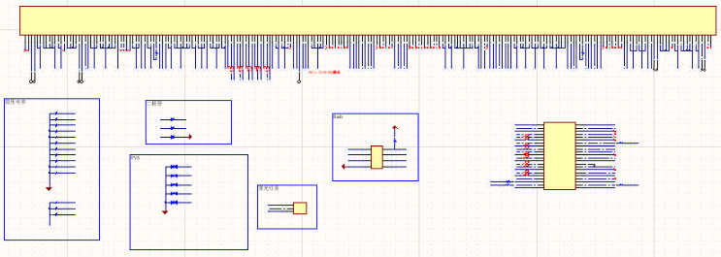
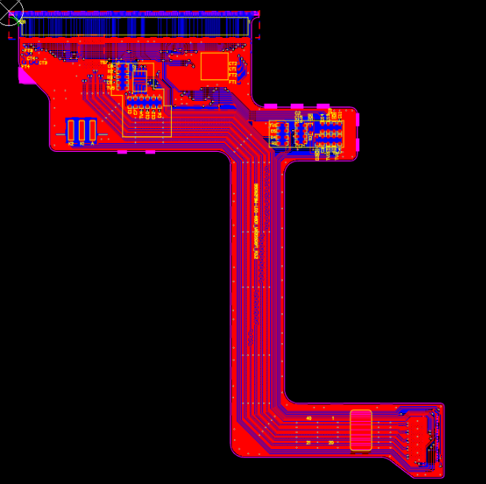
1-3-1. FPCA Gerber/Layout and Schematic Diagram
7/57

Slide 8
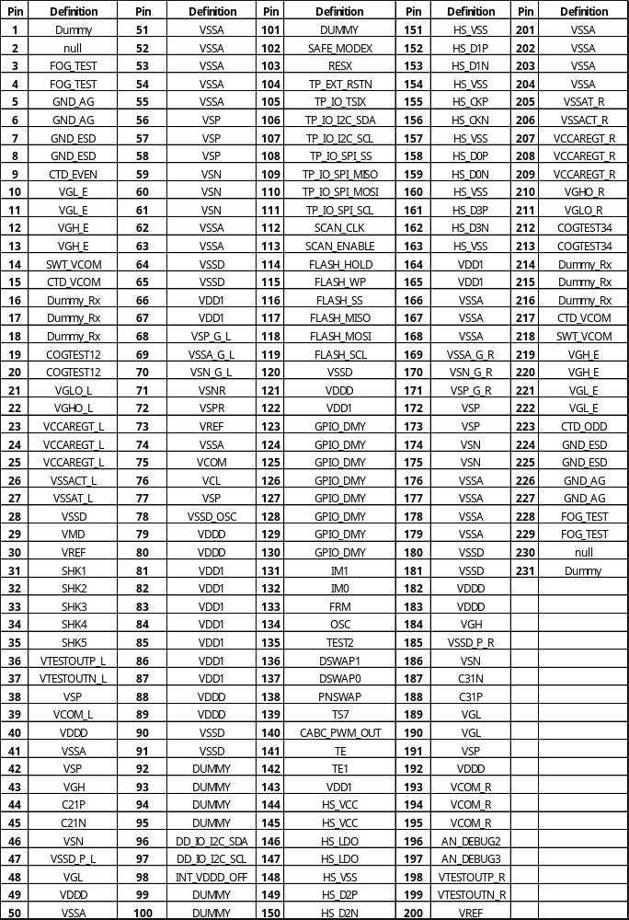
1-3-2. FPC Pin Assignment
8/57

Slide 9
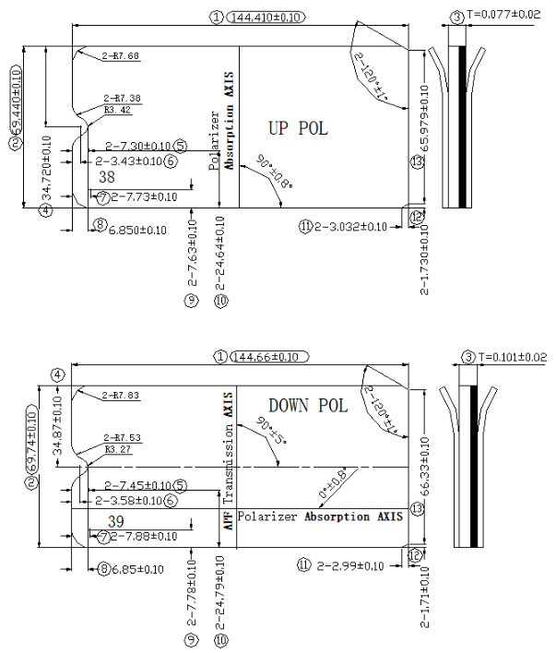
1-3-3. Pol General Spec
9/57

Slide 10
2-1. Absolute Maximum Ratings
The following are maximum values which, if exceeded, may cause faulty operation or damage to the unit.
Table 2.1 Absolute Maximum Ratings
Parameter | Symbol | Values |  | Units | Notes
 |  | Min | Max
LCD Analog Voltage | VSP | +5.4 | +6 | V
 | VSN | -5.4 | -6 | V
LCD I/O Voltage | IOVCC | +1.65 | +1.95 | V
LED Current | ILED | - | 25 | mA
Storage Humidity | Hstg | - | 90 | %RH
Storage Temperature | Tstg | -30℃ | 70 | ℃
10/57

Slide 11
3-1. ELECTRICAL CHARACTERISTICS
Table 3.1 Electrical Characteristics Of TFT-LCD Module
Parameter |  | Symbol | Values |  |  | Units | Notes
 |  |  | Min | Typ | Max
LCD Input Analog Voltage |  | VSP-Vss | 5.4 | 5.5 | 6 | V
 |  | VSN-Vss | -5.4 | -5.5 | -6 | V
LCD Logic I/O Voltage |  | IOVCC-Vss | 1.65 | 1.8 | 1.95 | V
LED Input Current |  | I_{LED} |  | 20 | 25 | mA
“H” Level Input Voltage |  | V_{IH} | 0.8IOVCC | - | IOVCC | V
“L” Level Input Voltage |  | V_{IL} | 0 | - | 0.2IOVCC | V
“H” Level Output Voltage |  | V_{OH} | 0.8IOVCC | - | IOVCC | V
“L” Level Output Voltage |  | V_{OL} | 0 | - | 0.2IOVCC | V
Input high level leakage current |  | I IH | - | - | 1 | µA | Applicable Pin： REST H ：IOVCC L ：Vss
Input low level leakage current |  | I IL | 1 | - | - | µA
LCD Power Consumption | Normal | P_{N} | 138 | 143 | 153 | mW | 1
 | Sleep in | P_{D} | 645 | 675 | 708 | uW
 | BLU | P_{B} | - | 928 | 960 | mW | 2
Notes:
(1) The specified current and power consumption are under the conditions at VSP = 5.5V,VSN=-5.5V,IOVCC = 1.8V, T = 25°C, and fv = 60 Hz, at white pattern (TYP)
The specified current and power consumption are under the conditions at VSP = 5.5V,VSN=-5.5V,IOVCC = 1.8V, T = 25°C, and fv = 60 Hz, at R/G/B pattern (MAX)
(2) LED Backlight assumptions: 24 Vf(MAX), 40 mA. (8S2P LED Total Input )
3-2. Logic Power Consumption
Parameter | Symbol | Values |  | Units | Notes
 |  | Typ | Max
Normal Mode | I_{IOVCC} | 29.08 | 30 | mA | White Pattern
 | I_{Vsp} | 10.16 | 11 | mA
 | I_{Vsn} | 6.44 | 7 | mA
Sleep Mode | I_{IOVCC} | 199 | 220 | uA
 | I_{Vsp} | 40 | 43 | uA
 | I_{Vsn} | 18 | 20 | uA
11/57

Slide 12
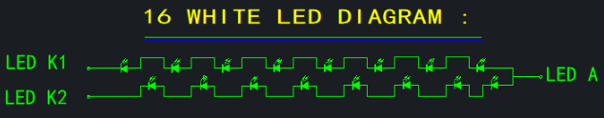
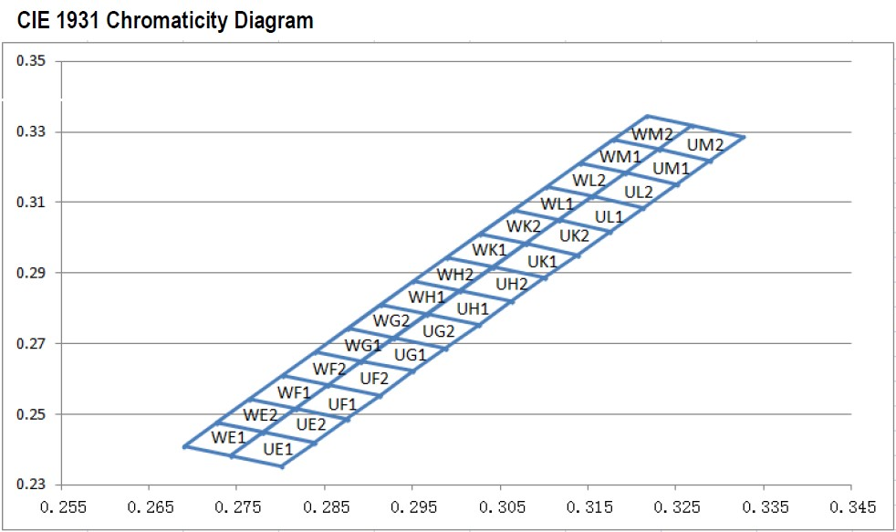
3-3. BACK LIGHT UNIT
3-3-1 The edge-lighting type of back light unit consists of 16 LEDs which is connected in serial.
Table 2-3-1 Electrical Characteristics Of Back Light Unit
Parameter | Symbol | Values |  |  | Units | Notes
 |  | Min | Typ. | Max
LED Current | I_{LED} | - | 20 | 25 | mA
LED Forward Voltage | V_{LED} | - | 2.9 | 3.0 | V
3-3-2 LED Rank
Luminous Flux Rank Chart
BIN CODE | MIN Unit：mcd | MAX Unit：mcd | TEST CONDITION
37 | 3000 | 3100 | IF=20mA
38 | 3100 | 3200
Color Rank Chart
Color Rank | UL1 | UK2
12/57

Slide 13
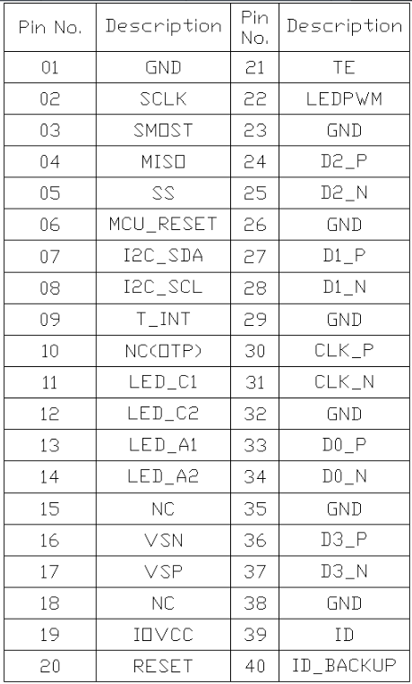
3-4. LCD INTERFACE CONNECTIONS
Interface Connector: : Molex 5055514020
Table 3.4 LCD Connector Pin Configuration
13/57

Slide 14
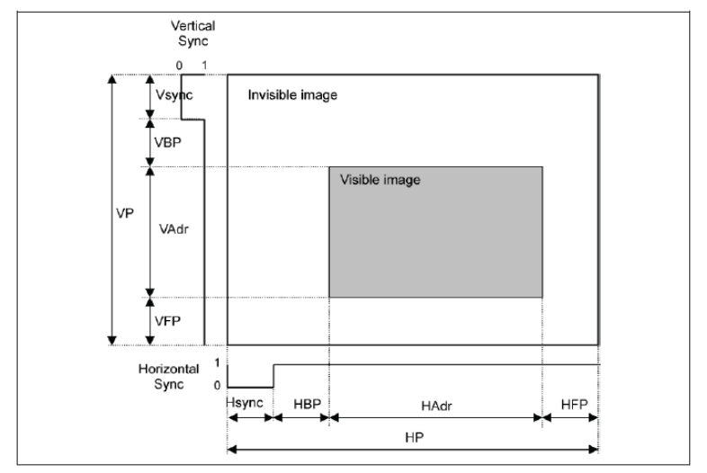
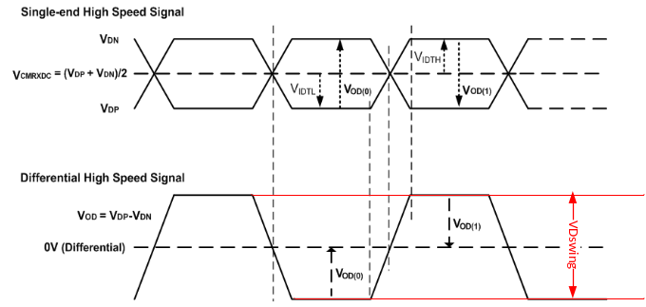
3-5. SIGNAL TIMING SPECIFICATIONS
ITEM |  |  | SYNBOL | Timing | UNIT
LCD | Frame Rate |  | - | 60 | Hz
Timing | DCLK | Frequency | fCLK | 160 | MHz
 |  | Period | Tclk | 6.25 | ns
 | Horizontal | Horizontal total time | tHP | 1152 | t_{CLK}
 |  | Horizontal Active time | tHadr | 1080 | t_{CLK}
 |  | Horizontal Pulse Width | tHsync | 24 | t_{CLK}
 |  | Horizontal Back Porch | tHBP | 24 | t_{CLK}
 |  | Horizontal Front Porch | tHFP | 24 | t_{CLK}
 | Vertical | Vertical total time | tvp | 2324 | t_{H}
 |  | Vertical Active time | tVadr | 2270 | t_{H}
 |  | Vertical Pulse Width | tVsync | 5 | t_{H}
 |  | Vertical Back Porch | tVBP | 7 | t_{H}
 |  | Vertical Front Porch | tVFP | 42 | t_{H}
Differential Swing |  |  | VDswing | 200 | mV
Bit Rate |  |  | TX SPD(MBPS) | 963 | Mbps
Pixel Fomat |  |  |  | 24 | Data bit/pixel
Lane |  |  |  | 4 | Lane
14/57

Slide 15
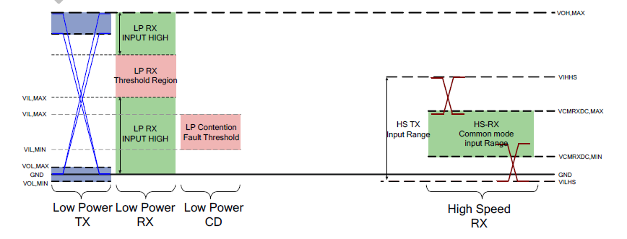
3-6. MIPI Data&CLK Line Impedance Test Result
(a) MIPI interface DC characteristic：
Item |  | Parameter | Min. | Typ. | Max. | Unit
LP_TW | Thevenin output high level | VOH | 1.1 | 1.2 | 1.3 | V
 | Thevenin output low level | VOL | -50 |  | 50 | mV
 | Output impedance of LP transmitter | ZOLP | 110 | - | - | Ω
HS_RX | Common-mode voltage HS receive mode | VCMRX(DC) | 70 | － | 330 | mV
 | Differential input high threshold | VIDTH | － | － | 70 | mV
 | Differential input low threshold | VIDTL | -70 | － | － | mV
 | Single-ended input high voltage | VIHHS | － | － | 460 | mV
 | Single-ended input low voltage | VILHS | -40 | － | － | mV
 | Single-ended threshold for HS termination enable | VTERM-EN | － | － | 450 | mV
 | Differential input impedance | ZID | 80 | 100 | 125 | Ω
LP_RX | Logic 1 input voltage | VIH | 880 | － | － | mV
 | Logic 0 input voltage. not in ULPState | VIL | － | － | 550 | mV
 | Input hysteresis | VHYST | 25 | － | － | mV
LP_CD | Logic 1 contention threshold | VIHCD | 450 | － | － | mV
 | Logic 1 contention threshold | VILCD | － | － | 200 | mV
15/57

Slide 16
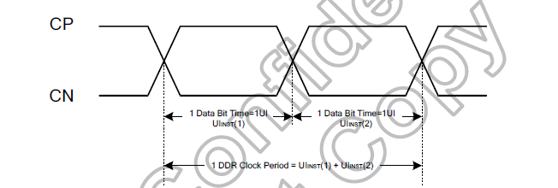
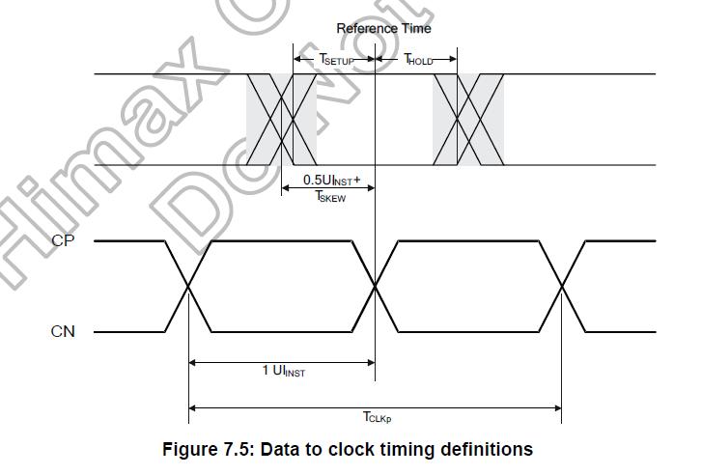
(b) MIPI data to clock timing definitions
Clock Parameter | Symbol | Min | Typ. | Max. | Unit
UI instantaneous | UI INST | 0.83 | － | 12.5 | ns
Data to Clock Setup Time [Receiver] | T SETUP [RX] | 0.15 | － | 0.85 | UI INST
Clock to Data Hold Time [Receiver] | T HOLD[RX] | 0.15 | － | 0.85 | UI INST
Data to Clock Skew (Measured at transmitter) | T SKEW [TX] | -0.15 | － | 0.15 | －
Note: (1) This value corresponds to a minimum 80 Mbps/lane data rate.
(2) The minimum UI shall not be violated for any single bit period, i.e., any DDR half cycle within a data burst.
(3) Maximum total bit rate is 4.8Gbps of at 24-bit data format /3.6Gbps at 18-bit data format / 3.2Gbps at 16-bit data
format.
16/57

Slide 17
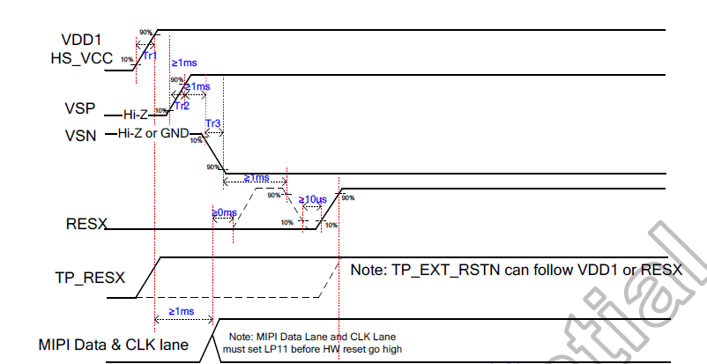
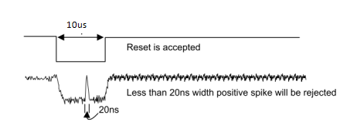
(2)Reset Input Timing
Symbol | Parameter | Pad | Min. | Typ. | Max. | Unit | Note
tRESW | Reset low pulse width | RESX | 10 |  |  | us
tREST | Reset completion time | RESX |  |  | 50 | ms | Reset during Sleep In mode
 |  | RESX |  |  | 120 |  | Reset during Sleep Out mode
RESX Pulse | Action
Shorter than 5us | Reset Rejected
Longer than 10us | Reset
Between 5us and 10us | Reset Start
*5) It is necessary to wait for 50msec after releasing RESX before sending commands
17/57

Slide 18
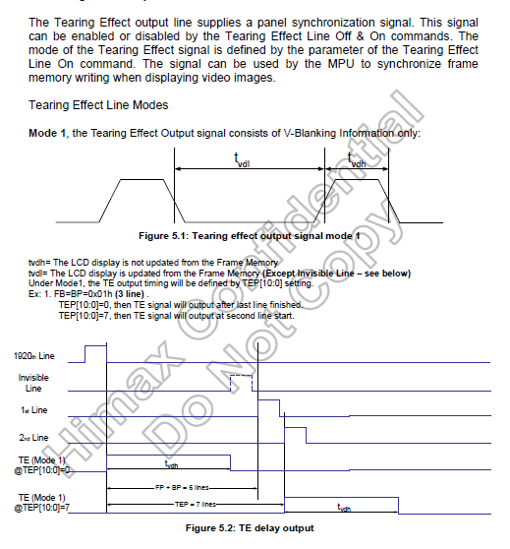
(3)TE
Tearing effect output line
18/57

Slide 19
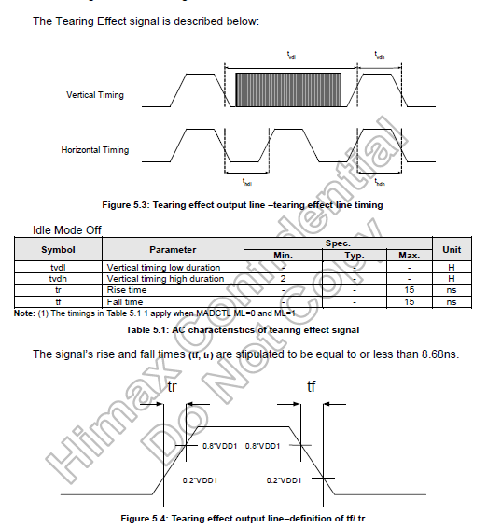
Tearing effect line timing
19/57

Slide 20
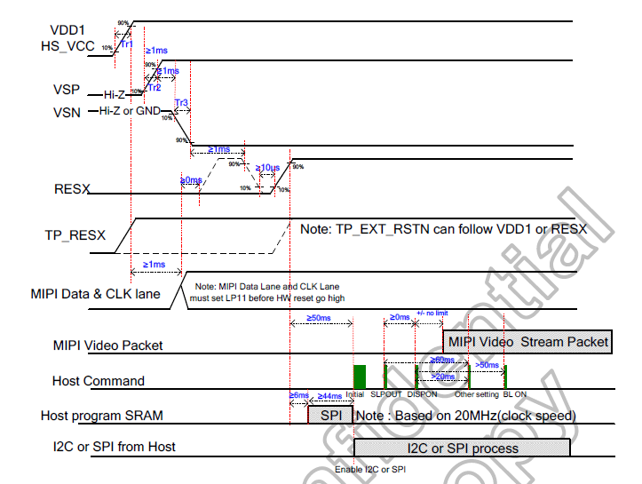
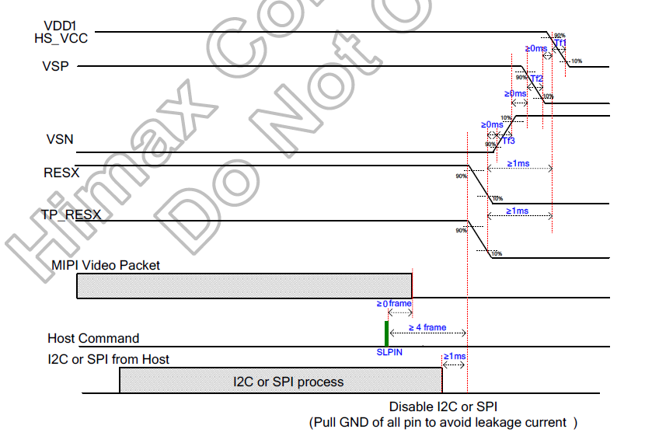
3-7. Power On/Off Sequence
20/57

Slide 21
3-8. Software Flow
Block A : Power On
Block B : Initialize
Block C : MIPI CMD mode on
Block D : Sleep Out & BC_CTRL enable & Display On
Normal mode
Block E : Display Off & BC_CTRL_disable & Sleep In
Block F : MIPI CMD mode off
Standy by mode
Block G : Power Off
Fig 3.7 Software Flowchart
21/57

Slide 22
3-9. Initial Code
Command List
1 | Power on IOVCC = 1.8V
2 | Delay > 1ms
3 | Power on VSP = 5.5V
4 | Delay > 1ms
5 | Power on VSN = - 5.5V
6 | Reset Pin = High
7 | Delay > 1ms
8 | Reset Pin = Low
9 | Delay > 10 us
10 | Reset Pin = High
11 | Delay > 50ms
12 | Intial code setting
13 | Change to DCS command
14 | SLP Out (0x11)
15 | Delay >40ms
16 | Display on (0x29)
17 | Delay >20ms
18 | Other setting
19 | Delay> 30ms
20 | BL On
Display Off & SLP in sequence
1 | Change to DCS command
2 | SLP in (0x10)
3 | Delay > 4 frames
4 | Power off
22/57

Slide 23
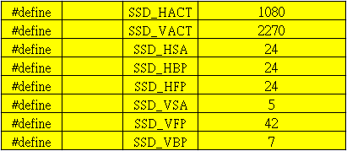
3-9-2: porch setting
3-9-8: CE off
Step | Command Parameter | Command name | Operation
1 | CE | CE
 | 20
3-9-9: CE on
Step | Command Parameter | Command name | Operation
1 | CE | CE
 | 24
Step | Command | Command name | Operation
 | Parameter
2 | E6 | E4
 | CF
 | DE
 | DD
 | F0
 | 55
 | C0
 | C0
 | EC
23/57

Slide 24
Step | Command | Command name | Operation
 | Parameter
2 | EE | E4
 | 55
 | 77
 | 93
 | 00
 | 00
 | AA
 | 85
 | 77
 | 00
 | 00
 | AA
 | 00
 | 70
 | 70
 | 00
 | AA
 | 00
 | 00
 | 00
 | 00
 | AA
 | 00
 | 00
 | 00
 | 00
 | AA
 | 1A
 | 1D
 | 00
 | 00
 | AA
 | 1C
 | 1F
 | 00
 | 00
 | AA
 | 4D
 | 4D
 | 00
 | 00
 | AA
 | F9
 | F9
 | EA
 | 00
 | 95
 | 00
 | 03
 | 11
 | 00
 | BE
24/57

Slide 25
3-9-10: CABC off
Step | Command Parameter | Command name | Operation
1 | 55 | 55
 | 00
3-9-11: CABC on(UI mode)
Step | Command | Command name | Operation
 | Parameter
1 | B9 | B9
 | 83
 | 11
 | 2A
Step | Command | Command name | Operation
 | Parameter
2 | 51 | 51
 | 0F
 | FF
Step | Command | Command name | Operation
 | Parameter
3 | 55 | 55
 | 01 |  | UI mode
Step | Command | Command name | Operation
 | Parameter
4 | 53 | 53
 | 24
25/57

Slide 26
Step | Command | Command name | Operation
 | Parameter
5 | E4 | E4
 | 2D
 | 01
 | 2C
 | 00
 | 08
 | 00
 | 10
 | 08
 | 04
 | 04
 | 8D
 | 8D
 | 8D
 | 99
 | 99
 | C2
 | C2
 | FF
 | FF
 | FF
 | FF
 | EF
3-9-12: CABC on(Movie mode)
Step | Command | Command name | Operation
 | Parameter
1 | B9 | B9
 | 83
 | 11
 | 2A
Step | Command | Command name | Operation
 | Parameter
2 | 51 | 51
 | 0F
 | FF
Step | Command | Command name | Operation
 | Parameter
3 | 55 | 55
 | 03 |  | Movie mode
26/57

Slide 27
Step | Command | Command name | Operation
 | Parameter
4 | 53 | 53
 | 24
Step | Command | Command name | Operation
 | Parameter
5 | E4 | E4
 | 2D
 | 01
 | 2C
 | 00
 | 08
 | 00
 | 10
 | 08
 | 04
 | 04
 | 00
 | 22
 | 49
 | FF
 | 07
 | 41
 | A9
 | E0
 | F1
 | AA
 | FF
 | EF
27/57

Slide 28
3-9-12: ACO off
Step | Command Parameter | Command name | Operation
1
3-9-13: ACO on
Step | Command Parameter | Command name | Operation
1
3-9-14: SRE off
Step | Command Parameter | Command name | Operation
1
3-9-15: SRE on
Step | Command Parameter | Command name | Operation
1
28/57

Slide 29
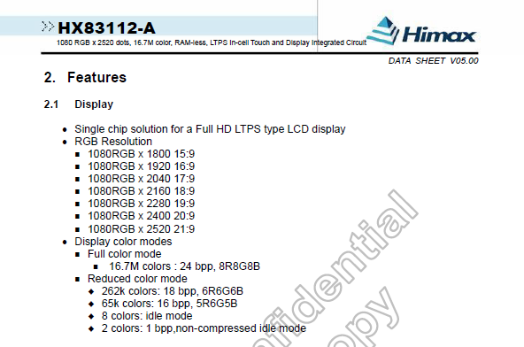
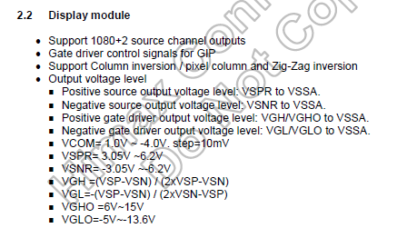
3-10. IC General Spec and Size
29/57

Slide 30
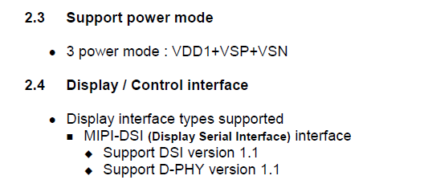
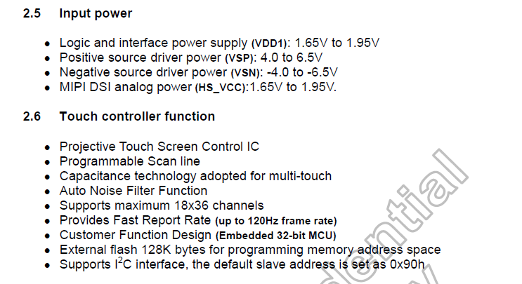
30/57

Slide 31
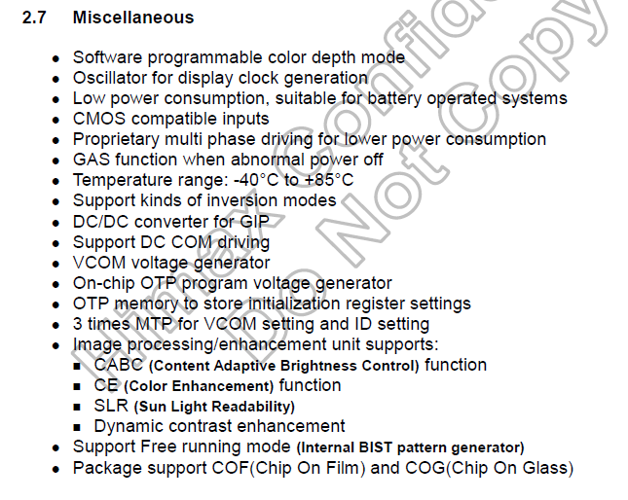
31/57

Slide 32
3-11. Power Consumption
 | Parameter | Symbol | Typ | Unit | Remarks
CABC off | Logic Power | L0 | 147.098 | mw
 |  | L32 | 157.987 | mw
 |  | L64 | 157.344 | mw
 |  | L96 | 158.742 | mw
 |  | L127 | 157.82 | mw
 |  | L160 | 158.341 | mw
 |  | L192 | 159.258 | mw
 |  | L224 | 160.505 | mw
 |  | L255 | 159.129 | mw
 |  | R255 | 194.563 | mw
 |  | G255 | 192.387 | mw
 |  | B255 | 193.334 | mw
 |  | 8 color bar | 184.163 | mw
 |  | 0-255 Gray Transition | 164.807 | mw
 |  | Lenovo UI |  |  | Lenovo will send pic.
 |  | Icon Interface
 | BLU | 25% on | 185.588 | mw
 |  | 50% on | 392.8512 | mw
 |  | 75% on | 648.8575 | mw
 |  | 100% on | 960.4791 | mw
 | Symbol | Logic | BLU | Remarks
CABC on | L0 | 149.365
 | L32 | 158.578
 | L64 | 159.084
 | L96 | 158.474
 | L127 | 157.71
 | L160 | 159.577
 | L192 | 160.002
 | L224 | 160.661
 | L255 | 158.623
 | R255 | 194.242
 | G255 | 192.89
 | B255 | 194.021
 | 8 color bar | 184.63
 | 0-255 Gray Transition | 167.948
 | Lenovo UI | - | - | Lenovo will send pic.
 | Icon Interface | - | -
If there is more than one mode for CABC function, please fill out all data
32/57

Slide 33
4. OPTICAL CHARACTERISTICS
4-1. Optical Characteristics – Backlight 100%
Parameter | Symbol | Condition | Min | Typ | Max | Unit | Remarks
Viewing Angle | Θ12 | CR >10 | 80 | - | - | ° | Note 1,5
 | Θ6 |  | 80 | - | - | ° | Note 1,5
 | Θ9 |  | 80 | - | - | ° | Note 1,5
 | Θ3 |  | 80 | - | - | ° | Note 1,5
Contrast Ratio | CR | Optimal | 1000 | 1500 | - | - | Note 1,4
Brightness | Lv | Optimal | 380 | 450 | - | Cd/m² | Note 1
Brightness Uniformity | Y | Optimal | - | 1.2 | 1.4 | - | Note 1,7(400P)
Flicker |  |  | - | - | -28 | dB | Note 1,2
Crosstalk |  |  | - | - | 2 | % | Note 1,3
Response time | τ_{f} or τ_{r} | Θ =0 ° Ta =25 °C | - | 25 | 35 | ms | Note 1,6 B-W
Color Gamut | NTSC | - | 76 | 82 | - | % | Note 1
White Chromaticity | Suv | CIE 1976 | 0 | - | 0.13 | - | Note 1
 | Huv |  | 0 | - | 360 | - | Note 1
 | Suv | CIE 1976 | 0.13 | - | 0.2 | - | Note 1
 | Huv |  | 180 | - | 270 | - | Note 1
Red Chromaticity | Suv | CIE 1976 | 3.47 | 3.57 | 3.67 | - | Note 1
 | Huv |  | 12.63 | 14.13 | 15.63 | - | Note 1
Green Chromaticity | Suv | CIE 1976 | 1.63 | 1.75 | 1.87 | - | Note 1
 | Huv |  | 121.1 | 123.6 | 126.1 | - | Note 1
Blue Chromaticity | Suv | CIE 1976 | 3.93 | 4.23 | 4.53 | - | Note 1
 | Huv |  | 262.96 | 265.96 | 268.96 | - | Note 1
4-2. Cell&BLU Optical Characteristics
Parameter | Typ | Unit | Remarks
Aperture Ratio | 51.9 | %
Upper Pol Trans. | 41.7 | %
Lower Pol Trans. | 43.4 | %
Panel Trans. |  | % | w/o APF
Panel Trans. | 4.6% | % | with APF
BLU Luminance | 10700 | Cd/m² | Center
BLU Luminance Uniformity | 1.2 | - | Note1,7
33/57

Slide 34
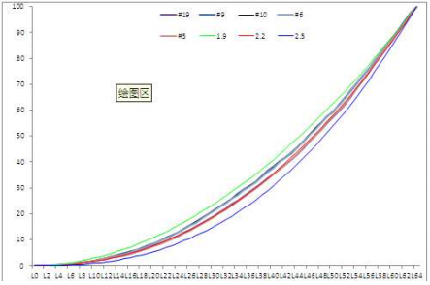
4-3. Gamma/Color Coordinate Uniformity/CE Function/CABC Function
4.3-1 Gamma Curve
Request: R/G/B/W, 0-255 gray scale, step 1 gray scale
4.3-2 Color Coordinate Uniformity
Request: white pattern, 0-255 gray scale, step 4 gray scale.
Gray Scale | x | y
96 | 0.1890 | 0.4561
128 | 0.1890 | 0.4566
192 | 0.1891 | 0.4568
224 | 0.1893 | 0.4570
4.3-3 CE function(on and off)
Request: Macbeth color checker. Please provide all CE on data if there is more than one CE solution.
4.3-4 CABC function(on and off)
Request: Pictures data comparison(Lenovo UI, icon pattern, L255, L192, L127, L64, L0, some colorful pattern),
Movies comparison( three segments with different frames details, lighter, light+dark, darker)
34/57

Slide 35
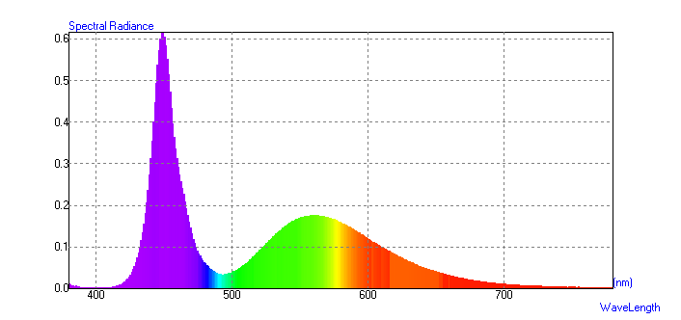
4-4. LCD Spectrum and BLU Spectrum
Center Point
LCD Spectrum
BLU Spectrum
35/57

Slide 36
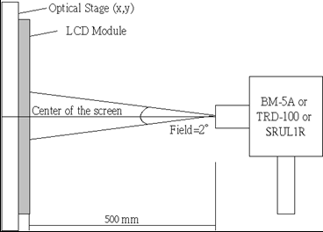
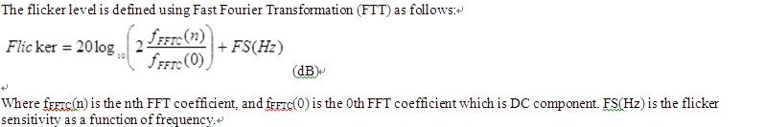

[Note 1] Optical Test Equipment Setup
Fig 4.1. Optical Characteristic Measurement Equipment and Method
[Note 2] Flicker
36/57

Slide 37
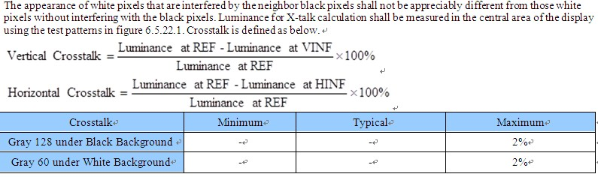



[Note 3] Crosstalk
37/57

Slide 38
[Note 4]
Contrast Ratio is defined as follows ;
Contrast Ratio(CR) =
Photo detector output with LCD being “White”
Photo detector output with LCD being “Black”
[Note 5]
Viewing Angle Range is defined as follows;
UP
(12 o’clock)
Φ=90º
θ=0º
z
A
yu
θ
LEFT
(9 o’clock)
Φ=180º
xl
Φ
xr
RIGHT
(3 o’clock)
Φ=0º
TFT-LCD
Module
yd
DOWN
(6 o’clock)
Φ=270º
Fig 4.2 Viewing Angle Definitions
38/57

Slide 39
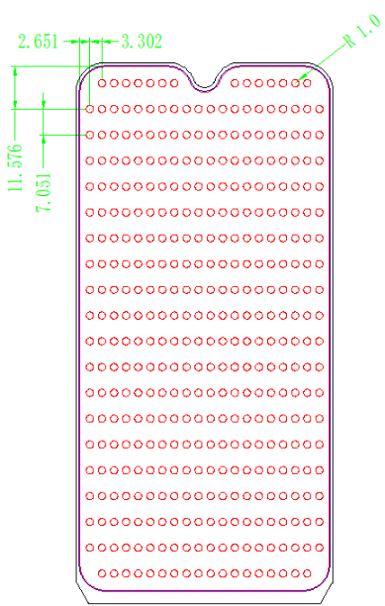
[Note 6]
Response time is obtained by measuring the transition time of photo detector output, when input signals are applied so as to make the area “black” to and from “white”.
White
100%
90%
Photo detector Output
10%
0%
Black
τ_{r}
τ_{f}
Black
[Note 7]
Fig 4.3 Response Time Definition
Time
To test for uniformity, the test area, which is 1mm inside of the active area, is divided into 20(M) rows and 20(N) columns for the main display. The measurement spot is placed at the center of each box. 20 x 20 spots will be tested and the uniformity is calculated as the ratio of the maximum to minimum luminance. 2mm diameter spots will be tested
Brightness Maximum Photo detector output for P1-P400 with all pixels white
Uniformity Minimum Photo detector output for P1-P400 with all pixels white
=
Fig 4.4 Brightness Measurement Points
39/57

Slide 40
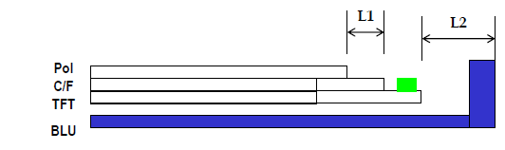
5. MECHANICAL CHRACTERISTICS
The contents provide general mechanical characteristics for the model.
In addition the figures in the next page are detailed mechanical drawing of the LCD.
Items | Description | Typ. | Tolerance | Unit
Mother Glass | Size | 1300×1500×0.5 |  | mm
Q-Panel | Size | 619.84 x 638.76 x 0.5 782.06 x 638.76 x 0.5 |  | mm
C/F and TFT thickness after slimming | thickness | 0.15+ 0.15 | ±0.03 | mm
Panel | A/A | 68.04 x 143.01 | ±0.03 | mm
 | C/F | 69.64x 145.11 | ±0.15 | mm
 | TFT | 69.64x 147.21 | ±0.15 | mm
 | BM(U/D/L/R) | 0.9/3.3/0.8/0.8 | ±0.15 | mm
 | IC Bonding Area | 2.1 | ±0.15 | mm
 | Pol Size | 69.44*144.41 69.74*144.66 | ±0.1 | mm
 | Gap Between Pol~C/F border (U/D/L/R) | 0.1/0.6/0.1/0.1 | ±0.15 | mm
Module | Horizontal | 70.04 | ±0.1 | mm
 | Vertical | 147.86 | ±0.15 | mm
 | Thickness | 1.33 | +0.08/-0.1 | mm
 | UV Glue Thickness | <0.15 | <0.15 | mm
 | Gap between Glass~LCM outline | 0.2/0.2//0.2/0.4 | ±0.2 | mm
40/57

Slide 41
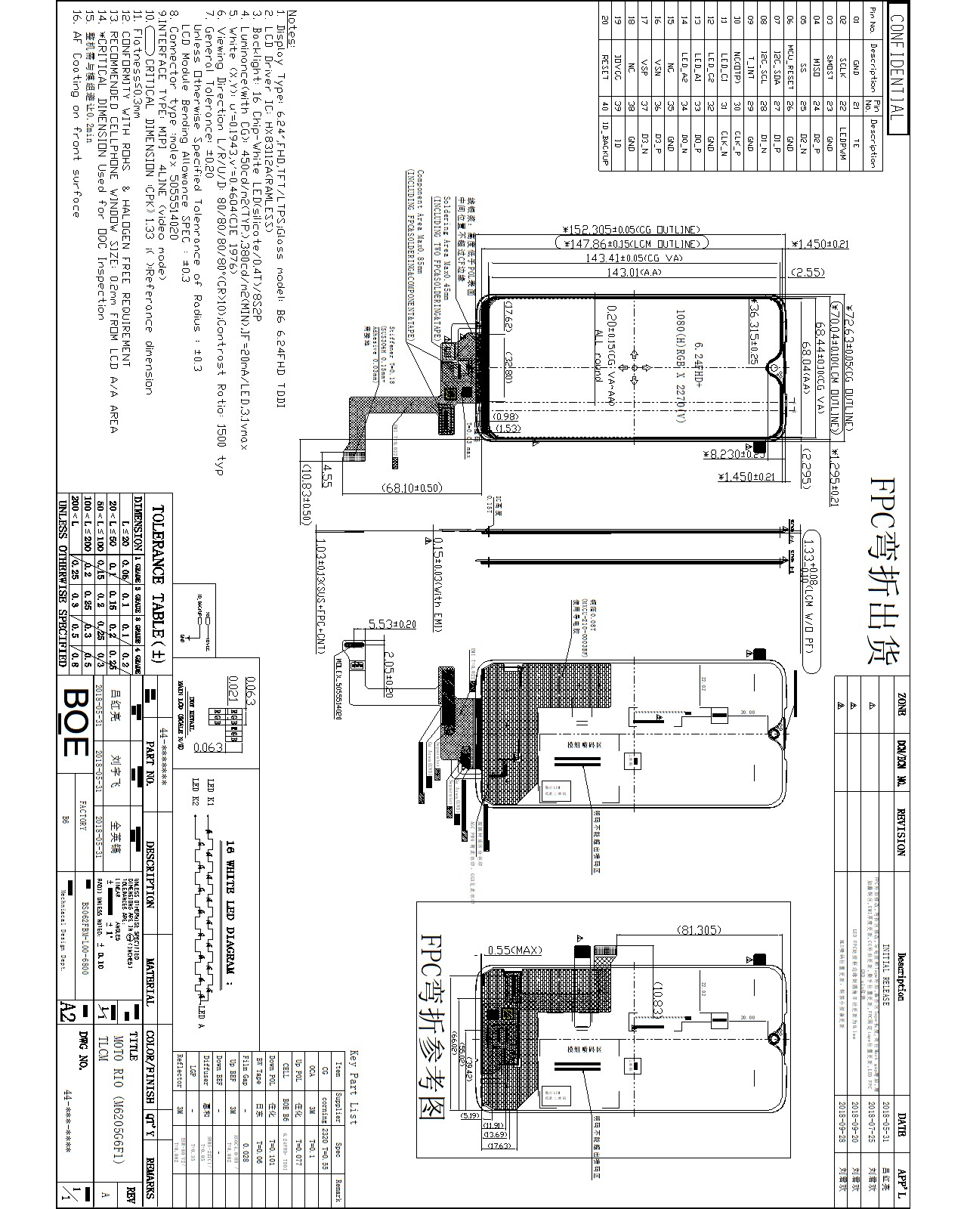
5.1 TLCM Drawing
Folded and unfolded status
41/57

Slide 42
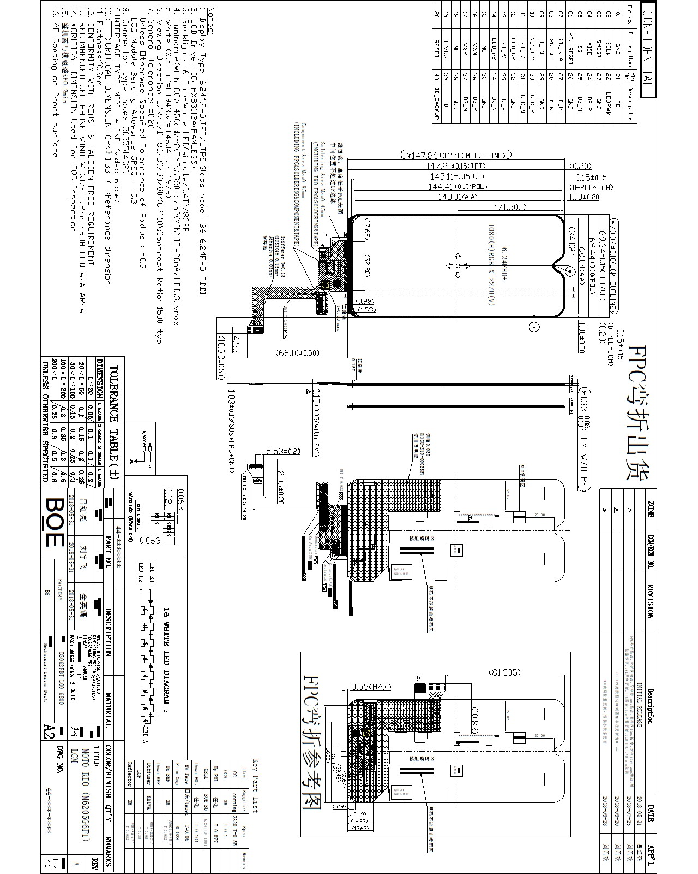
5.2 LCM Drawing
Folded and unfolded status
42/57

Slide 43
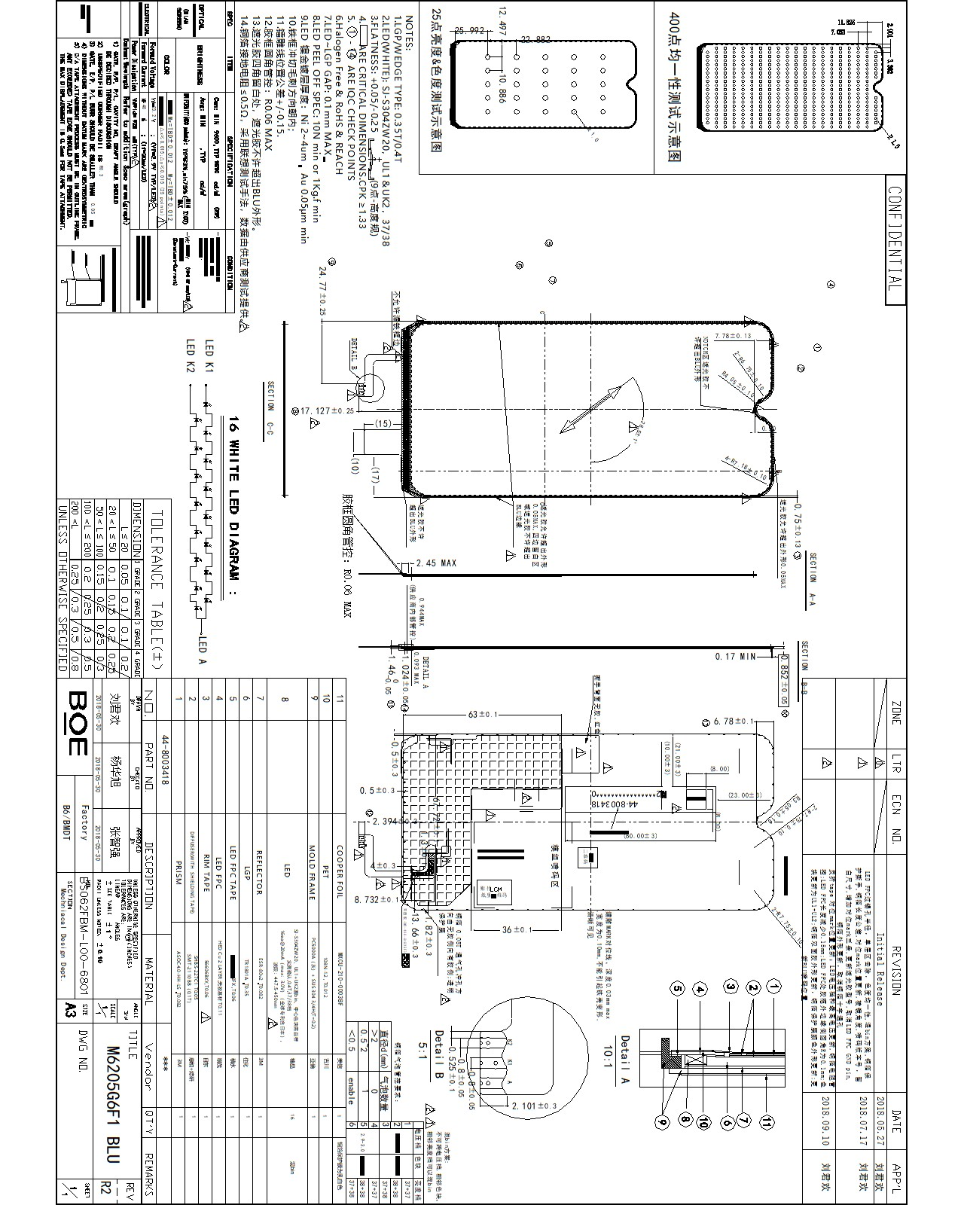
5.3 BLU Outline Dimension
43/57

Slide 44
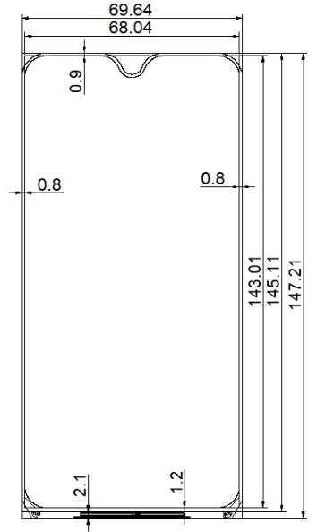
5.4 Panel Outline Dimension
44/57

Slide 45
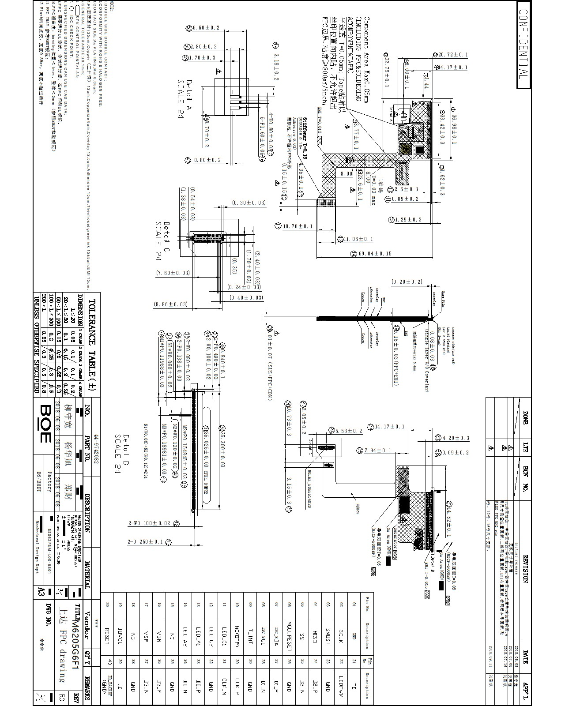
5.5 FPCA Outline Dimension
45/57

Slide 46
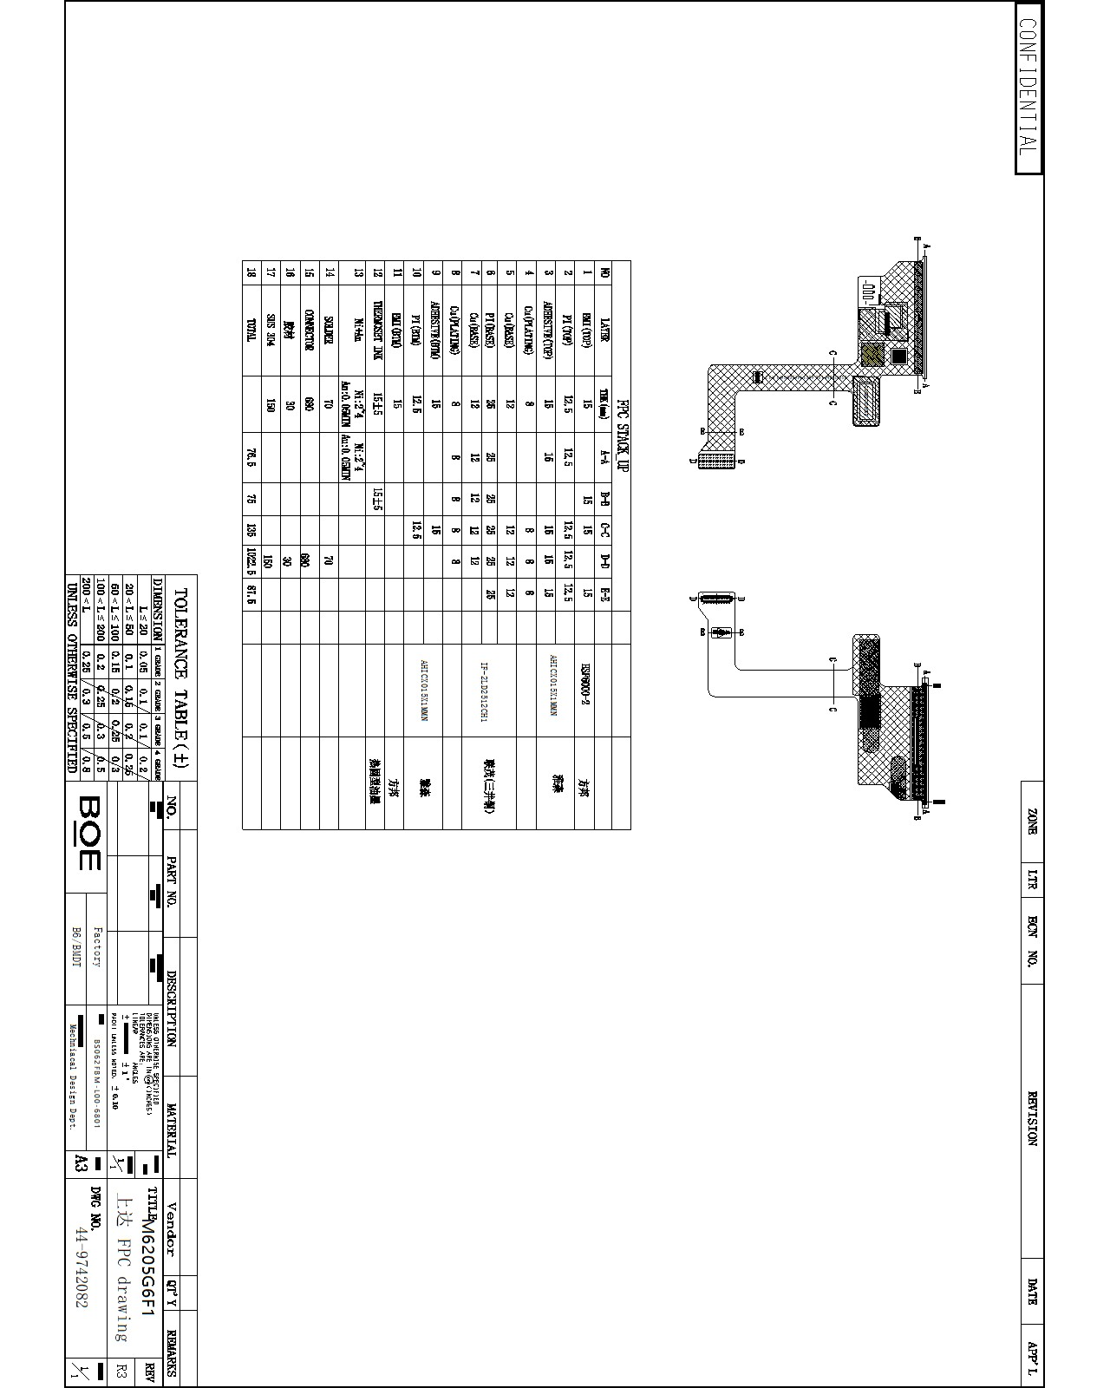
5.6 FPCA Stackup
46/57

Slide 47
6. RELIABLITY TEST
Must be accordance with Lenovo RA test items
Test Items | Conditions
Operation Temperature | -20℃ To 70℃
Operating Humidity | 0% ~ 90%
Temperature when stored | -40℃ To 80℃
Humidity when stored | 0% ~ 90%
MTBF | >10,000POH
If after 10,000 hours, the brightness of the panel is 50% greater than the initial value, the MTBF report and SDA test report should be given to providers.
47/57

Slide 48
7. Safety & Environment Test Reports
48/57

Slide 49
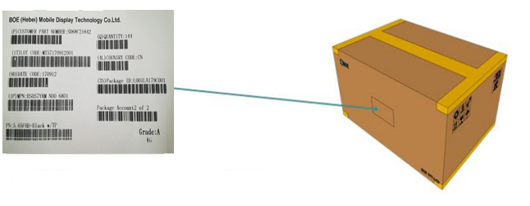
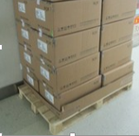
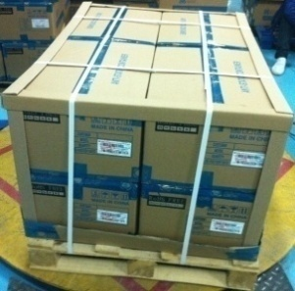
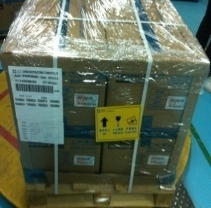
8. Package
8.1. Packing Description
Support operation
Bottom cover & retaining wall
bandage
Wrap film & label
49/57

Slide 50
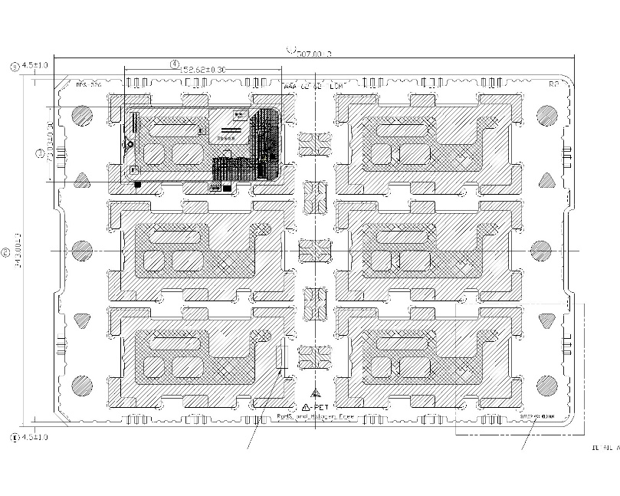
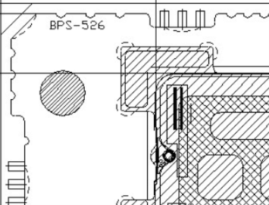
8.2. Description of Packing Tray
Confirm that the whole trays are straight stacked. The display area of the product should be placed downward. It is confirmed whether the product pallet number is 12 storeys. The whole trays need to be placed 0 degrees in a row, and it is not allowed to be placed intersecting.
Differentiating the product model of the tray according to the material number of the tray edge.
50/57

Slide 51
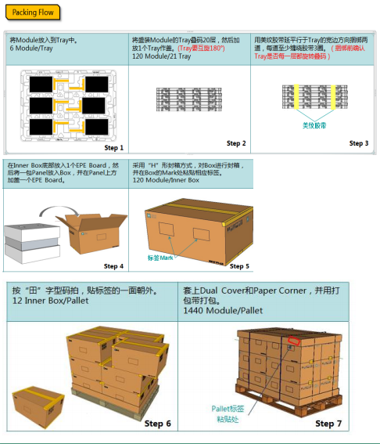
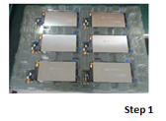
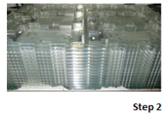
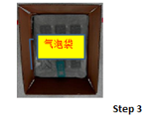
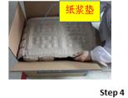
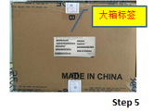
8.3. Description of Packing Box
Put the product in the tray | Fold up 24 layers of pallets full of products and put a tray cover on it. | Lot is loaded into an anti static bubble bag, the opening is folded well and the tape is sealed with BOE tape. After packing two small packages, the product is moved to the scavenging area, waiting for scavenging to print out large box labels
Put the bottom of Lot on the bottom of the pulp pad, put it in a large box, fold the other Lot in the same direction, and cover the top with the pulp pad on the top. | Sealing with sealing tape to “工-shaped” , put the large box label on the specified position. And attach seals to the box of Ipsilateral upper and lower middle, weighing after completion.
51/57

Slide 52

9.1 Incoming Inspection Standard
Reference Moto Appearance testing standard
《MBG-S-PQM-061 Cosmetic Specification for Mobile Phones and
Wearable Products_V2.0》
52/57

Slide 53

9.2 Reliability Test
Reference Moto workbook
《Lenovo_Moto Unified EE Workbook REV07》
《Lenovo_Moto Unified ME Workbook REV03》
《Lenovo_Moto Unified OE Workbook high REV05》
《Lenovo_Moto Unified Reliability REV04.xls》
53/57

Slide 54
9.3 Quality service flow to Lenovo
In order to serve for Lenovo better,after-sales service flow as follow：
1> According to the P/O of Lenovon,BOE send the products to the appointed site.
2> Lenovo organize staffs to inspect the products.
3> Inspection standard provided by BOE takes effect after authorizing by Lenovo,inspection and judgment of NG products are according to the standard approved by both sides.
4> In order to guarantee information of quality sharing timely and service provided by BOE effective,employees of Lenovo in charge of quality inspection inform the CS of BOE appointed of the quality status of products inspected regularly(weekly).
5> After BOE achieve the relevant information，by negotiating with the quality representative of Lenovo,confirm time and site,both BOE and the representative judge the NG products presented by customer.
6> When Lenovo put forward special quality service，BOE will cooperate actively.
7> After judgement by both sides，BOE are responsible for replacing the NG products due to BOE, bring them back and sending the new products to the appointed site.
8> BOE promise to provide related introduction of LCD and training of products usage.
9> Lenovo should operate according to the usage of LCD products,to the NG products due to wrong operation process, BOE do not take relevant reresposibility.
10>Both Lenovo and BOE should handle the quality problems following the principle of negotiation and cooperation,to the NG products whose attribution of liability is ambiguous,resolve by consulting with each other
54/57

Slide 55
9.4 LCD Module operation manual
9.4.1 Notes of storage
1>LCD is comprised of glass,so please prevent it from direct external shocks in any way.
2>Storage temperature of the LCD out Spec range,it will cause material status change,as the temperature recovery the performance can't return to the original.So the LCD module should be always kept in the SPEC.Similarly, the LCD module should be stored in the humidity within the SPEC,the electrostatic increase performance that may caused by the low humidity, and high humidity may cause LCD such as ITO line corrosion and damage.Appropriate storage environment should be: temperature: 22 +/- 5 ℃ humidity: 55% +/- 10%.
3>The LCD module shoule be stored in a dark place,and keep it away from direct sunlight、strong fluorescence or ultraviolet light for a long time.
4>The LCD module should be stored away from contacting chemical liquid, such as alcohol, acetone, IPA, etc., these can cause LCD to damage. If there is water on the surface of the LCD, please wipe away immediately, it will cause POL color changes and other defects.Note:Avoid LCD reflector in the backlight contact with main board welding PAD of phone direct,it can cause reflection corrosion or damage,request paste insulation tape on the LCD board PAD after the welding.
5>If order to storage and maintenance, the LCD shouid be stored in anti-static PE bag, and don't let it exposure in the atmosphere for a long time.
9.4.2 Notes on board assembly
1>When using the LCD module assembly, make sure the staff wore wrist strap efficiently,and the workbench placing modules must also be grounded effectively.
2>When moving the LCD module, please place it in the tray which provided by BOE , When taking the LCD module, please hold both sides of the border, in order to protect it from damage. In assembling the machine, please handle it carefully.When assembling LCD, please prevent it from bearing too much pressure or twisting forces.
3>Please don't disassemble the LCD module or make the FPC of LCD module suffering fatal injury, this will cause the product permanently impaired.
55/57

Slide 56
4>Avoid using a hard texture object to wipe the surface of the LCD. If it is necessary to wipe, please use deionized Air-gun or very soft cotton cloth. The surface polarizer protective film of LCD module can only be opened before assembled, otherwise dust, saliva or foreign material will stick on the surface of the LCD or protective film. After the protective film opened, can only use the deionized Air-gun to remove surface dust or foreign bodies that may occur. Using fingers or a rag and other contacts are not allowed. Avoid using sharp objects hit the surface of the LCD, this will cause permanent damage to the polarizer.
5>Avoid making PCB board distorted, peeling, squeezing or impact force, that will cause the PCB line or relevanted components damage resulting in poor LCD functionality.
6>The use method of the terminal connector, please refer to the instructions provided by BOE
7>Double screen product keep the small screen upward direction, two adjacent trays reverse placed into 180°.An empty tray on the top cover.
8>When welding on the PCB, please make sure that do not cause short circuit or open circuit of PCB original line,otherwise, LCD products will cause fatal injuries.
9>Please operate the connector carefully, connector damaged due to customer operations need to be borne by the customer.
9.4.3 Use note
1>Avoid the DC(direct current) directly to the LCD panel,and don't use the high voltage on the LCD Panel or module.This will cause the LCD product functional damage or shorten the life.
56/57

Slide 57
2>When using the LCD module in high temperature or low temperature (-20 ℃~-50 ℃),the response time will te longer, there will may be abnormal display phenomenon,but it dose't mean function of the LCD is NG.IF the temperature recovery to normal ,the LCD can display normal.So please don't use the LCD module in low temperature,because we are using the normal temperature liquid crystal we use can only work in room temperature.
3>Avoid the LCD display area get pressure，it will cause abnormal display.It dosen't mean function of LCD isNG.IF the operation normally,the LCD can display normal.
4>The LCD electrical data should be tested by using customer's phone,if necessary, this can use function inspection device provided by Hy-LCD.
57/57

