Slide 1
moto e⁵ play (ROW)
Product Marketing Brief
Version 3.0 | Apr. 10, 2018
MBG WW Marketing

Slide 2
moto e⁵ play (ROW) Product Marketing Brief
Version History
Version | Date | Notes
First release | Mar. 20 | First release
V2.0 | Mar.28 | APAC SKU is canceled; Tiny changes in PMB;5.34 inch will be unified to 5.3 inch for all marketing assets.
V3.0 | Apr.10 | Update Moto experience
Project Leads
Product Marketing (Owner) | Helen Hao haomeng1@lenovo.com
Brand Marketing | Amrita Sebastian amritas@lenovo.com
Product Management | Yanzhao Zhang zhang10y@motorola.com
Geo Leads
AP | Shashank Sharma: ssharma2@lenovo.com Rachna Lather: rachna@motorola.com
EM | Augustin Becquet: abecquet@lenovo.com Virginie de Beco：vbeco@lenovo.com
LAE | Edson Bortolli：bortolli@motorola.com Renata Altenfelder Silva： renata@motorola.com
NA | Marcelo Airoldi：Marcelo.Airoldi@motorola.com Marcela Lacerda：mlacerda@motorola.com
DISCLAIMER
Please note that this is an internal document and CONTAINS CONFIDENTIAL PRODUCT INFORMATION. Images contained within this document may be conceptual or copyrighted, and are for visualization purposes only. Images herein are not to be used elsewhere, especially for consumer-facing materials, unless otherwise stated. This is a living document, which the Product Marketing team strives to keep as up to date as possible.

Slide 3



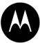



moto e⁵ play Product Marketing Brief
CONTENTS
moto new branding & products
WHAT product design, naming, positioning, summary, KSPs, specs & software
WHAT wallpaper, packaging, clings & accessories
WHY KSP research
WHO competitive landscape & target audience
WHEN & WHERE SA timeline, regional SKUs & project tracker
HOW demo script & spec card

Slide 4
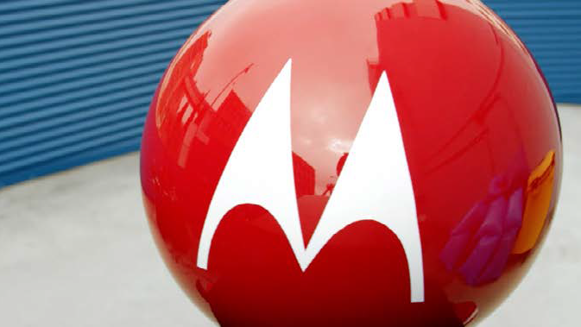

hellomoto
Re-launching an iconic brand

Slide 5
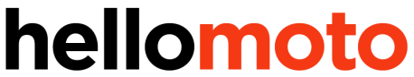
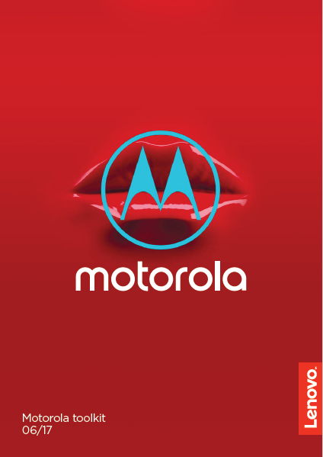
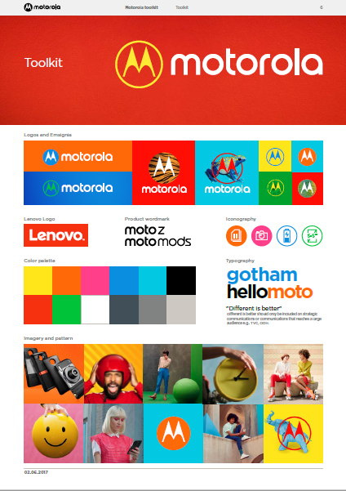
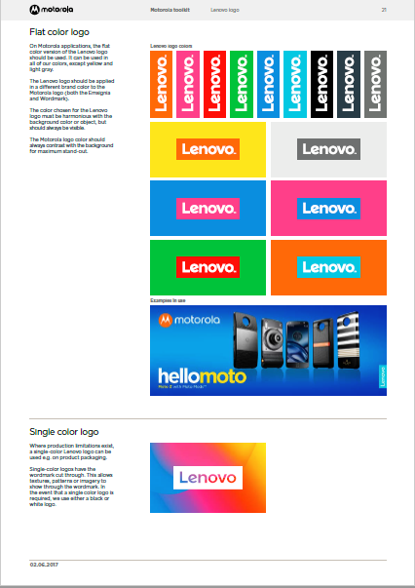
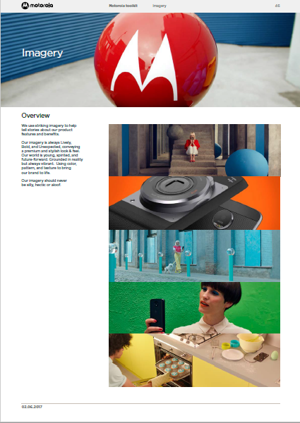
BRAND VISUAL IDENTITY
Taking a cue from brand Lenovo’s visual identity, we have used those design elements in a ‘more is more’ way to develop the Moto brand. An eclectic mix of photography, illustration, color and graphics have been brought together to create a Bold, but premium. Fashionable, yet fun. look and feel.
For detailed information on branding and VI guidelines please refer to the Moto Collective

Slide 6


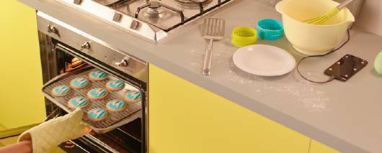
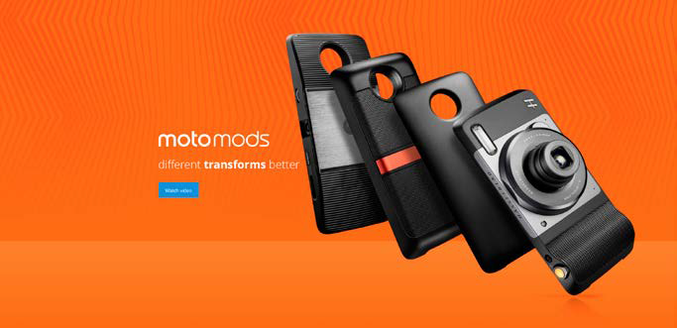
‘more is more’
Bold, but premium. Fashionable, yet fun.

Slide 7

BRAND STRATEGY
Our
motivation
To push beyond
the expected
and live a life less
ordinary.
What we do
Innovative
products that
deliver a better
mobile lifestyle.
What we
promise
We challenge
convention to
liberate you from
the ordinary.
Our attitude
We are: lively not
hectic, unexpected
not silly, and bold
not aloof.

Slide 8



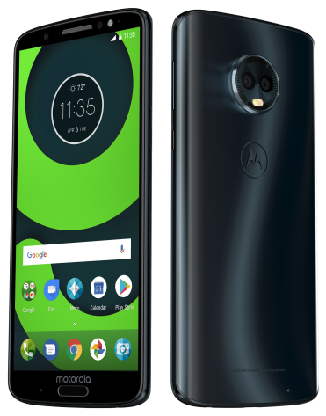

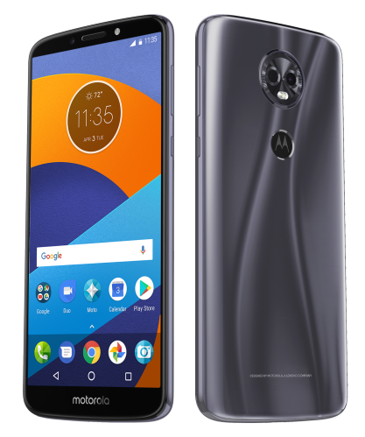
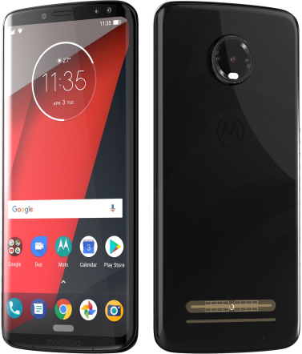

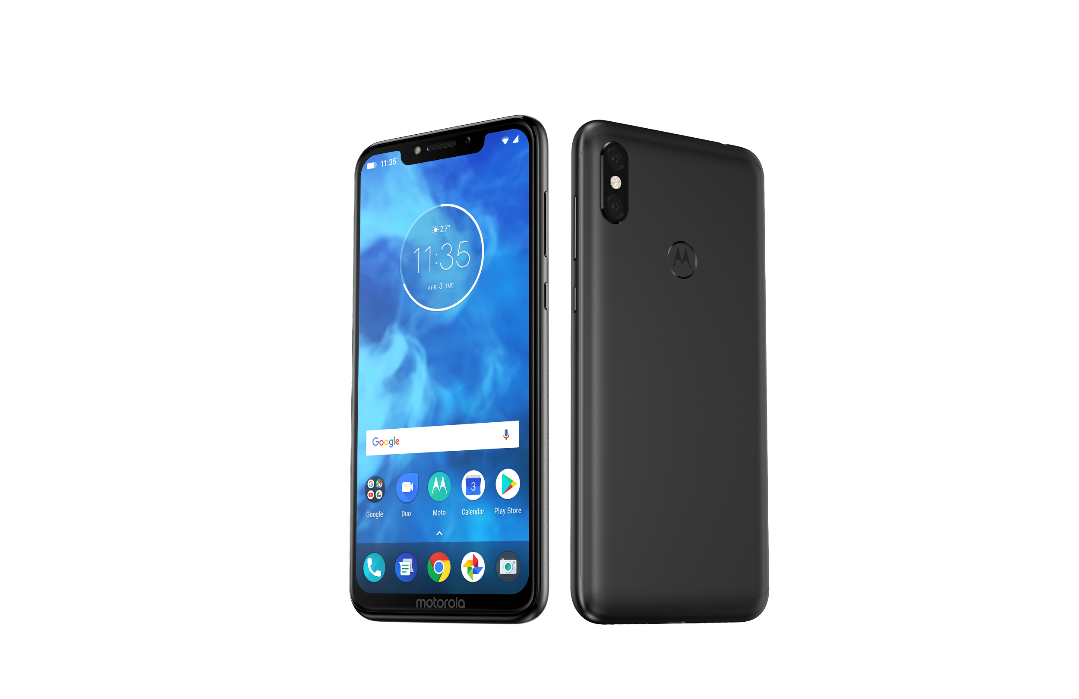
g
e
2018 Product Portfolio
z
PREMIUM
FOR ALL
To be updated
one
EVERYDAY
ENTERTAINMENT
UNLIMITED
POSSIBILITIES
INCREDIBLE
VALUE

Slide 9
moto e⁵ play Product Marketing Brief
moto new branding & products
WHAT product naming, design, positioning, summary, KSPs, specs & software
WHAT wallpaper, packaging, clings & accessories
WHY KSP research
WHO competitive landscape & target audience
WHEN & WHERE SA timeline, regional SKUs & project tracker
HOW demo script

Slide 10

moto e⁵ play Product Marketing Brief
PRODUCT NAMING GUIDANCE
Internal Name: Golf Lite
Marketing Name: moto e⁵ play
Please do NOT use other formats in consumer facing assets unless instructed in Typography guideline
e.g. Moto E ROW Moto E5 MOTO E⁵ PLAY
Word Mark （Logo）
Headline
(Lowercase + Bold)
Body Copy
(Lowercase + Bold)
moto e⁵ play
moto e⁵ play
NOTES
The above examples are directional only. More details on product naming guidance available on the next slide.
For detailed information on branding and VI guidelines for external marketing assets please refer to the Moto Toolkit from the Lenovo Corporate Branding team.

Slide 11
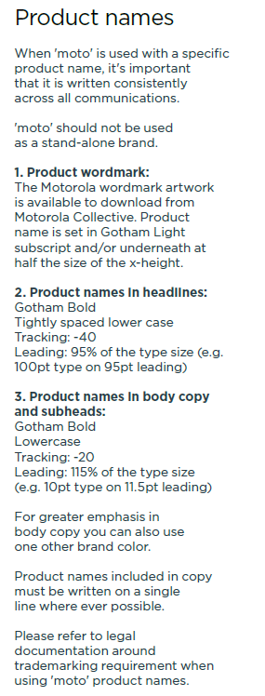
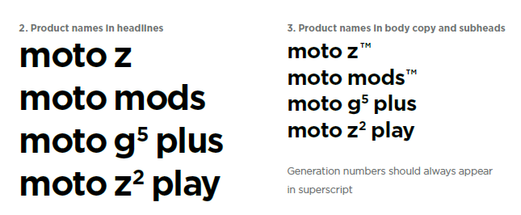
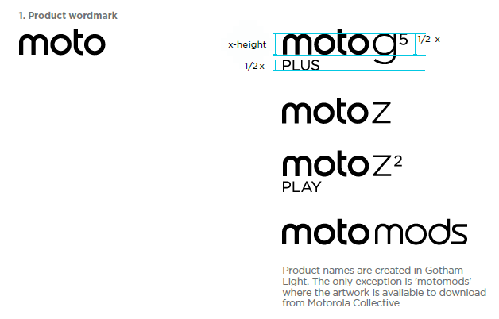
moto Product Naming Guidance

Slide 12



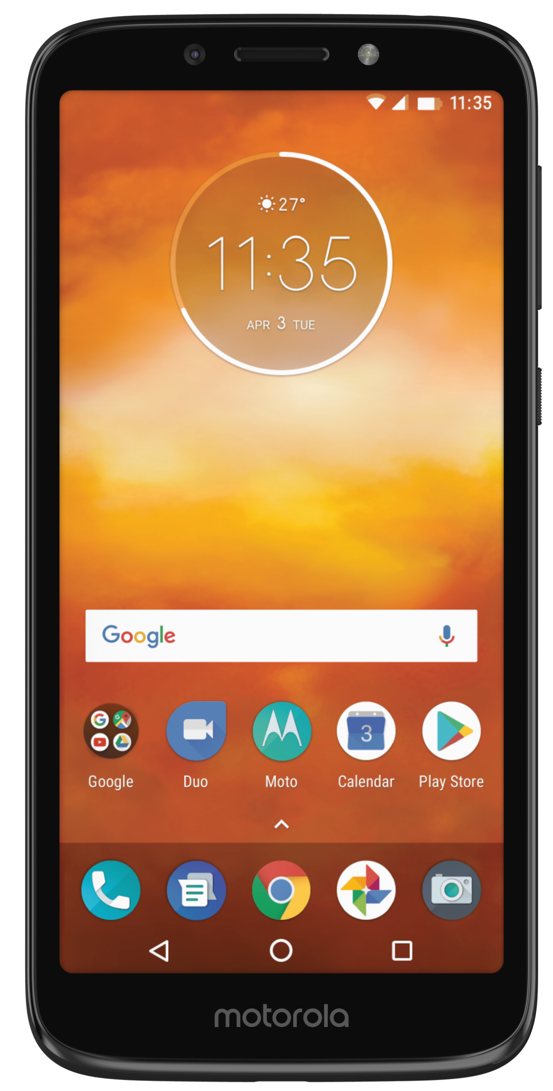
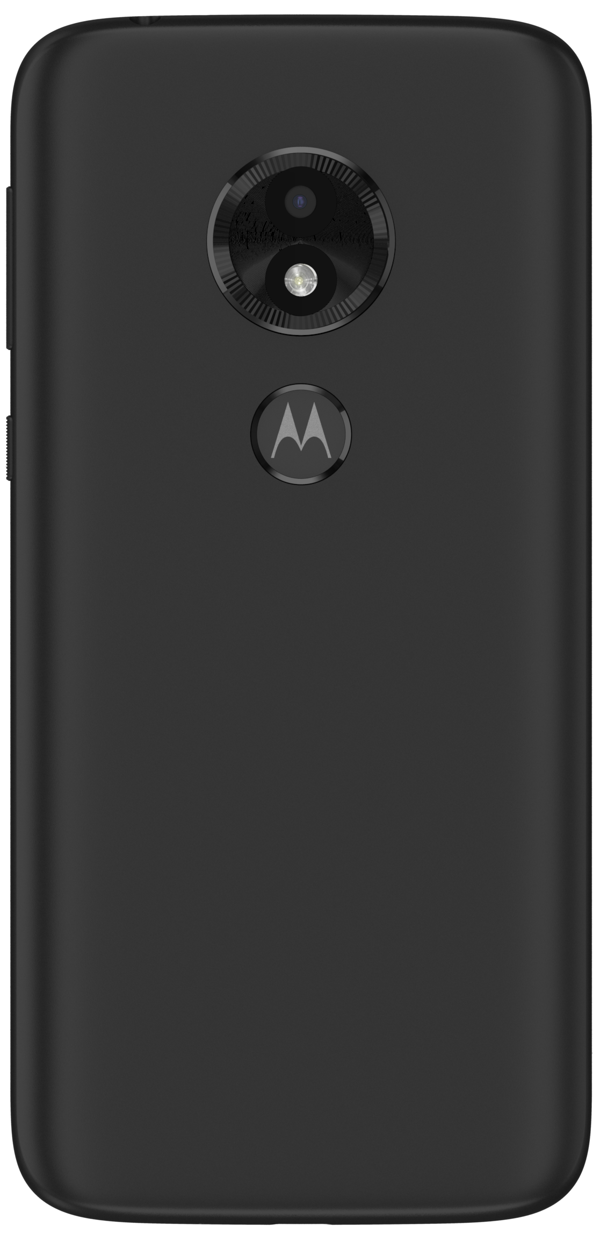





moto e⁵ play Product Marketing Brief
e
POSITIONING STATEMENT
Never hesitate to go for the moto e⁵ play, an entry level smartphone with exceptional features like a Max Vision (18:9) display and fingerprint reader that will surprise you.
KEY PRODUCT INFO
Screen | 5.3" 960 x 480 FWVGA+
Z-Height | 9.19mm
Weight | 145g
Price | €99¹
Battery Size | 2100mAh Removable Battery
Operating System | Android™ GO
Color Options | Black/Gold
Expected Availability | July, 2018
Exceptional Value
PRODUCT SUMMARY
With a Max Vision (18:9) display and fingerprint reader, the new moto e⁵ play is here to bring you conveniences to an entry-level smartphone like never before. An 8MP autofocus rear camera can always take sharp photos. On the front side, a selfie flashlight gets you brighter pictures in low light. Expandable storage means more of your favorite media can always travel with you. Plus, a Qualcomm® Snapdragon™ processor and 2100mAh battery make sure your essentials are in place.
NOTES
1 Price varies by region

Slide 13
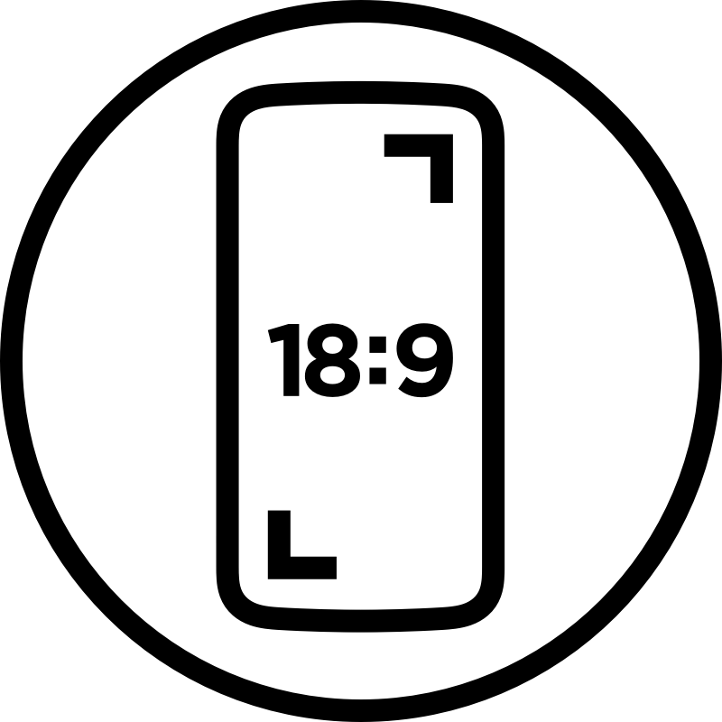





moto e⁵ play (ROW)
NOTES
1 Optional single SIM
1
2
3
Max Vision 18:9 Display
5.3” screen slimmer than ordinary 16:9 screens for convenient single-hand use
Fingerprint Reader
Bypass PINs and passwords with an ultra-fast Moto Batwing fingerprint reader
8 MP + 5MP Camera
Focus faster with Autofocus and get brighter selfies in low light with flash light
4
5
6
Android™ GO
Simplify your life with stock Android and moto experiences
Dedicated microSD Slot
You can have both a 2nd SIM card¹ and a microSD card at the same time
Qualcomm® SnapdragonTM quad-core processor
For more responsive performance

Slide 14
moto e⁵ play Product Marketing Brief
NOTES
Full legal disclaimer please refer to last slide
1
DETAILED SPECS
Operating System | AndroidTM 8.0, Oreo
System Architecture / Processor | Qualcomm® Snapdragon™ 425 processor with 1.4GHz quad-core CPU and Adreno 308 GPU
Memory (RAM) | 1GB
Storage (ROM) | 16 GB, expandable by up to 128GB microSD card
Dimensions | 147.88x 71.2 x 9.19mm
Weight | 150 g
Display | 5.34” 960 x 480 FWVGA+ (18:9)
Battery | 2100mAh interchangeable
Charging | 5W rapid charger
Water Protection | Water repellent coating
Networks | Please refer to next slide for details
Bands (by model) | Please refer to next slide for details
Rear Camera | 8 MP, f2.0, 1.12um pixels, LED flash, Slo motion mode, Burst Shot, Pro Mode, HDR, Panorama, Auto Night Mode
Video Capture | 1080P(30fps), 720P(30fps), 480P(30fps)
Front Camera | 5MP, Selfie Flash/Light
SIM Card | Nano SIM card
Connectivity | Micro-USB, OTG
FM Radio | Yes
Bluetooth® Technology | Bluetooth® 4.2 LE
Wi-Fi | 802.11 a/b/g/n, 2.4GHz + 5GHz, Wi-Fi hotspot
Speakers/Microphones | 2-in-1 front-ported speaker, 2 Mics
NFC | No
Location Services | GPS, AGPS, GLONASS
Sensors | Proximity, Accelerometer, Ambient Light, Magnetometer (e-Compass), Sensor Hub
Colors | Black，Gold

Slide 15
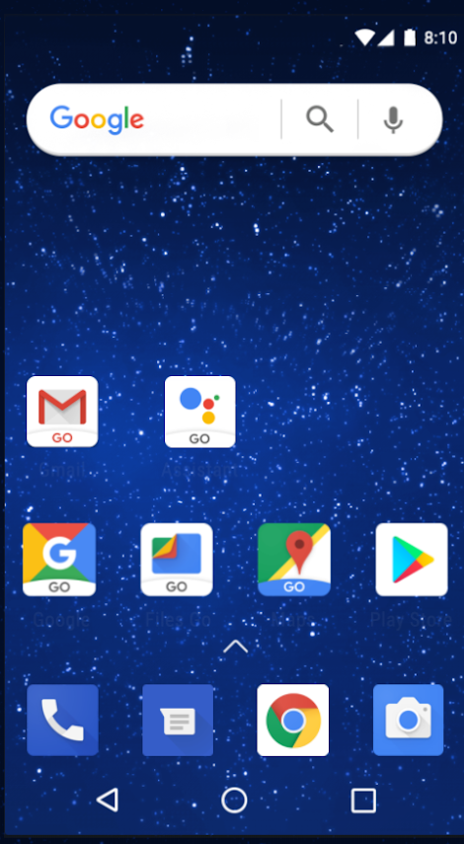






moto e⁵ play (ROW)
Android™ GO
Introducing Android Oreo (Go edition)
A powerful experience for entry-level smartphones. It’s the best of Android, built with new and reimagined apps, so even the most affordable Android smartphones are as sweet as can be
better performance
peace of mind
saving space
> fewer pre-installed and lighter apps
> more available storage
data saver
> built-in data manager: manages which apps to use your data and when
built to use less
> 50% smaller app size for most popular apps from google
> lighter updates and downloads
security that never sleeps
> same key security features as
Android Oreo
> Google Play Protect: built-in mobile security
NOTES
Android GO：Software may change
Screen is a example

Slide 16
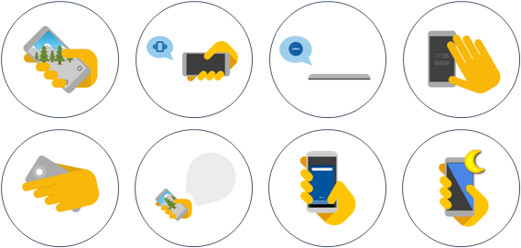
moto e⁵ play Product Marketing Brief
NOTES
1 Software (moto experiences)may change
MOTO EXPERIENCES
Moto Actions¹ Perform simple, natural actions to easily access useful phone functionality at the right time. | Moto Display¹ Get simple, discrete preview of notifications and updates that you can easily interact with.
Quick screenshot: place 3 fingers on screen to take a screenshot | Quick reply: reply to emails and messages from lock screen. Note: User must approve bypass lock screen.
Swipe to shrink screen: for a better one-hand use. | Quick actions: archive emails, call back, and use voice actions. Note: actions vary by app.
Pick up to stop ringing: lift to switch to vibrate when rings. | Battery meter: see battery level on the lockscreen; color match.
Flip for Do not disturb: silence notifications and calls. | Night Display: adjusts screen to warmer tones for better sleep.
 | Display notifications: updates without unlocking the screen.
 | Music Controls: pause, play, previous/next without unlocking your pho,
 | Attentive Display: Your screen stays on while you are looking at it.

Slide 17
moto e⁵ play Product Marketing Brief
PRELOADED SOFTWARE AND APPS
Google GO Suite | Calculator，Calendar，Camera，Clock，Contacts，Downloads (renamed to Files in O)，FM Radio，Google Settings，Help ，Launcher 3，Messages (GMS)，Moto，Phone (GMS Dialer)，Photos，Play Music，Settings Android Go Apps:Assistant Go，Chrome，Gmail Go，Maps Go，Play Store，Google Go (search)，YouTube Go，Fies Go，Latin IME Go，GMS Go Core Services
NOTES
Software and app preload are subject to regional availability
Software may change

Slide 18
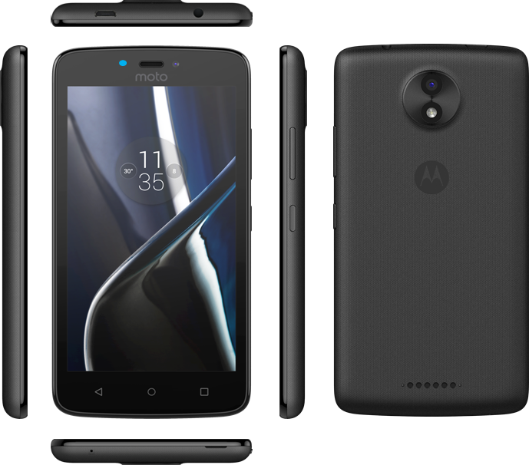
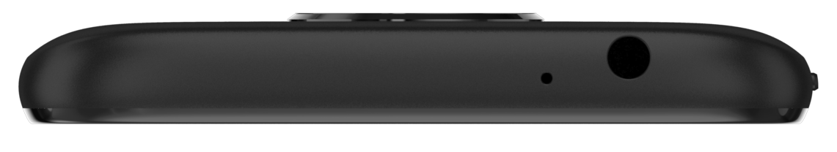
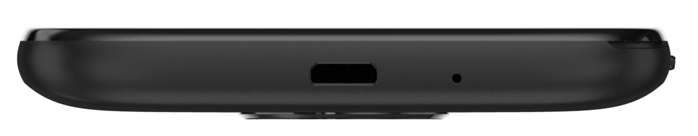
moto e⁵ play Product Marketing Brief
DESIGN PROGRESSION
2017
2018
1. | Dimensions/ Screen Size change
2. | Speaker amount reduce
3. | Motorola branding change
4. | Touch key remove
5. | Micro-USB slot position change
6. | Batwing logo built-in fingerprint reader add
7 | Speaker position change
145.5x73.6x9mm
1
147.88x 71.2 x 9.19mm
2
6
7
3
4
5
moto c
moto e⁵ play
Moto Design Identity

Slide 19
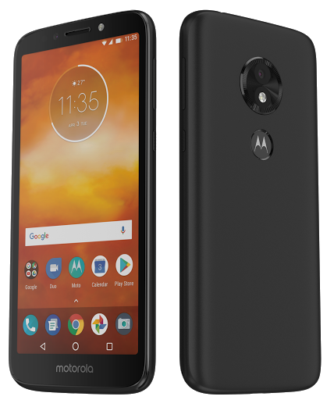
moto e⁵ play Product Marketing Brief
Plastic Back
FPS
Volume and power key
HSJ
DESIGN SHOWROOM
Front camera and Front Selfie Flash
Removable Back Cover
Motorola Family Design

Slide 20
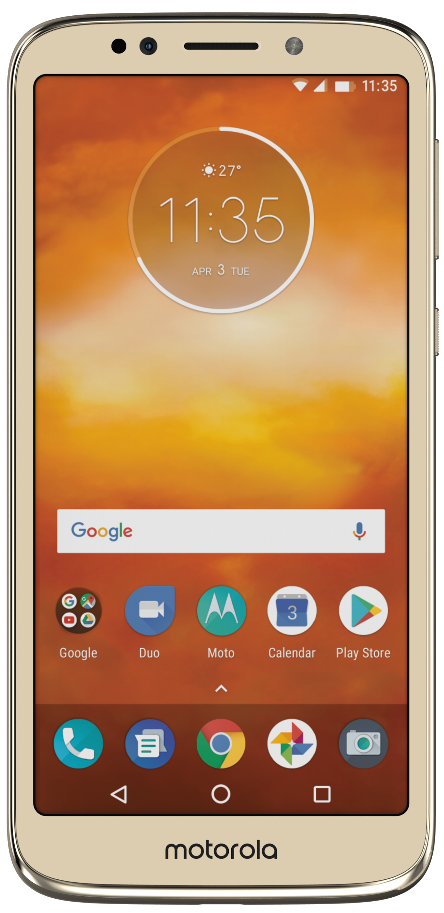
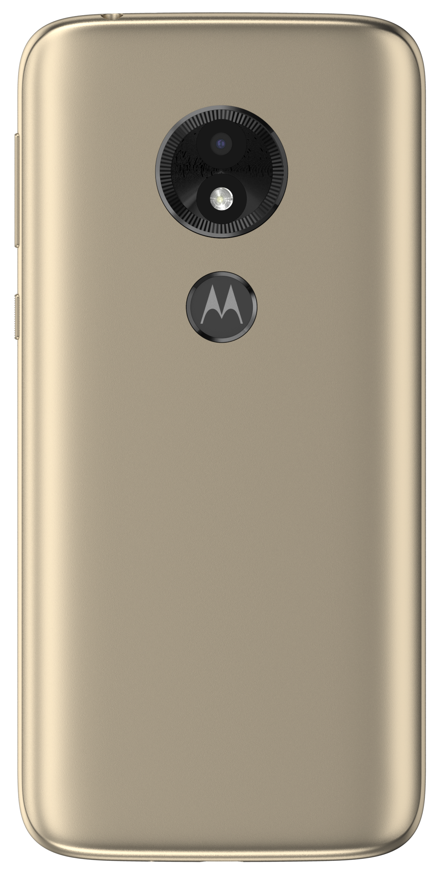
moto e⁵ play Product Marketing Brief
COLOR OPTIONS
Black
Gold

Slide 21
moto e⁵ play Product Marketing Brief
DETAILED SPECS
NOTES
Full legal disclaimer please refer to last slide
1
Important notice
Please always refer to globe data for latest and most accurate info.
EMEA
Networks | 4G LTE (Cat4), UMTS / HSPA+, GSM / EDGE
Bands (by model) | 4G: FDD LTE band 1/3/5/7/8/20 TDD LTE band 38/40/41 3G: WCDMA band 1/2/5/8 2G: GSM band 2/3/5/8
LatAm
Networks | 4G LTE (Cat4), UMTS / HSPA+, GSM / EDGE
Bands (by model) | 4G: FDD LTE band 1/2/3/4/5/7/17(Brazil)/28 3G: WCDMA(Latam) band 1/2/4/5/8 WCDMA(Brazil) band 1/2/5/8 2G: GSM band 2/3/5/8

Slide 22
moto e⁵ play Product Marketing Brief
MODEL COMPARISON (based on Mar./5 Global Data)
Important notice
Please always refer to globe data for latest and most accurate info.
GEO | RF SKU | SIMs | Memory | Rear CAM | Front CAM | NFC | Slots | SW EX | Model Name for ref.
EMEA + EM (MY/Russia/UAE) | SKU#6 EMEA | Dual | 1GB+16GB | 8MP AF | 5MP FF | No | 3（2*Nano SIMs+microSD） | Android Go | XT1920-16
WE | SKU#6 EMEA | Dual | 1GB+16GB | 8MP AF | 5MP FF | No | 3（2*Nano SIMs+microSD） | Android Go | XT1920-16
WE | SKU#6 EMEA | Single | 1GB+16GB | 8MP AF | 5MP FF | Yes | 2（1*Nano SIMs+microSD） | Android Go | XT1920-15
LatAm | SKU#2 LatAm | Single | 1GB+16GB | 8MP AF | 5MP FF | No | 2（1*Nano SIMs+microSD） | Android Go | XT1920-18
LatAm | SKU#2 LatAm | Dual | 1GB+16GB | 8MP AF | 5MP FF | No | 3（2*Nano SIMs+microSD） | Android Go | XT1920-19

Slide 23
moto e⁵ play Product Marketing Brief
Comparison between moto e⁵ plus, moto e⁵ and moto e⁵ play
Specification | moto e⁵ play (NA) | moto e⁵ play (ROW) | moto e⁵ (ROW) | moto e⁵ plus (ROW)
Operating system | AndroidTM 8.0, Oreo | AndroidTM GO | AndroidTM 8.0, Oreo | AndroidTM 8.0, Oreo
Processor | Qualcomm® SnapdragonTM 425/427 | Qualcomm® SnapdragonTM 425 | Qualcomm® SnapdragonTM 425 | Qualcomm® SnapdragonTM 425/430
Memory (RAM) | 2GB | 1GB | 2GB | 2GB / 3GB
Storage (ROM) | 16GB | 16GB | 16GB | 16GB / 32GB
Dimensions and weight | 151 x 74 x 8.85 mm | 147.88 x 71.2 x 9.19 mm | 154.4 x 72.2 x 8.95 mm | 161.9 x 75.3 x 9.35 mm
Display | 5.2” HD (16:9) | 5.3” FWVGA+ (18:9) | 5.7” HD+ (18:9) | 6” HD+ (18:9)
Battery | 2800 mAh | 2100 mAh | 4000 mAh | 5000 mAh
Water protection | P2i | No | No | No
Rear camera | 8 MP | 8 MP | 13 MP (1.12um) with PDAF | 12 MP (1.25um) with Laser Autofocus/PDAF
Front camera | 5 MP | 5 MP | 5 MP | 8 MP
Bluetooth® | 4.2 |  | 4.2 | 4.2
ChopChop/Twist | No | No | No | No
Design | Plastic | Plastic | Plastic | Polymer back + Reflective design
Price (estimation) | 99 EUR | 99 EUR | 139 EUR | 159 EUR

Slide 24
moto e⁵ play Product Marketing Brief
moto new branding & products
WHAT product design, naming, positioning, summary, KSPs, specs & software
WHAT wallpaper, packaging, clings & accessories
WHY KSP research
WHO competitive landscape & target audience
WHEN SA timeline, regional SKUs & project tracker
HOW demo script

Slide 25
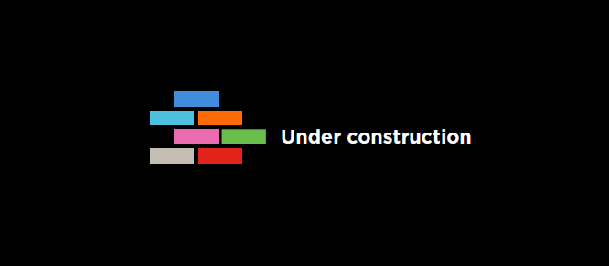
moto e⁵ play Product Marketing Brief
Package Copy
PACKAGING
Cling Copy
Packaging Overview
Packaging Artwork

Slide 26
moto e⁵ play Product Marketing Brief
WALLPAPER, HOME-SCREEN AND CLINGS
Wallpaper & Home-screen
Clings (EMEA)
Mock-screen
For dummy units

Slide 27
moto e⁵ play Product Marketing Brief
ACCESSORIES
Earphone¹
In-box
Charger
In-box
(Plug-type varies by region)
USB Cable
In-box

Slide 28
moto e⁵ play Product Marketing Brief
moto new branding & products
WHAT product design, naming, positioning, summary, KSPs, specs & software
WHAT wallpaper, packaging, clings & accessories
WHY KSP research
WHO competitive landscape & target audience
WHEN & WHERE SA timeline, regional SKUs & project tracker
HOW demo script

Slide 29



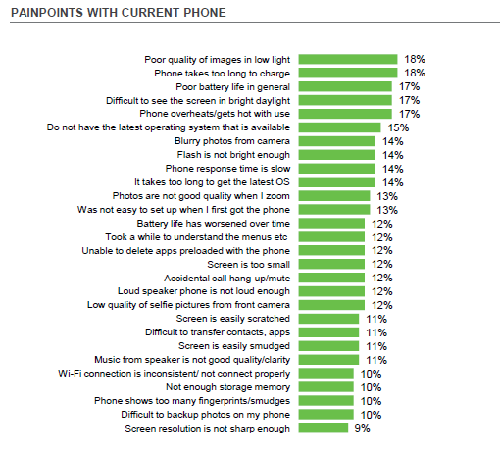
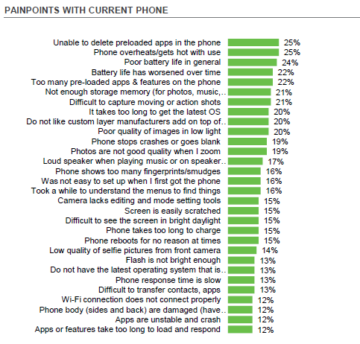
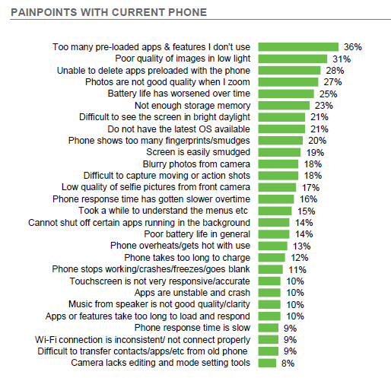
moto e⁵ play Product Marketing Brief
KSP RESEARCH
Painpoints that are addressed by moto e⁵ play

Slide 30
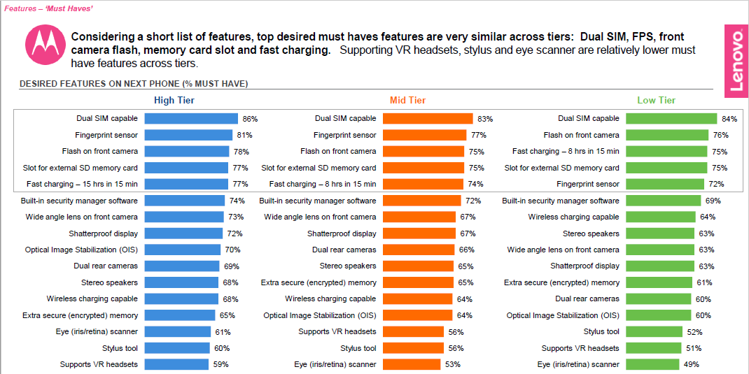
moto e⁵ play Product Marketing Brief
KSP RESEARCH INDIA
moto e⁵ play has multiple desirable features wanted by low tier smartphone consumers
Dual SIM capable
Front Selfie Flash
Expandable storage
Fingerprint reader
SOURCE: 2017 PUF Study India

Slide 31
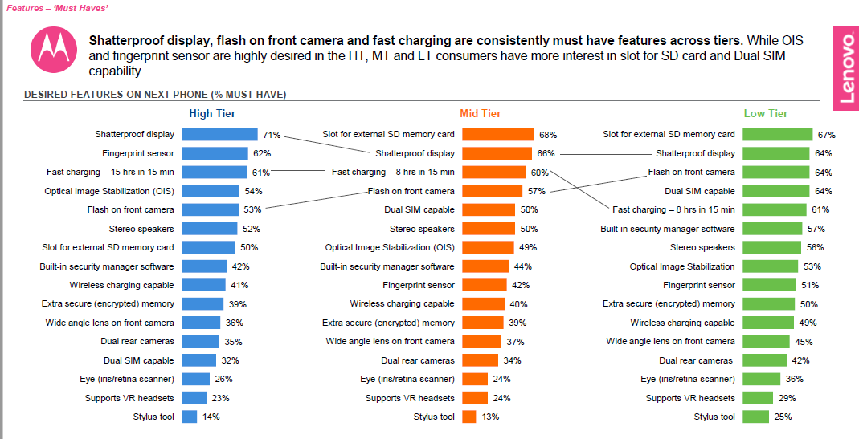
moto e⁵ play Product Marketing Brief
KSP RESEARCH BRAZIL
moto e⁵ play has multiple desirable features wanted by low tier smartphone consumers
External storage
Front Selfie Flash
Dual SIM capable
Fingerprint reader
SOURCE: 2017 PUF Study Brazil

Slide 32
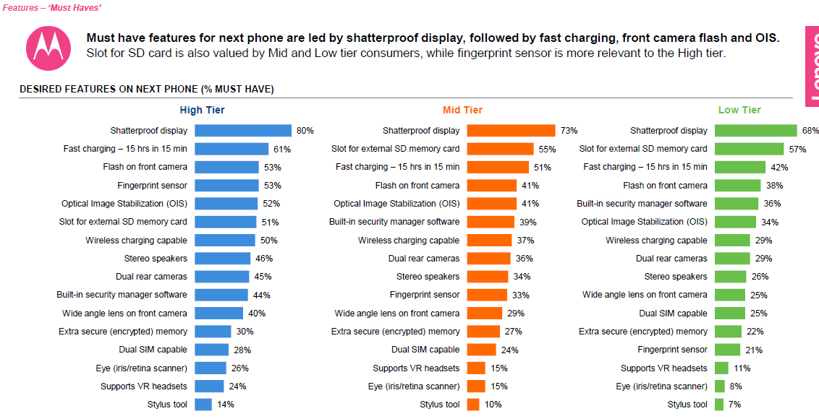
moto e⁵ play Product Marketing Brief
KSP RESEARCH GERMANY
moto e⁵ play has multiple desirable features wanted by low tier smartphone consumers
External storage
Front Selfie Flash
Dual SIM capable
Fingerprint reader
SOURCE: 2017 PUF Study Germany

Slide 33
moto e⁵ play Product Marketing Brief
moto new branding & products
WHAT product design, naming, positioning, summary, KSPs, specs & software
WHAT wallpaper, packaging, clings & accessories
WHY KSP research
WHO competitive landscape & target audience
WHEN & WHERE SA timeline, regional SKUs & project tracker
HOW demo script

Slide 34
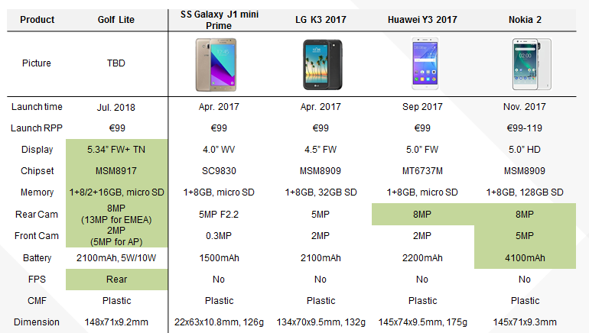
moto e⁵ play Product Marketing Brief
COMPETITIVE LANDSCAPE
The new moto e⁵ play outcompetes most models in the market in various aspects.

Slide 35
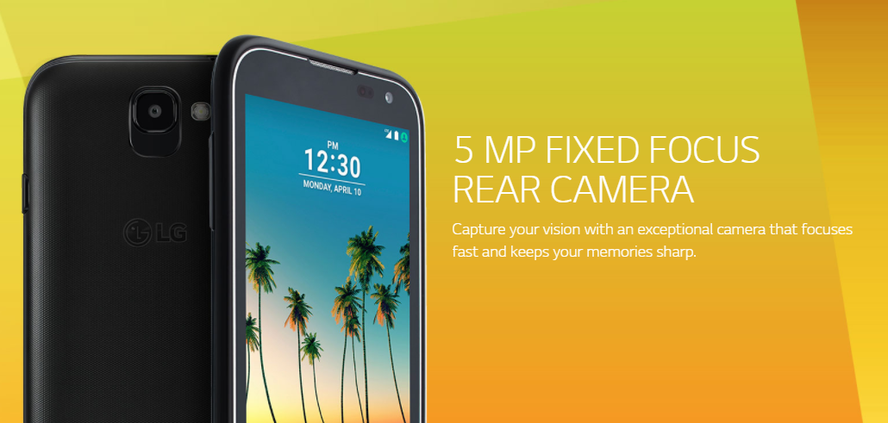
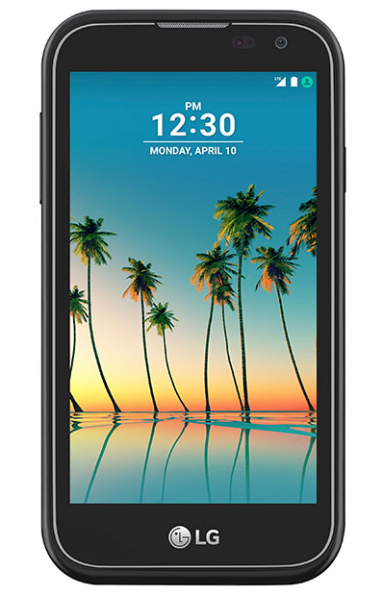
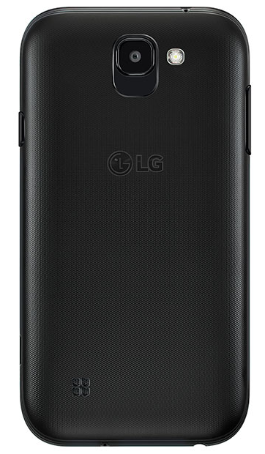
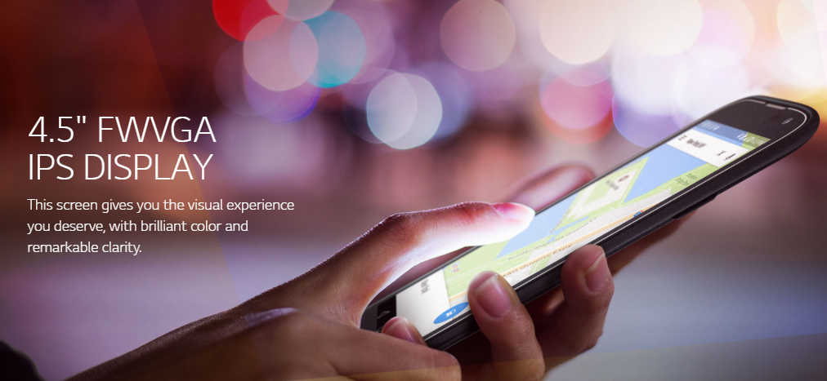
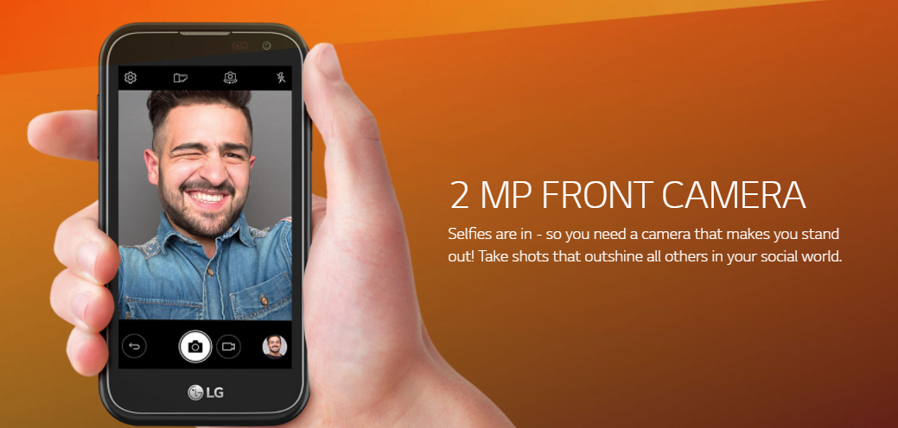

moto e⁵ play Product Marketing Brief
COMPETITOR MESSAGING
LG K3 2017
5MP FF Rear Camera
4.5” FWVGA IPS Display
2MP Front Camera
1.1GHz Quad-core Processor

Slide 36
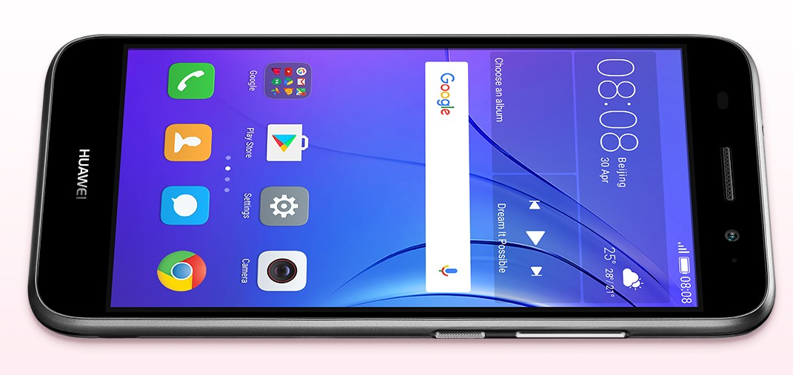
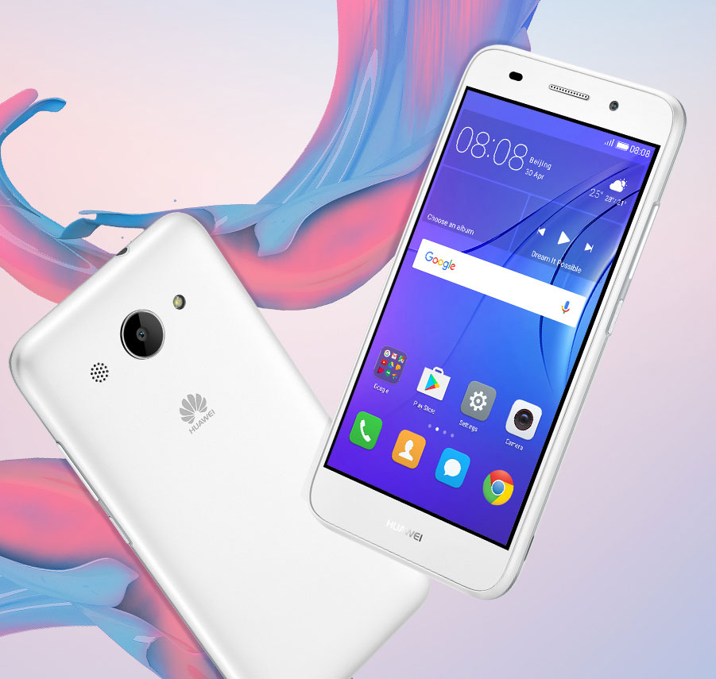
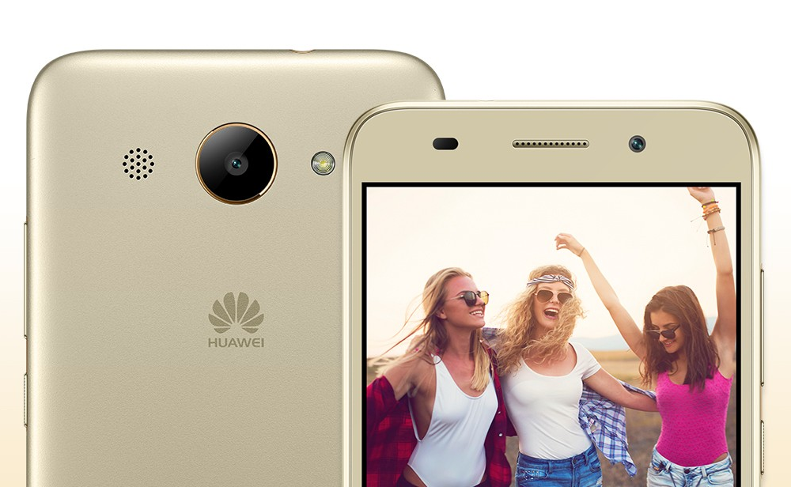

moto e⁵ play Product Marketing Brief
COMPETITOR MESSAGING
Enjoy The New 5-inch Display
Equipped with a large 5-inch screen, you can enjoy your favourite videos and games for a more delightful experience on the HUAWEI Y3 2017. The smoothly curved body - available in a variety of vibrant colours - lets you express your individuality to the world.
Huawei Y3 2017
Capture Every Beautiful Moment
An 8 MP F2.0 aperture camera on the HUAWEI Y3 2017 includes autofocus, which helps you capture better photos with clear and sharp details. Also standard are a number of useful camera modes, including beauty, time-lapse, and panorama. So no matter what you want to capture, you have the tools to do it.
5” Display
8MP AF Camera
Loud Speaker
Software Experience
Listen with Clarity
The HUAWEI Y3 2017 carries a loud speaker that makes sure you don't miss any phone calls even when you’re in noisy environments, and gives you a pleasant audio experience when you’re listening to your favourite song or watching your favourite video.

Slide 37
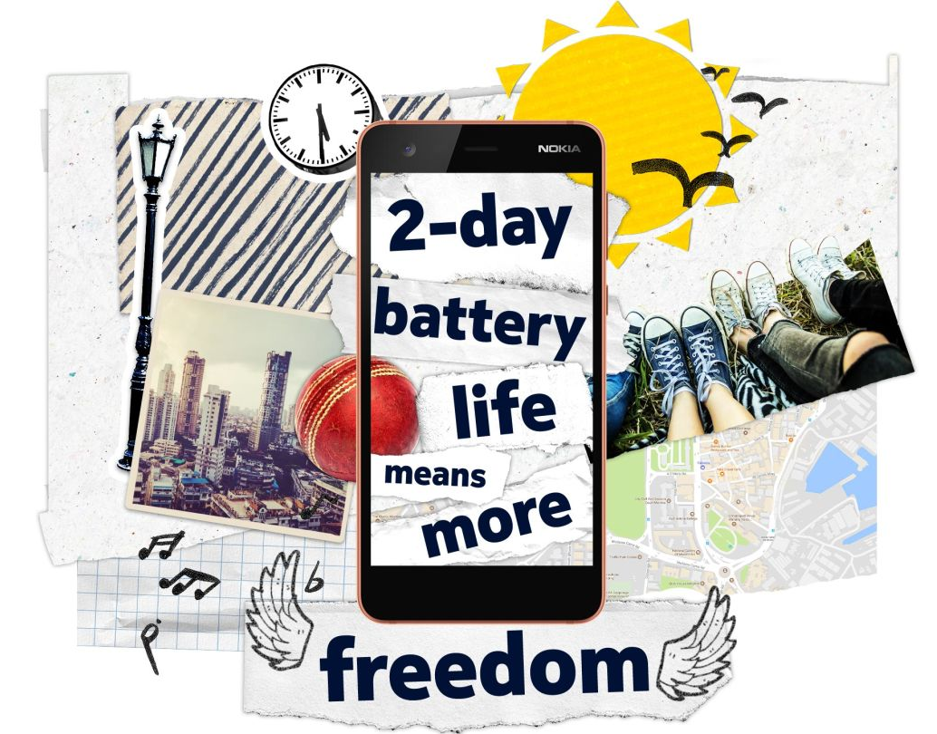
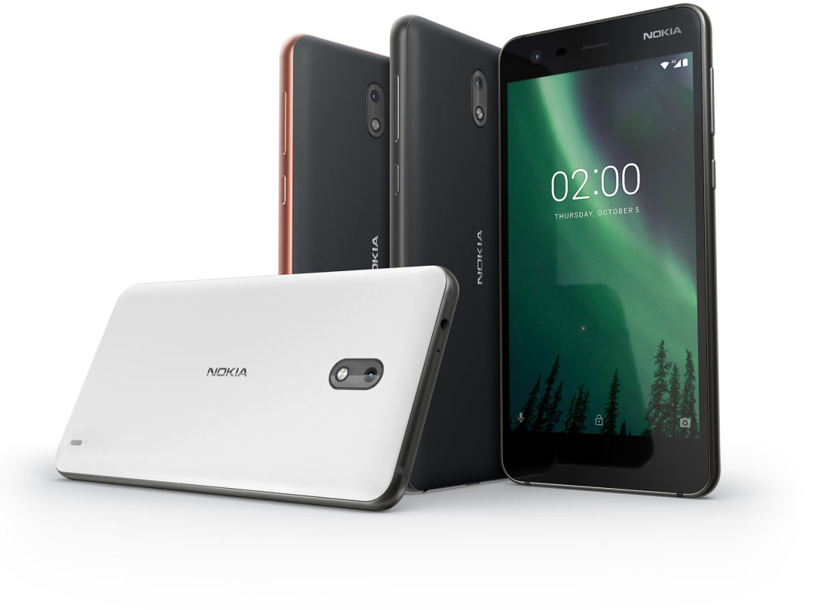
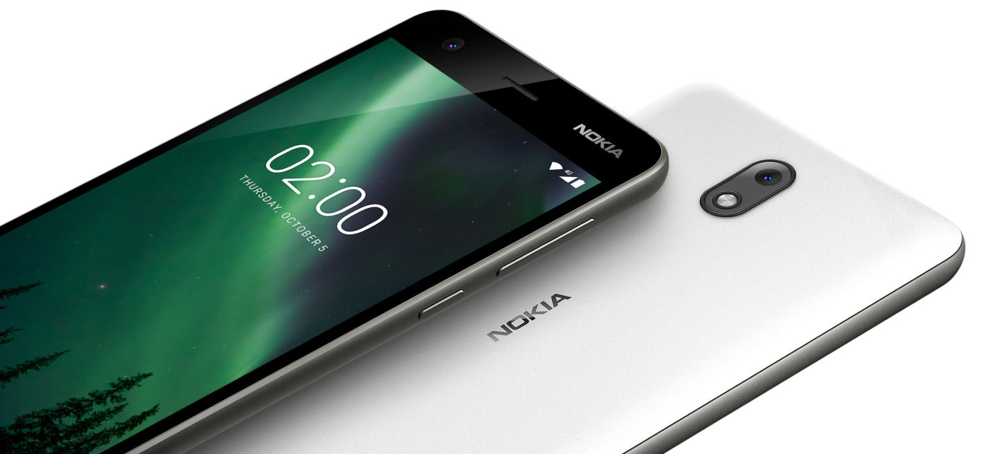
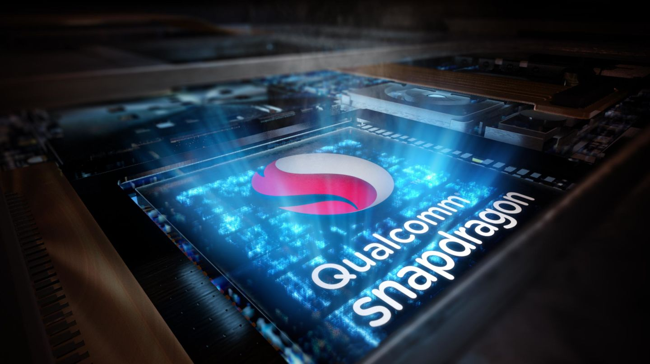
moto e⁵ play Product Marketing Brief
COMPETITOR MESSAGING
Nokia 2
Power for days
The Nokia 2 gives you a 2-day battery life1 from a single charge with its powerful 4100 mAh battery3. Frequent top-up charges will become a thing of the past.
Improved image quality, for longer
Bright and responsive, the 5" LTPS LCD screen offers impressive contrast and clarity wherever you go. And it’s energy efficient – whether you're browsing the web or watching videos, you won't need to worry about draining the battery in an instant.
Perfectly balanced performance
The Nokia 2 is built with one of the most trusted chipsets available. Power-efficient and dependable, the Qualcomm® Snapdragon™ 212 Quad-core processor delivers a fluid user experience without compromising your battery life.
2-day Battery Life
Quad-core Snapdragon CPU
5” LCD
Durable Design
Pure Android Nougat
8MP Rear / 5MP Front Camera

Slide 38
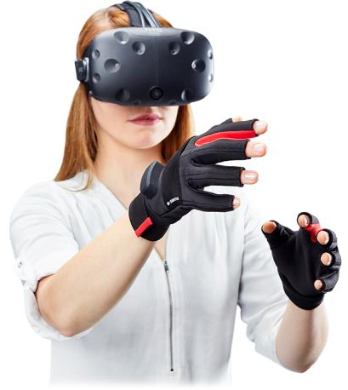

moto e⁵ play Product Marketing Brief
TARGET AUDIENCE
TECH
CENTRICS
  “I love CE products, doing research on CE products is definitely one of my favorite hobbies. I research before buying and learn everything possible about my products once I buy them.
  Because I am so knowledgeable on CE products, people always ask for my opinion and advise.
  I compare prices, but probably won’t buy the cheapest brand.
  I don’t buy CE devices to show off or get noticed by others.”
Primary
Target
  DEAL
  SEEKER
Secondary
Target
I am looking to buy the cheapest products available, I will wait for prices to fall and buy only on promotions
I won’t pay for any unessential features or design
I’m not a big fan of consumer electronics, I find them intimidating and am overwhelmed by all the choices available. I don't like to do research and learn about CE products
20%
14%
11%
9%
Share of survey population
…
Share of value
…
SOURCE: December 2013 Global Segmentation N=23,726 in 8 countries.

Slide 39
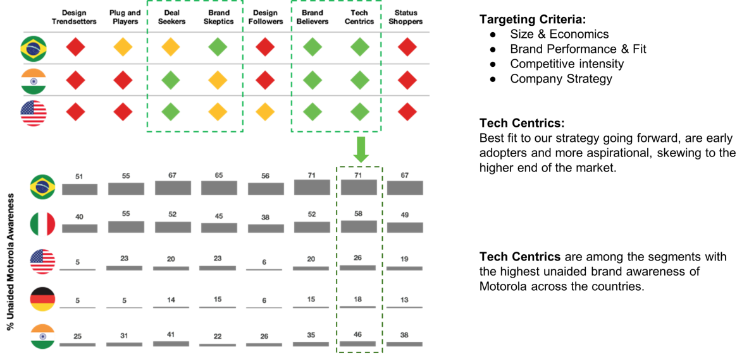
moto e⁵ play Product Marketing Brief
RATIONALE FOR CHOOSING THE TECH CENTRIC TARGET

Slide 40
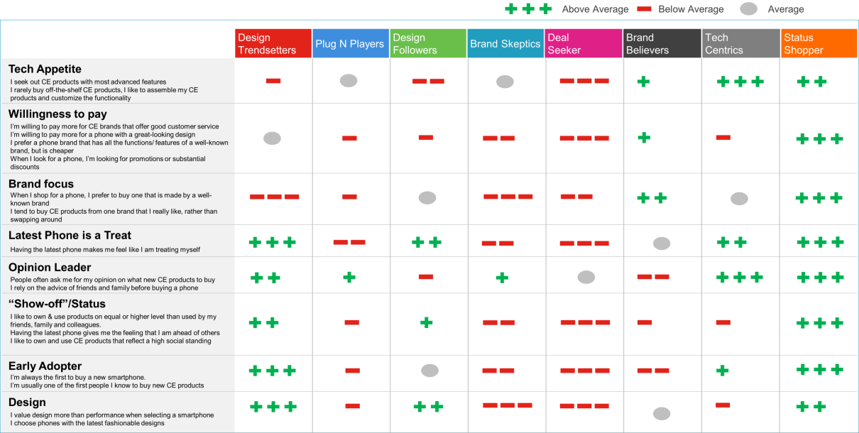
moto e⁵ play Product Marketing Brief
SEGMENT COMPARISON
SOURCE: Derived from the Lenovo Segmentation.

Slide 41
moto e⁵ play Product Marketing Brief
moto new branding & products
WHAT product design, naming, positioning, summary, KSPs, specs & software
WHAT wallpaper, packaging, clings & accessories
WHY KSP research
WHO competitive landscape & target audience
WHEN & WHERE SA timeline, regional SKUs & project tracker
HOW demo script

Slide 42
moto e⁵ play Product Marketing Brief
SCHEDULE
Important notice
Please always refer to Global Data for latest and most accurate schedule
GEO | Earliest OK2SHIP Date | Earliest SA Date
APAC - India | Jul/25 | Jul/25
APAC - Indonesia | Aug/15 | Aug/15
EM - Asia | Jul/13 | Jul/13
EM - MEA | Jul/13 | Jul/23
New WE | July/13 | Jul/13
LATAM - Brazil | Jul/16 | Jul/16
LATAM - RoLA | Jul/13 | Jul/14

Slide 43
moto e⁵ play Product Marketing Brief
PROJECT TRACKER
Marketing core-team meeting doc to track latest updates!
Product | Global Program Manager | Product Marketing Lead | DPL/Product Mgr. | Supply Chain NPI PM | China Packaging Lead | CXD Designer | CXD UIUX PM (Wallpaper) | UG/GSG Lead for English version | UG/QSG/legal Guide localiazation | Training | Brand Management | Moto Web | Mock units
Golf Lite | Binb Jiang <jiangbinb@lenovo.com> | Meng1 Hao <haomeng1@lenovo.com> | Yanzhao Zhang <zhang10y@motorola.com> | Huoyan HY1 Hong <honghy1@lenovo.com> | Tim BZ1 Ke <kebz2@lenovo.com> | Jun1 Wu <wujun1@lenovo.com> | Susan J Wu | Elinor Gao <gaoyy5@lenovo.com> | Guilherme Saba | Delphine Girard Kerrison | Amrita Sebastian | Jayme C. | Bob Lindgren

Slide 44
moto e⁵ play Product Marketing Brief
moto new branding & products
WHAT product design, naming, positioning, summary, KSPs, specs & software
WHAT wallpaper, packaging, clings & accessories
WHY KSP research
WHO competitive landscape & target audience
WHEN & WHERE SA timeline, regional SKUs & project tracker
HOW demo script & spec card

Slide 45
moto e⁵ play Product Marketing Brief
DEMO SCRIPT
Demo Pointers
Basic Checklist
The unit is not physically damaged
The OS is functioning smoothly
Battery is fully charged
‘Must Have’ Content/Accessory Checklist
Wallpaper
Image gallery
ePOS
Optional Content
Videos if any
Features | Say | Show
Display | This 5.3” Max Vision 18:9 display first time comes to a phone at this price point. You can enjoy broader view when gaming or browsing. You would not want to go back to the regular display once you have used it. | Show the screen Run Games Play Youtube videos Compare it with a 16:9 display phone
Fingerprint Reader | The iconic motorola logo on the back now incorporates a fingerprint reader to unlock your phone instantly and protect your data. It’s also a rare feature to be found on phones at this price. | Show the Fingerprint Reader Setup and unlock the phone
Battery | A built-in 2100mAh battery can support you almost a full day’s usage. *TBD | Take off rear cover *TBD
Camera | Both front camera and rear camera comes with a flash light to take brighter photos or selfies under low light. | Take some photos Take selfies with front flash on/tourch
System | With an up-to-date Android Go system, your phone has the latest security updates as well as smooth smartphone experience. | Show split screen/Picture in Picture Show security updates in System Settings
Download & Storage Guidance
Step 1
Download relevant assets(when ready)and store it in a clearly marked folder in your computer
Step 2
Connect the demo unit to your computer via USB cable
Step 3
Drag the folder from your computer and drop it in your phone and store folder on the desktop

Slide 46

moto e⁵ play Product Marketing Brief
SPEC CARD
147.88 x 71.2 x 9.19mm (LxWxT)
5.3” FWVGA+ (960x480) LCD
Qualcomm® SnapdragonTM 425 1.4GHz Quad-core processor*
Android™ Go operating system*
8 rear camera with LED flash, 5MP front camera with selfie flashlight*
1 memory; 16GB built-in storage*; expandable by up to 128GB microSD card
2100mAh removable battery with 5W charger*
*Specification varies by region/model.

Slide 47
moto e⁵ play Product Marketing Brief
MARKETING LEGAL DISCLAIMERS
[General]
Certain features, functionality and product specifications may be network dependent and subject to additional terms, conditions, and charges. All are subject to change without notice. MOTOROLA and the Stylized M Logo are registered trademarks of Motorola Trademark Holdings, LLC. All other trademarks are the property of their respective owners. ©2018 Motorola Mobility LLC. All rights reserved. moto e⁵ play is designed and manufactured for Motorola Mobility, a wholly owned subsidiary of Lenovo.
[Battery life]
All battery life claims are approximate and based on a standard mixed use profile. The mixed use profile is based on Motorola devices on major 4G LTE networks with excellent coverage and includes both usage and standby time. Out-of-box settings are applied to the mixed use profile to project battery performance. Actual battery performance will vary and depends on many factors including signal strength, network configuration, age of battery, operating temperature, features selected, device settings, and voice, data, and other application usage patterns.
[Memory]
Actual usable RAM memory may be less due to system configuration.
[Storage]
Available user storage is less due to preloaded software, and is subject to change due to software updates.
[MicroSD Card]
Supports up to 128GB microSD card, microSD cards sold separately. Content with DRM restrictions may not be able to be moved to the card.
[Moto Key]
Requires Bluetooth® 2.1 support on your computer with at least Windows 7 or later versions of the Windows operating system.

