Slide 1
Bounce Product Overview
Version: 2.0

Slide 2
Special Notes
Info in these PowerPoint slides is as of 6/17. If there are any changes in the program (e.g. specs, launches), Change Request (CR) will be issued and the product team will review to approve/reject.

Slide 3
Product Family and Market Names
- Bounce is an internal name in Motorola
- For VZW, “Droid” product family … successor of Droid Turbo (Internal Name: Quantum) that was launched in Oct 2014
- For LATAM, successor of Moto MAXX (Internal Name: Quantum) launched in Nov 2014
- For Asia, successor of Moto Turbo (Internal Name: Quantum) launched in Mar 2014
- 2 Variants
  - VZW
    - Market Name: TBD
  - ROW
    - Market Name: TBD

Slide 4
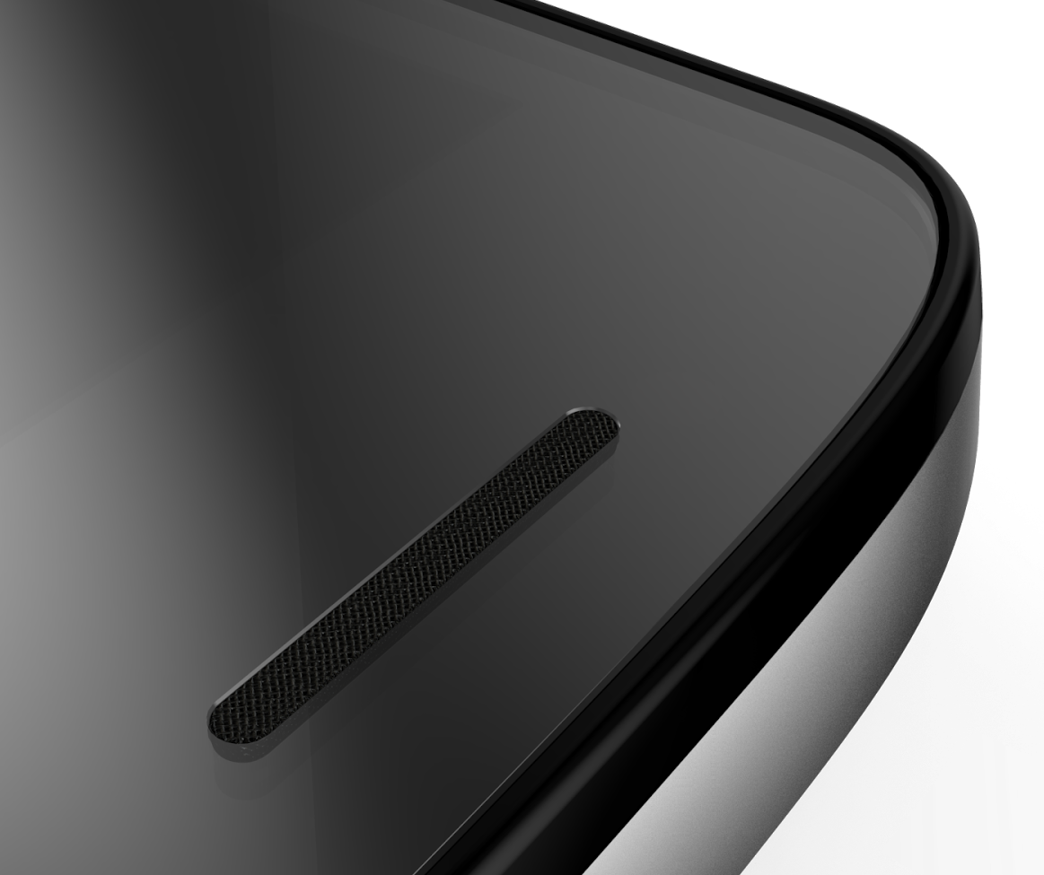
ShattershieldTM
Shatterproof Display System:
Flexible plastic OLED display to help absorb impact
Acrylic substrate similar to the shatterproof material that borders hockey rinks
Consumer replaceable Armor layer with diamond-like nano-coating to resist scratches
The world’s first guaranteed shatterproof display

Slide 5
Launching Regions/Countries
Timeframe – Q3 2015
  North America
    - U.S.
  Latin America
    - Brazil, Chile, Colombia, Mexico
  Europe
    - France, Germany, Italy, Spain, U.K.
  MEA
    - Saudi Arabia, UAE
  Asia
    - Australia, India
    - CR in progress to add: Hong Kong, Indonesia, Japan, Singapore, Thailand

Slide 6
Variants
Region/Model Numbers | VZW | ROW
 | XT1585 | XT1580
North America | ✔
Latin America |  | ✔
Europe |  | ✔
MEA |  | ✔
Asia |  | ✔

Slide 7
Specifications (Bounce vs. Quantum – Differences)
 | Bounce | Quantum
Processor | 2.0GHz Octa-Core MSM8994 | 2.7GHz Quad-Core APQ 8084AB
RF Bands | VZW Variant LTE B2/3/4/5/7/13/20 CDMA 800/1900 UMTS 850/900/1900/2100 ROW Variant LTE B1/2/3/4/5/7/8/12/13/17/20/25/28/29 TD-LTE B40 UMTS 850/900/1700/1900/2100 VZW & ROW Variants GSM 850/900/1800/1900 | VZW Variant LTE 2/3/4/7/13 CDMA 800/1900 UMTS 850/900/1900/2100 ROW Variant LTE B2/3/4/5/7/17 UMTS 850/1700/1900/2100 VZW & ROW Variants GSM 850/900/1800/1900
Battery | 3760mAh | 3900mAh
Display | 5.43” POLED qHD 1440x2560 | 4.3” AMOLED qHD 1440x2560
Dimensions | 78.0mm (x) 149.4mm (y) 7.5mm (z) | 73.3mm (x) 143.5mm (y) 7.8 MGF or 8.3 BN mm (z)
Weight | 160.00g | 169.00g MGF or 176.00g BN
Notes:
MGF = Metalized Glass Fiber with Kevlar
BN = Ballistic Nylon with Kevlar

Slide 8
Specifications (Bounce vs. Quantum – Differences (cont’d))
 | Bounce | Quantum
BT | 4.1 | 4.0
Camera (Front) | 5MP Wide Angle | 2MP
Camera (Front Flash) | 1 | N/A
Camera (Rear Flash) | 2 | 1
Inductive Charging | No | Yes
Launching SW | Android Lollipop | Android KitKat
Microphones | 5 | 4
SD Card Support | Yes | No
Turbo Charging | 25W 15 mins of charging upto 13 hrs battery life | 15W 15 mins of charging upto 8 hrs battery life
WiFi | 802.11 a/b/c/g/n/ac/MIMO | 802.11 a/b/g/n/ac

Slide 9
Specifications (Bounce vs. Quantum – Common)
 | Bounce | Quantum
3.5mm HS | Yes
Battery Type | Embedded
Camera (Rear) | 21MP
Loudspeaker | Yes, Front Porting
RAM | 3GB
ROM | 32/64GB
Removable Back Cover | No
SIM | Nano SIM
USB Type | USB 2.0

Slide 10
Specifications (Bounce vs. Quantum – Common (cont’d)
 | Bounce | Quantum
Accelerometer | Yes
Ambient Light Sensor | Yes
Gyroscope | Yes
Hall Effect Sensor | Yes
HDMI | No
IR | Yes
Magnetometer (e-Compass) | Yes
NFC | Yes
Proximity Sensor | Yes
Sensor Hub | Yes
Audio | AAC, AAC+, AAC+ Enhanced, AMR NB, AMR WB, MIDI, MP3, RA (v9, v10), WAV, WMA (v9, v10), XMF
Video | Capture/Playback/Streaming, HD Video, Video Streaming, DivX, H.263, H.264, MPEG4, RV v9, WMV (v9, v10)

Slide 11
Specifications (Bounce vs. Lynx – Differences)
 | Bounce | Lynx
Processor | 2.0GHz Octa-Core MSM8994 | 1.7GHz Quad-Core MSM8939
RF Bands | VZW Variant LTE B2/3/4/5/7/13/20 CDMA 800/1900 UMTS 850/900/1900/2100 ROW Variant LTE B1/2/3/4/5/7/8/12/13/17/20/25/28/29 TD-LTE B40 UMTS 850/900/1700/1900/2100 VZW & ROW Variants GSM 850/900/1800/1900 | Droid Variant LTE B2/3/4/5/7/13/20 CDMA 800/1900 UMTS 850/900/1800/1900 UMTS Variant LTE B1/2/3/4/5/7/8/11/12/17/19/20/25/28/38/40/41 TD-LTE B38/40/41 UMTS 850/900/1800/1900/2100 Droid & UMTS Variants GSM 850/900/1800/1900
Battery | 3760mAh | 3630mAh
Display | 5.43” POLED qHD 1440x2560 | 5.5” TFT LCD Full HD 1080x1920
Dimensions | 78.0mm (x) 149.4mm (y) 7.5mm (z) | 75.0mm (x) 148.0mm (y) 8.9-10.9mm (z)
Weight | 160.00g | 169.00g
Notes:
MGF = Metalized Glass Fiber with Kevlar
BN = Ballistic Nylon with Kevlar

Slide 12
Specifications (Bounce vs. Lynx – Differences (cont’d))
 | Bounce | Lynx
Camera (Front) | 5MP Wide Angle | 5MP
Camera (Front Flash) | 1 | N/A
RAM | 3GB | 2GB
Removable Back Cover | No | Yes
Turbo Charging | 25W 15 mins of charging upto 13 hrs battery life | 15W 15 mins of charging upto 8 hrs battery life
WiFi | 802.11 a/b/c/g/n/ac/MIMO | 802.11 a/b/g/n

Slide 13
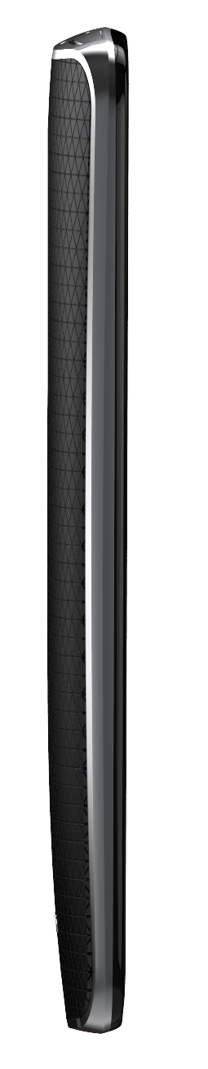
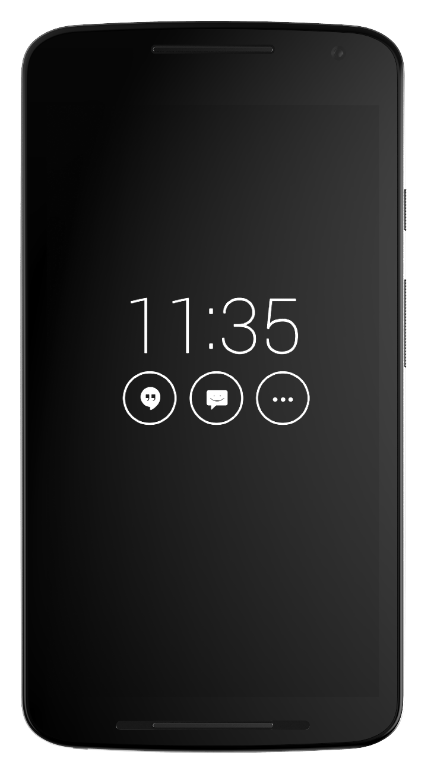
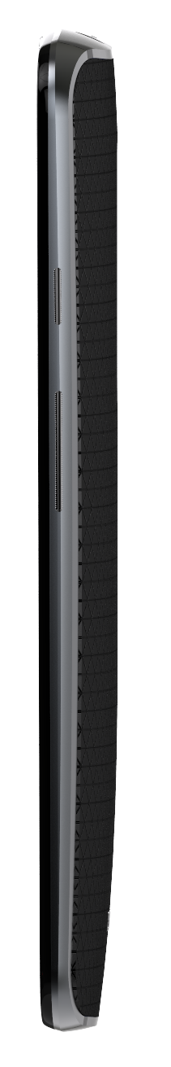
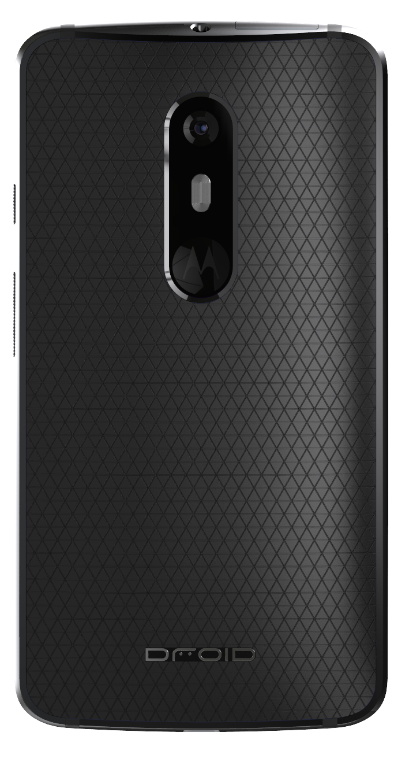
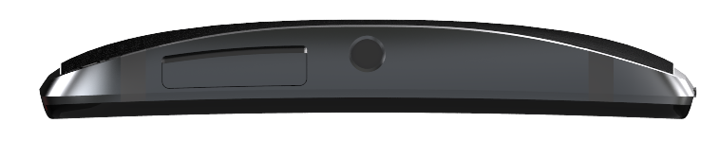
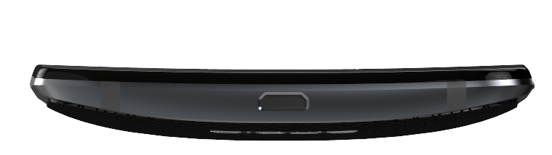
Device Overview
Power/Lock Key
Volume Keys
21MP Camera
Earpiece
Card Tray Door
3.5mm
Headset Jack
5MP
Camera
uUSB Connector

Slide 14
IMEI & Regulatory Info
Numeric & barcode of IMEI(s) and regulatory info are available ...
Will be updated when info is available
Regulatory Info
Numeric & Barcode of IMEI(s)

Slide 15
SIM Card(s) & microSD
SIM card(s) and microSD are inserted into device ...
Will be updated when info is available
SD Card Slot
SIM Slot

